Slide 1
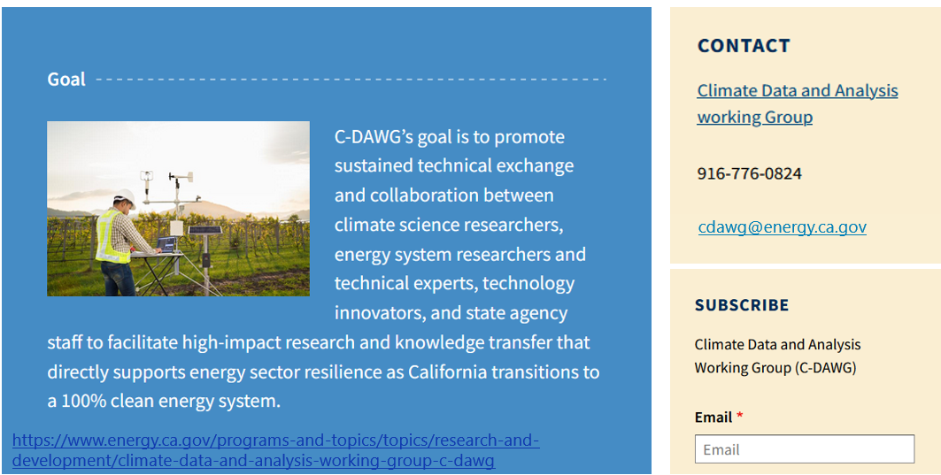
Thank you!
Notes:
https://www.energy.ca.gov/programs-and-topics/topics/research-and-development/climate-data-and-analysis-working-group-c-dawg

