Slide 1
EPIC 5: Opportunity to Shape Funding Plan
May 29: Climate Adaptation, Virtual, REGISTER
From April 10 - May 1, 2024, stakeholders participated in an initial set of technical working groups to shape how the state's ratepayer-funded EPIC program will spend approximately $1 billion between 2026 and 2030 on electricity-related RD&D. Output from the first technical working groups: draft strategic objectives (clear, measurable, and robust targets) for review by stakeholders. Climate Adaptation
Participants can provide comment during the meetings:
Proposed edits and clarifications
Critical missing elements
Key considerations
Methods for achieving a path to market
Ways to measure success
Please let us know by May 22 at picg@theaccelerategroup.com if you would like to provide a 5-7 minute presentation addressing some or all of these points.
Presentations will need to be submitted by May 24.

Slide 2
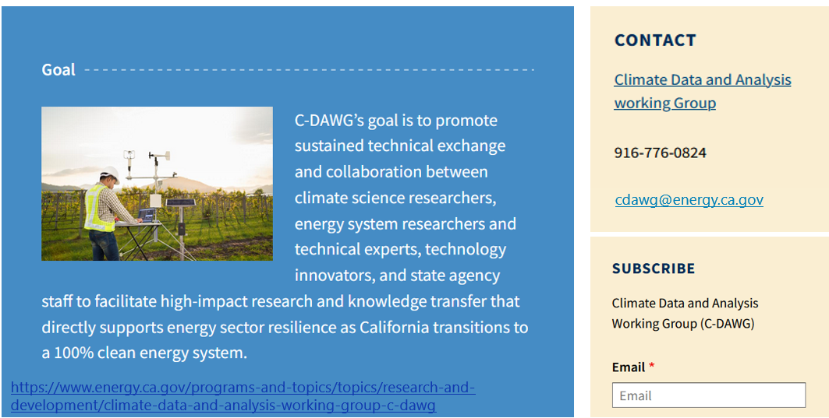
Thank you!
Notes:
https://www.energy.ca.gov/programs-and-topics/topics/research-and-development/climate-data-and-analysis-working-group-c-dawg

