Slide 1
Today’s Agenda

Slide 2
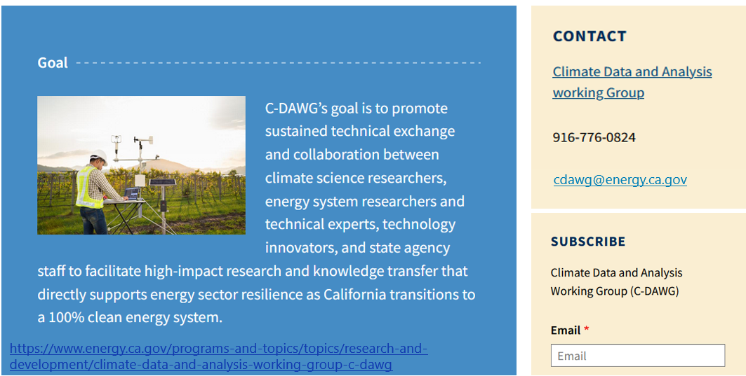
Thank you!

