Slide 1
RFP-24-301 Pre-Bidders Conference
Compliance, Monitoring, and Reporting Support for Federal Funding
California Energy Commission
Presenters: Reta Ortiz, Lana Makhnovskaya and Darren Lee
Date: July 30, 2024

Slide 2
Agenda
Time | Item
10:00 am | Welcome and Introduction Housekeeping Participation Survey
10:05 am | Solicitation Background Purpose of Solicitation Available Funding
10:15 am | Proposal Requirements and Organization
11:00 am | Submission and Evaluation
11:30 am | Q&As
12:00 pm | Adjourn

Slide 3
Housekeeping
This conference will be recorded.
Participants will be muted during the presentation. Please chat your question in the Q&A window.
This presentation and other solicitation updates including Q&As will be posted at the solicitation webpage, when they are available.

Slide 4
Commitment to Diversity
The Energy Commission adopted a resolution strengthening its commitment to diversity in our funding programs. The Energy Commission continues to encourage disadvantaged and underrepresented businesses and communities to engage in and benefit from our many programs.
To meet this commitment, Energy Commission staff conducts outreach efforts and activities to:
Engage with disadvantaged and underrepresented groups throughout the state.
Notify potential new bidders about the Energy Commission’s funding opportunities.
Assist bidders in understanding how to apply for funding from the Energy Commission’s programs.
Survey participants to measure progress in diversity outreach efforts.

Slide 5
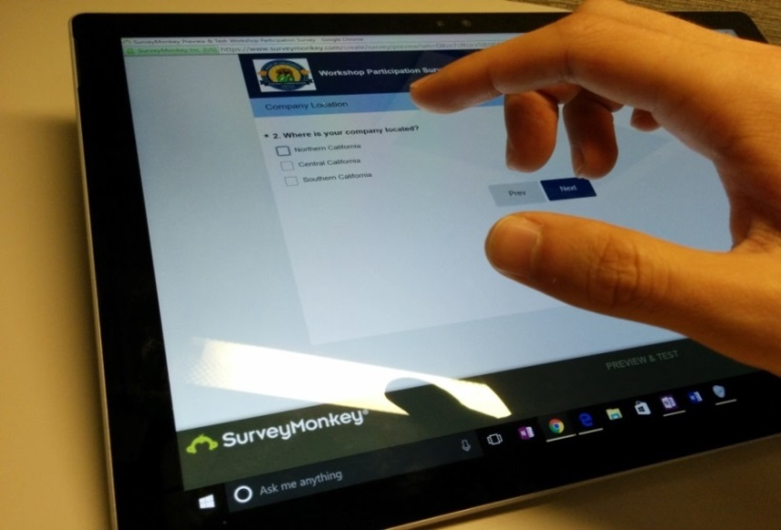
We Want to Hear From You!
Participation Survey
Survey responses will be summarized anonymously to track attendance of underrepresented groups in our workshops for public reporting purposes.
Online participants, please use this link: https://forms.office.com/g/AxDFqxsYgi
Thanks!

Slide 6
Solicitation Background
CEC is pursing and administering multiple clean energy funding opportunities made available through the Infrastructure Investment and Jobs Act (IIJA) and Inflation Reduction Act (IRA)
The IIJA directs federal funding to infrastructure programs and projects, designed to modernize and upgrade American infrastructure, create good-paying union jobs, tackle the climate crisis, and advance environmental justice.
The IRA directs federal funding to support the development of a new clean energy economy, designed to lower energy costs for families and small businesses, accelerate private investment in clean energy solutions, strengthen supply chains, and create good-paying jobs.

Slide 7
Purpose of Solicitation
The purpose of this solicitation is to fund an Agreement to obtain expertise and requested services with the administrative monitoring, reporting, and compliance requirements associated with federal funding received by the CEC. These services include but are not limited to:
Davis-Bacon Act or State Prevailing Wage Compliance Monitoring
Build America/Buy America Act
National Historic Preservation Act
National Environmental Policy Act
Equipment and property records
Small, minority, and women owned business compliance and outreach

Slide 8
Federal Programs
The CEC anticipates receiving approximately $1.105 billion in federal funding from the following federal opportunities:
• Grants for Charging and Fueling Infrastructure, including the National Electric Vehicle Infrastructure (NEVI) Formula Program
• Energy Efficiency Revolving Loan Fund Capitalization Grant Program
• Energy Efficiency and Conservation Block Grant Program
• Home Efficiency Rebates Program
• Home Electrification and Appliance Rebates Program
• Training for Residential Energy Contractors Grants
• Resilient and Efficient Codes Implementation Grant Program
• Preventing Outages and Enhancing the Resilience of the Electric Grid Formula Grants to States and Indian Tribes.
• State Energy Financing Institutions (SEFI) Supported Projects
• Solar for All Program

Slide 9
Available Funding
$20,000,000 is available for the Agreement (Contract) resulting from this RFP.
There is up to a total of $60,000,000 with up to a 12-year term with optional amendments.
This is an hourly rate plus cost reimbursement Agreement and the award will be made to the responsible Bidder receiving the highest points.
Match funds are not required or accepted for this RFP.
This RFP will award one Agreement.

Slide 10
Eligible Bidders
This is an open solicitation for private entities only.
Bidders must accept the terms and conditions included in the solicitation. (Attachment 8)
Bidders are encouraged to register with the California Secretary of State, as all contractors must be registered and in good standing to enter into an agreement with the Energy Commission: http://www.sos.ca.gov

Slide 11
Reference Materials for RFP
Bidders responding to this RFP may want to familiarize themselves with the following documents:
Infrastructure Investment and Jobs Act, Public Law 117-58 (November 15, 2021). https://www.congress.gov/bill/117th-congress/house-bill/3684.
Inflation Reduction Act, Public Law 117-169 (August 16, 2022) https://www.congress.gov/bill/117th-congress/house-bill/5376
Uniform Administrative Requirements, Cost Principles, and Audit Requirements for Federal Awards in 2 CFR Part 200
Audit requirements in 2 CFR Part 200, Subpart F.
Amendments to the Uniform Administrative Requirements, Cost Principles, and Audit Requirements for Federal Awards in 2 CFR Part 200 for the Department of Energy Awards in 2 CFR Part 910.
The Funding Opportunity Announcement and/or Administrative and Legal Requirements documents for each federal funding opportunity.
Many Department of Energy, Energy Efficiency and Renewable Energy Office funding opportunities are listed here: https://eere-exchange.energy.gov/.
Many Department of Energy Grid Deployment Office funding opportunities are listed here: https://www.energy.gov/gdo/funding-opportunities-and-requests-information
Many Department of Transportation funding opportunities are listed here: https://www.fhwa.dot.gov/bipartisan-infrastructure-law/ and https://www.fhwa.dot.gov/inflation-reduction-act/.
23 C.F.R., Chapter I, Subchapter 6, Part 680 – National Electric Vehicle Infrastructure Standards and Requirements. https://www.ecfr.gov/current/title-23/chapter-I/subchapter-G/part-680.
23 U.S.C. Chapter 1 - FEDERAL-AID HIGHWAYS Caltrans Local Assistance Procedures Manual. https://dot.ca.gov/programs/local-assistance/guidelines-and-procedures/local-assistance-procedures-manual-lapm.

Slide 12
Overview of Scope of Work Tasks
Task # | Administrative Task Name
1 | Agreement Management
Task # | Technical Task Name
2 | Federal Compliance Training Support
3 | Project Compliance Support
4 | Financial Management
5 | Evaluation of Subrecipients
6 | Federal Reporting
7 | Oversight Requirements
8 | Audit Support
9 | Modification of Performance Period and Closeout

Slide 13
Scope of Work Task 1- Agreement Management
Task 1: Agreement Management
The goals of this task are the management, oversight, and administrative duties to be performed by the Contractor for this Agreement
Agreement Management
Work Authorizations – project scope will vary for each work request

Slide 14
Scope of Work Technical Tasks- Work Authorizations
All Work on an as-needed basis
Signed Work Authorization is required prior to any work on technical tasks
Work expected in two phases
Setting up the federally funded programs
Assist in compliance, monitoring, reporting and auditing work
Access to Confidential and Personal Information
Requirements for handling Confidential Information and Personal Information included in Task 1.7; Exhibit D

Slide 15
Scope of Work Tasks 2 and 3
Task 2: Federal Compliance Training Support
Identification of administrative reporting compliance requirements for one or more federally funded programs
Development of materials and provision of training to Energy Commission staff, contractors, and subrecipients on federal reporting and compliance requirements
Task 3: Project Compliance Support
Identification of administrative reporting compliance requirements for federally funded programs
Incorporation of all applicable compliance responsibilities in the terms and conditions of sub-awards and ensuring subrecipients are responsible for providing all necessary information
Guidance on subrecipient tasks and deliverables in the project scope of work related to federal compliance responsibilities
Development of subaward monitoring and administration procedures
Submittal of reports to federal agencies and entering data as required, such as in the federal PAGE system
Assistance with ensuring projects move through the federal-aid highway processes as outlined in the Caltrans Local Assistance Procedures Manual

Slide 16
Scope of Work Tasks 4 and 5
Task 4: Financial Management
Federal award requirements for the CEC’s financial management system
Sufficient and effective internal controls
Federal payment procedures
Allowable costs determinations
Revisions to budgets and program plans
Appropriate use of program income
Standards for conflict of interest
Task 5: Evaluation of Subrecipients
Evaluation of subrecipient qualifications with applicable federal requirements
Assessment of the performance risk of sub-awardees
Modification of subawards based on risk evaluation
Debarment and Suspension checks
Technical assistance to subrecipients

Slide 17
Scope of Work Tasks 6 and 7
Task 6: Federal Reporting
Reporting on program performance
Reporting significant developments
Reporting on federal interest in real property
Closeout Reporting
Other reporting requirements under uniform or specific federal awards.
Task 7: Oversight Requirements
Monitoring subrecipients for compliance of federal requirements
Support CEC staff to perform and report on onsite reviews
Providing training to the CEC on compliance monitoring
Monitoring subrecipients to ensure compliance with the Caltrans Local Assistance Procedures Manual as applicable
Monitoring compliance areas that have the most complex requirements

Slide 18
Scope of Work Tasks 8 and 9
Task 8: Audit Support
Audit of Subrecipients:
Conduct audits of federal subrecipients
Attend compliance or audit meetings with state and/or federal agencies on project oversight and administration
Ensure audit services comply with 2 CFR Part 200, Subpart F, and 2 CFR Part 910, Subpart F.
Audit of Energy Commission:
Provide support and guidance to the Energy Commission during the audit process, including responses to questions and gathering information/data.
Task 9: Modification of Performance Period and Closeout
Modifying period of performance as needed
Developing and performing closeout procedures
Submitting all required project documentation
Ensuring prompt payment

Slide 19
Disable Veteran Business Enterprise (DVBE) Form (Attachment 3)
This RFP is subject to a mandatory certified DVBE participation of at least three percent (3%).
This requirement can be satisfied by the Bidder or certified DVBE subcontractor.
Preference points are awarded for DVBE participation above 3%, with the maximum preference points awarded at 7%.
See Section V. Business Participation Programs for more information

Slide 20
Bidder Declaration Form GSPD-05-105 (Attachment 4)
Bidders will complete Bidder Declaration Form (Attachment 4) to identify:
Disabled Veterans Business Enterprise (DVBE)
Small Business
Micro Business

Slide 21
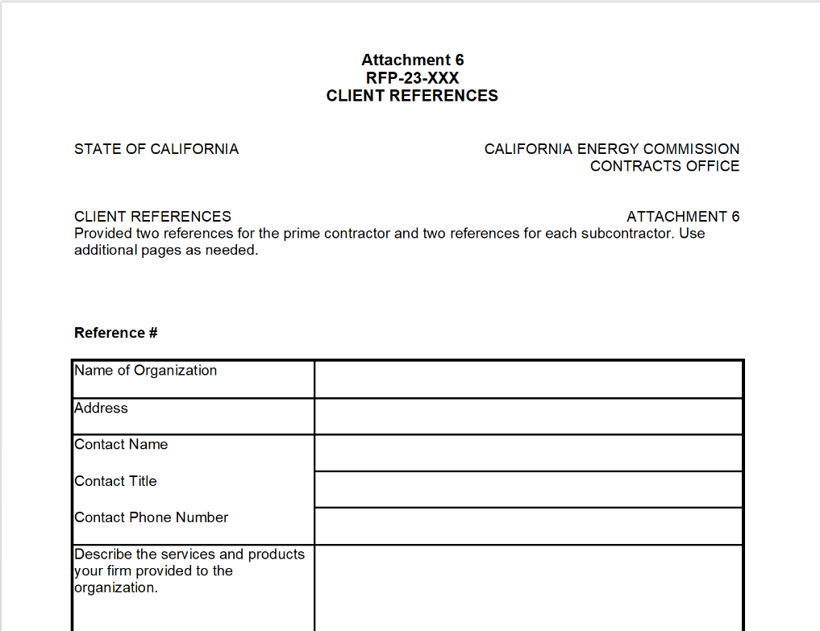
Client References (Attachment 6)
Two client references are required for the Contractor and two for each subcontractor.
Describe the work product and its relevance to the work described in the RFP.

Slide 22
Budget (Attachment 7)
Identifies how the Energy Commission funds will be spent to complete the project.
All subcontractors must complete a separate budget workbook.
Ensure that all rates provided are maximum rates for the entire project term.
Direct Labor
Fringe Benefits
Indirect Costs
Travel:
Travel has been capped at $50,000 for the first two years of the of the agreement
Identify the types of trips necessary to complete tasks

Slide 23
Additional Requirements- Byrd Anti-Lobbying Certification & Generative Artificial Intelligence
Byrd Anti-Lobbying Amendment Certification (Attachment 11)
Certification is required when bidding for a federally-funded contract exceeding $100,000
Bidder certifies they will not and have not used Federal funds to pay any person or organization for influencing or attempting to influence an officer or employee of a member of Congress in connection with obtaining a Federal contract or any other award covered by 31 U.S.C. 1352.
Generative Artificial Intelligence (Attachment 12)
Bidders must notify the Energy Commission in writing if their solution or services under the Agreement includes or makes available, any GenAI, including GenAI from third parties or subcontractors.
Bidder shall complete GenAI Reporting and Factsheet (STD 1000).
If you and/or your subcontractor(s) will not be using or offering GenAI technology, model, service, or system (collectively “product") in the work under the Agreement, then check the “No” box and sign the form.
If you and/or your subcontractor(s) will be using or offering GenAI technology, model, service, or system (collectively “product”) in the work under the Agreement, then check the “Yes” box, complete the remainder of the questions, and sign the form.
Failure to submit the GenAI Disclosure Reporting and Factsheet shall result in rejection of the Proposal.

Slide 24
Additional Requirements- Federal Disadvantaged Business Enterprise
Good Faith Effort:
Ensure DBEs are made aware of contracting opportunities
Make info on opportunities available
Consider dividing requirements when feasible to permit maximum participation
Encourage contracting with a consortium of DBEs
Use the services and assistance of the Small Business Administration and the Minority Business Development Agency of the Department of Commerce.
Documentation of Good Faith Effort:
Bidders/solicitation list or databases that includes DBEs;
Date of last update to bidders/solicitation list or database;
How were DBEs made aware of the solicitation;
Sample of letters with DBEs;
Sample of advertisement/posting;
Attendance list for pre-bid conference;
Include unsuccessful bidders on database or list
Locating Certified DBEs:
The Small Business Administration: https://www.sba.gov/federal-contracting/contracting-assistance-programs/small-disadvantaged-business
The U.S. Department of Transportation: https://www.transportation.gov/civil-rights/disadvantaged-business-enterprise.
The California Department of Transportation: https://dot.ca.gov/programs/civil-rights/dbe

Slide 25
Proposal Organization
Each Bidder must complete and include the following:
SECTION 1, Administrative Response | SECTION 2, Technical and Cost Proposal
Cover Letter | Approach to Tasks in Scope of Work
Table of Contents | Team Structure and Coordination. (Narrative and Organizational Chart)
Contractor Status Form – Attachment 1 | Client References
Darfur Contracting Act Form – Attachment 2 | Previous Work Products
Small Business Certification – If applicable | Budget Forms
Completed Disabled Veteran Business Enterprise Form – Attachment 3
Bidder Declaration Form - Attachment 4
Contractor Certification Clauses – Attachment 5
TACPA Forms - If applicable
Iran Contracting Act Form –If applicable
CA Civil Rights Laws Certification
Byrd Anti-Lobbying Amendment Certification
GenAI Disclosure & Factsheet Form

Slide 26
Submission Requirements
Method of Delivery is the Energy Commission Grant Solicitation System (GSS), available at: https://gss.energy.ca.gov/
Electronic files must be in Microsoft Office Word (.doc, .docx) and Excel (.xls, .xlsx) formats, unless originally provided in solicitation in another format.
Proposal documents should meet formatting requirements, and page recommendations.
Attachments requiring signatures (e.g., Contractor Status Form) may be scanned and submitted in PDF format.
First-time users must register as a new user to access system.
Grant Solicitation System (GSS) How to Apply presentation: https://www.energy.ca.gov/media/1654

Slide 27
GSS WARNING
START THE PROCESS EARLY!
Proposals must be fully submitted BEFORE the deadline listed in the solicitation manual
The GSS system will shut off at the deadline
Proposals in the process of being submitted prior to the deadline will NOT be accepted after the deadline
Proposal will NOT be accepted after the deadline

Slide 28
GSS Structure
Register as a New User
Log In
3 Step Proposal Process:
Select Solicitation
Upload Files
• Select documents for upload
Tag files with document type
Designate confidential documents (if applicable)
Review and Submit
All three steps must be complete BEFORE the deadline

Slide 29
Proposal Evaluation
Evaluation of proposals consists of two stages:
Stage One - Screening
A. Administrative and Completeness Screening
Must Pass to progress to Stage 2
B. Screening Criteria for Handling of Energy Commission (or a Third Party) Confidential Information
Stage Two: Technical and Cost Evaluation of Proposals

Slide 30
How will my Proposal be Evaluated? Stage One- Screening
B. Screening Criteria for Handling of Energy Commission (or a Third Party) Confidential Information
Questions must be completed in Contractor’s Status Form (Attachment 1)
All answers must be either “yes” or “no” for each question
Any “no” answer means Bidder will be screened out in Stage One Administrative and Completeness
For more information on confidentiality and security requirements, see Attachment 8, Exhibit D for definitions and specific agreement terms.

Slide 31
How will my Proposal be Evaluated? Stage Two: Technical and Cost Evaluation of Proposals
Evaluation Committee applies the scoring scale to the scoring criteria.
Proposals must obtain a minimum passing score of 49 points for Criteria 1-5 in order to continue the Part 2. Cost Criteria evaluation.
Proposals must obtain a minimum passing score of 70 points for Criteria 1-6 in order to be considered for funding.
Review Evaluation Process and Criteria section of the manual and ensure the proposal provides a clear and complete response to each scoring criteria.
Scoring Criteria | Maximum Points
1. Approach to Tasks in the Scope of Work | 15
2. Team Structure and Coordination | 10
3. Relevant Experience and Qualifications | 25
4. Client References | 10
5. Previous Work Products | 10
6. Cost Criteria | 30
Total | 100
Minimum Points to Pass | 70

Slide 32
How will my Proposal be Evaluated? Stage Two: Technical Evaluation of Proposals
Scoring Scale
% of Possible Points | Interpretation | Explanation for Percentage Points
0% | Not Responsive | Response does not include or fails to address the requirements being scored. The omission(s), flaw(s), or defect(s) are significant and unacceptable.
10-30% | Minimally Responsive | Response minimally addresses the requirements being scored. The omission(s), flaw(s), or defect(s) are significant and unacceptable.
40-60% | Inadequate | Response addresses the requirements being scored, but there are one or more omissions, flaws, or defects or the requirements are addressed in such a limited way that it results in a low degree of confidence in the proposed solution.
70% | Adequate | Response adequately addresses the requirements being scored. Any omission(s), flaw(s), or defect(s) are inconsequential and acceptable.
75% | Between Adequate and Good | Response better than adequately addresses the requirements being scored. Any omission(s), flaw(s), or defect(s) are inconsequential and acceptable.
80% | Good | Response fully addresses the requirements being scored with a good degree of confidence in the applicant’s response or proposed solution. No identified omission(s), flaw(s), or defect(s). Any identified weaknesses are minimal, inconsequential, and acceptable.
85% | Between Good and Excellent | Response fully addresses the requirements being scored with a better than good degree of confidence in the applicant’s response or proposed solution. No identified omission(s), flaw(s), or defect(s). Any identified weaknesses are minimal, inconsequential, and acceptable.
90% | Excellent | Response fully addresses the requirements being scored with a high degree of confidence in the applicant’s response or proposed solution. Applicant offers one or more enhancing features, methods or approaches exceeding basic expectations.
95% | Between Excellent and Exceptional | Response fully addresses the requirements being scored with a better than excellent degree of confidence in the applicant’s response or proposed solution. Applicant offers one or more enhancing features, methods or approaches exceeding basic expectations.
100% | Exceptional | All requirements are addressed with the highest degree of confidence in the applicant’s response or proposed solution. The response exceeds the requirements in providing multiple enhancing features, a creative approach, or an exceptional solution.
Address all items described in section III. Proposal Format, Required Documents, and Delivery
Read the scoring criteria described in section IV. Evaluation Process and Criteria carefully and respond accordingly.

Slide 33
How will my Proposal be Evaluated? Cost Score
Budget Forms (Attachment 7, 7a, 7b)
• The Evaluation Committee will score costs only for the Bidder’s personnel who are included in the Budget forms.
• Bidder and subcontractors complete the following budget workbook:
o Budget Form Attachment 7
o Budget Loaded Rate Calculator Attachment 7a
o Budget Rates Summary Attachment 7b (auto populated)

Slide 34
How will my Proposal be Evaluated? Cost Score- Criterion 1 & 2
Loaded Labor Rate for years 1 and 2
The score for this criterion will be derived from the cost formula specified in Section IV of this RFP, which is the cumulative average loaded hourly rate in the Bidder’s Loaded-Rates Budget Form(s) (Attachment 7a).
Cost Justification
The score for this criterion will be evaluated based on the Bidder’s justification of proposed personnel identified in its proposal for the work to be performed by the proposed team; including a justification for the costs based on the expertise, experience, and resources of the project team and anticipated work.

Slide 35
How will my Proposal be Evaluated? Cost Score – Criterion 3
Labor Escalation of years 1 through 12
The score for this criterion will be derived from the total average escalation rate from the previous years to the following biannual years (two years) for Direct Labor and Fringe Benefits for the Bidder and any subcontractors.
The score for this criterion will be derived from the highest biannual (two years) escalation rate from the previous years to the following biannual years (two years) for Direct Labor and Fringe Benefits for the Bidder and any subcontractors.
Escalation Rate Table | 3a Points | 3b Points
0%-6% | 3 points | 2 points
6.01%-12% | 2 points | 1 points
12.01%-18% | 1 points | 0 points
>18.01% | 0 points | 0 points

Slide 36
How will my Proposal be Evaluated? Cost Score – Criterion 4
Indirect Rate Escalation of years 1 through 12
The score for this criterion will be derived from the total average escalation rate from the previous years to the following biannual years (two years) for Indirect rate for the Bidder and any subcontractors.
The score for this criterion will be derived from the highest biannual (two years) escalation rate from the previous years to the following biannual years (two years) for Indirect rate for the Bidder and any subcontractors.
Review the RFP Manual, Section IV Evaluation Process and Criteria, for full definitions and requirements.
Escalation Rate Table | 4a Points | 4b Points
0%-3% | 3 points | 2 points
3.01%-6% | 2 points | 1 points
6.01%-9% | 1 points | 0 points
>9.01% | 0 points | 0 points

Slide 37
How will my Proposal be Evaluated? Proposal Scoring – Preference Points
Preference points are applied only for those that meet the minimum passing score.
Preference points include:
Disabled Veteran Business Enterprise (DVBE) Incentive;
Small Business/Microbusiness Preference;
Small Business Participation Goal for IIJA
Target Area Contract Preference Act (TACPA).
Please review the solicitation manual, section V. Business Participation Programs, for full requirements.

Slide 38
Next Steps After Contract Award
Notice of Proposed Award: Shows total proposed funding amounts and the rank order of bidders.
Agreement Development: Proposal documents will be processed into a legal agreement.
Failure to Execute: The Energy Commission reserves the right to cancel the pending award if an agreement cannot be successfully executed with an awardee.
Project Start: Contractor may begin work on the agreement only after the agreement is fully executed (approved at an Energy Commission business meeting and signed by the Contractor, the Energy Commission and the Department of General Services).

Slide 39
Key Dates
Activity | Date
Solicitation Release | July 8, 2024
Pre-Bidders Conference | July 30, 2024 at 10:00 am
Deadline for Written Questions | July 30, 2024 at 5:00 pm
Anticipated Distribution of Questions and Answers | Week of August 9, 2024
Deadline to Submit Proposals | August 19, 2024 at 11:59 pm
Anticipated Notice of Proposed Award Posting | Week of September 9th
Anticipated Agreement Start Date | November 25, 2024

Slide 40
Questions and Answers
Please chat your question in the Question and Answers window or raise your hand and you will be called on to unmute yourself. Please remember to introduce yourself by stating your name and affiliation. (Feature found under the Participants panel)
Keep questions under 2 minutes to allow time for others.
Note that our official response will be given in writing and posted on the CEC Solicitation webpage.

Slide 41
Additional Questions
Please send all questions related to RFP-24-301 to:
Angela Hockaday
Commission Agreement Officer
(916) 931-5973
angela.hockaday@energy.ca.gov
Deadline to submit questions:
Tuesday, July 30, 2024 at 5:00 PM

Slide 42
Thank You!

