Slide 1
GFO-24-301 Pre-Application Workshop
Environmental Sustainability of a Clean Energy Transition (Enviro-SET)
Energy Research and Development Division, California Energy Commission
Presenter: Julia Harnad and David Stoms
Date: August 28, 2024

Slide 2
Agenda
Time | Item
10:00 am | Welcome and Introduction
10:05 am | Solicitation Background EPIC Research Program Purpose of Solicitation Available Funding
10:25 am | Application Requirements Project Group Requirements Attachments Submission Process Evaluation Process
11:00 am | Q&As
12:00 pm | Adjourn

Slide 3
Workshop Information
This workshop will be recorded and posted to the CEC website here: https://www.energy.ca.gov/event/funding-workshop/2024-08/pre-application-workshop-gfo-24-301-environmental-sustainability
Attendees will be muted during the presentation. Please chat your question using the Q&A window.
Updates to solicitation documents will be posted at the Grant Funding Opportunity’s webpage: https://www.energy.ca.gov/solicitations/2024-08/gfo-24-301-environmental-sustainability-clean-energy-transitions-enviro-set

Slide 4
Commitment to Diversity
The Energy Commission adopted a resolution strengthening its commitment to diversity in our funding programs. The Energy Commission continues to encourage disadvantaged and underrepresented businesses and communities to engage in and benefit from our many programs.
To meet this commitment, Energy Commission staff conducts outreach efforts and activities to:
Engage with disadvantaged and underrepresented groups throughout the state.
Notify potential new applicants about the Energy Commission’s funding opportunities.
Assist applicants in understanding how to apply for funding from the Energy Commission’s programs.
Survey participants to measure progress in diversity outreach efforts.

Slide 5
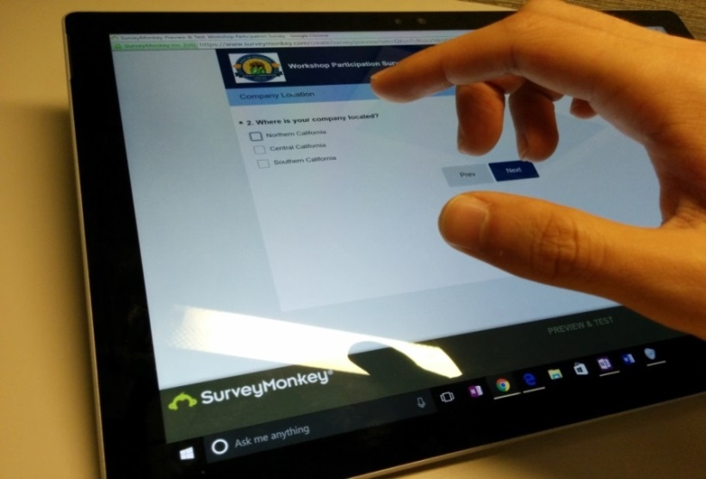
Participation Survey
Survey responses will be summarized anonymously to track attendance of underrepresented groups in our workshops for public reporting purposes.
We Want to Hear From You!
Online participants, please use this link: https://forms.office.com/pages/responsepage.aspx?id=RBI6rPQT9k6NG7qicUgZTmZQQhVkOulBuu_RhfhezOlUNEswN0RTMUZHN04xNVdNUVBUUVBRRkE1Ty4u&route=shorturl
Thanks!

Slide 6
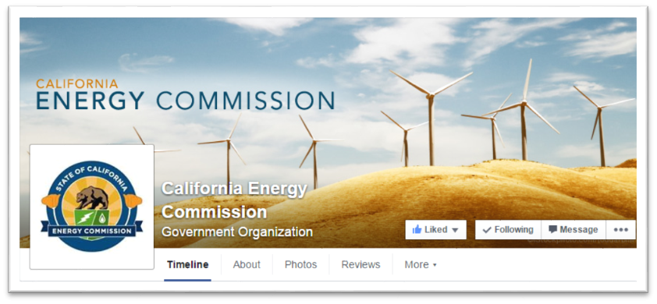
Connect With Us

Slide 7
Find a Partner on EmpowerInnovation.net
Empower Innovation strives to accelerate your clean tech journey with easy access to funding opportunities from the Energy Commission and other funding providers, curated resources and events, and connections to people and organizations.
FIND A PARTNER
Announce your interest in this funding opportunity and message other interested parties to find potential partners.
RESOURCES & TOOLS
Browse the collection of resources for clean tech innovators including Resource Libraries, Funding Sources, Tools, and Databases.
https://www.empowerinnovation.net/en/custom/funding/view/44133

Slide 8
EmpowerInnovation.net

Slide 9
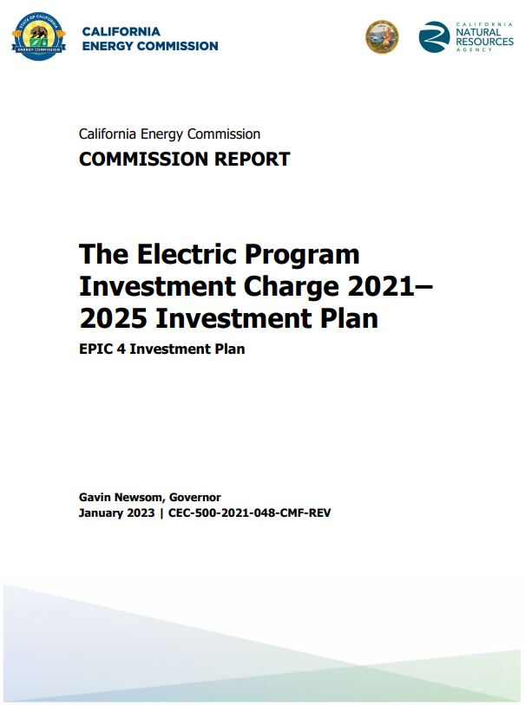
Research Program Background
This solicitation will award projects funded by the Electric Program Investment Charge (EPIC) Program; an electricity ratepayer surcharge established by the California Public Utilities Commission (CPUC) in December 2011.
Strategic objective: “Inform California’s transition to an equitable, zero-carbon energy system that is climate-resilient and meets environmental goals” (Chapter 7).
Initiative: Environmental Sustainability
Topic: 45, Advancing the Environmental Sustainability of Energy Deployments.
The purpose of the EPIC program is to benefit the ratepayers of three investor-owned utilities (IOUs)
Investment Plan: https://www.energy.ca.gov/publications/2021/electric-program-investment-charge-proposed-2021-2025-investment-plan-epic-4

Slide 10
Policy Drivers
AB 32, Global Warming Solutions Act of 2006: reduce GHG emissions to 1990 levels by 2020.​
SB 32, California Global Warming Solutions Act of 2006 emissions limit: statewide GHG emissions are reduced to 40% below the 1990 level by 2030.
SB 100, The 100 Percent Clean Energy Act of 2018: requires that 60% of California’s electricity be powered by renewable & zero-carbon sources by 2030 and 100% by 2045.
AB 758 Building Efficiency: achieve greater water and energy savings in existing residential and nonresidential buildings
AB 1109 CA Lighting Efficiency and Toxics Reduction Act: Recommend reduction in lighting consumption.
CA Green Building Standards Code (Part 11 of Title 24): regulations that promote sustainable practices, including voluntary bird-friendly measures for nonresidential buildings.
Integrated Energy Policy Report (IEPR): California Public Resources Code Section 25302 requires the Energy Commission to release a biennial report that provides an overview of major energy trends and issues facing the state.​

Slide 11
Purpose of Solicitation
Fund applied research to address knowledge gaps between the environment and:
Clean energy technologies
Decarbonized window designs
Energy efficient artificial lighting

Slide 12
Available Funding
Project Group | Available Funding | Minimum Award Amount | Maximum Award Amount
Group 1: Automated mapping of solar energy footprints and modeling land suitability for agrivoltaics | $ 700,000 | $ 600,000 | $ 700,000
Group 2: Assessing and minimizing environmental and biological resource impacts of clean energy deployments | $ 1,200,000 | $ 500,000 | $ 600,000
Group 3: Testing bird-friendly windows for decarbonized buildings | $ 600,000 | $ 500,000 | $ 600,000
Group 4: Identifying biologically appropriate exterior lighting | $ 500,000 | $ 400,000 | $ 500,000

Slide 13
Match Funding
There is no match funding requirement.
Applications that include match funding may receive additional points during the scoring phase.
Match funding contributors must submit match funding commitment letters that meet the requirements. Failure to do so will disqualify the match funding commitment from consideration.
Refer to the Solicitation Manual for more details on match funding.

Slide 14
Group 1: Automated mapping of solar energy footprints and modeling land suitability for agrivoltaics
Funding Amount: up to $ 700,000 (1 project)
Background:
SB 100 planning needs to track PV footprint expansion and projections.
Current methods of monitoring renewable energy project development are labor-intensive and incomplete.
Identifying land suitability for agrivoltaics could reduce impacts and promote dual-use benefits

Slide 15
Group 1: Automated mapping of solar energy footprints and modeling land suitability for
Requirements:
1. Develop open-source digital image analysis techniques to automatically detect solar PV facilities and generate CA map of solar footprints:
Detect and map utility-scale solar footprints distinguishing direct array and the total PV project area.
Differentiate between fixed versus tracking PV.
Map distributed PV facilities.
Detect types of site preparation and vegetation management with ground mounted PV.
2. Develop and apply multicriteria methods to map agrivoltaics land suitability.

Slide 16
Group 2: Assessing and minimizing environmental and biological resource impacts of clean energy deployments
Funding Amount: up to $ 1,200,000 (up to 2 projects)
Background:
Land based clean energy facilities’ development and operations may have environmental impacts on wildlife and plant communities.
New monitoring technologies are often lacking to study interactions between clean energy projects and biological organisms.
Regulators, energy planners and developers, permitting agencies and other stakeholders need to be informed about potential risks and mitigation solutions.

Slide 17
Group 2: Assessing and minimizing environmental and biological resource impacts of clean energy deployments
Examples of projects include but are not limited to:
Biological and Ecological Vulnerability Assessment
(fieldwork, modeling or monitoring)
Biological Impact Minimization or Compensatory Mitigation (curtailments or deterrents, offsets)
Dual Use Solar Energy Production (such as agrivoltaics)
Innovative Environmental Monitoring Technologies
(e.g. machine learning, environmental DNA)
Lithium Recovery’s Environmental Effects
(possible secondary effects on biological organisms)

Slide 18
Group 2: Assessing and minimizing environmental and biological resource impacts of clean energy deployments
Additional requirements to include in Project Narrative (attachment 4):
Discuss why the proposed species or ecosystem is being chosen for study and their priority in meeting CA clean energy goals.
If field work or testing is being proposed, include a commitment letter from the site owner.
Possess both scientific and environmental expertise and qualifications for the project team.

Slide 19
Group 3: Testing bird-friendly windows for decarbonized buildings
Funding Amount: up to $ 600,000 (1 project)
Background:
Hundreds of millions of birds are killed annually in North America from collisions with windows due to their reflectivity or transparency.
Window designs can provide energy services that decarbonize buildings.
Combining window technologies that can address building decarbonization and reduce bird fatalities simultaneously could have significant co-benefits.

Slide 20
Group 3: Testing bird-friendly windows for decarbonized buildings
Requirements:
Test window technologies that reduce bird collisions and provide one or more energy services that help decarbonize buildings.
Compare energy generation or conservation, costs, estimated reduction in bird fatalities, and tradeoffs.
Consult with relevant market stakeholders about acceptability.

Slide 21
Group 3: Testing bird-friendly windows for decarbonized buildings
Additional Requirements to include in Project Narrative (Attachment 4):
Explain the choice of bird species being proposed, their interactions with windows and possible response to new window technologies.
Discuss current CA building standards on windows and how the research could inform future standards.
Demonstrate relevant team qualifications.

Slide 22
Group 4: Identifying Biologically Appropriate Exterior Lighting
Funding Amount: up to $ 500,000 (1 project)
Background:
Title 24 requires light emitting diode (LED) exterior lighting to increase energy-efficiency.
Scientific evidence shows that “ecological light pollution” may have significant impact on night pollinating insects, bats, migratory birds, and other species.
Appropriate energy efficient lighting could minimize biological responses and impacts and help preserve the benefits provided by dark skies while also lowering energy consumption.

Slide 23
Group 4: Identifying Biologically Appropriate Exterior Lighting
Requirements:
Determine biologically appropriate energy efficient exterior lighting that benefit a range of affected CA species. Discuss:
How different species respond to varying types of exterior light properties.
Which CA landscapes and settings with light pollution tend to have the greatest impact on fauna and flora.
How to optimize lighting risk reduction across multiple species.
Make recommendations towards adapting Title 24 Building Standards on exterior lighting. This could include lighting for offshore wind infrastructure.

Slide 24
Group 4: Identifying Biologically Appropriate Exterior Lighting
Additional requirements to include in Project Narrative (Attachment 4).
Discuss which species will be prioritized and why.
Discuss current CA building standards and how the research can inform future updates to these standards.
Demonstrate expertise in understanding both species visual spectral responses to lighting and current outdoor spectral properties of lighting.
Demonstrate relevant team qualifications.

Slide 25
Eligible Applicants
This is an open solicitation for public and private entities.
Applicants must accept applicable EPIC terms and conditions.
Standard, UC, and DOE T&Cs available online: https://www.energy.ca.gov/funding-opportunities/funding-resources
Applicants are encouraged to register with the California Secretary of State, as all recipients must be registered and in good standing to enter into an agreement with the Energy Commission: http://www.sos.ca.gov

Slide 26
Application Requirements
Each Applicant must complete and | include the following:
1. Executive Summary (.docx) | 7. CEQA Compliance Form (.docx)
2. Project Narrative (.docx) | 8. Past Projects Information Form (.docx, .pdf)
3. Project Team (.docx, .pdf) | 9. Commitment and Support Letters (.pdf)
4. Scope of Work (.docx) | 10. Project Performance Metrics
5. Project Schedule (.xlsx) | 11. Applicant Declaration (.docx)
6. Budget (.xlsx) | 12. CEQA Reference Guide (.docx)
Notes:
.

Slide 27
Project Narrative (Attachment 2)
This is your opportunity to explain the entirety of the project. The narrative should explain:
Why is your project necessary and important to California?
What is your project approach and how will each major task be implemented?
How will the project be completed in the term proposed
How will the project outcomes benefit electric ratepayers?
Address the requirements for your group as described in Section I.C.
Respond to the scoring criteria described in Section IV.F.

Slide 28
Scope of Work (Attachment 4)
Tell us exactly what you are proposing to do in your project.
Identify what will be delivered to the Energy Commission.
Be sure to include in the technical tasks:
At least one product deliverable per task.
Address requirements in Section I.C. under Project Focus.
Be sure to include in the Project Schedule (Attachment 5):
Product deliverables that correspond with the Scope of Work.
Realistic dates on when product deliverables can be completed.

Slide 29
Budget (Attachment 6)
Identify how the Energy Commission funds and match funds will be spent to complete the project.
Subrecipients receiving $100,000 or more Energy Commission funds must complete a separate budget form.
Ensure that all rates provided are maximum estimated rates for the entire project term and any potential increases are included.
Travel Restrictions:
CEC funds should be limited to project task specific in-state travel.
Travel to conferences are generally not considered applicable travel for projects and should not use CEC funds.

Slide 30
Commitment and Support Letter Forms (Attachment 9)
Follow guidelines provided for commitment and support letters.
Commitment letters are required for entities or individuals that are committing match funding, testing/demonstration sites, including the Applicant (prime).
Support letters describe a project stakeholder’s interest or involvement in the project.
All applicants must submit at least one support letter.
Match funding must be supported by a match fund commitment letter(s).
Any project partners that will make contributions to the project (other than match and sites) must submit a commitment letter.
Limit to two pages per letter, excluding the cover page.

Slide 31
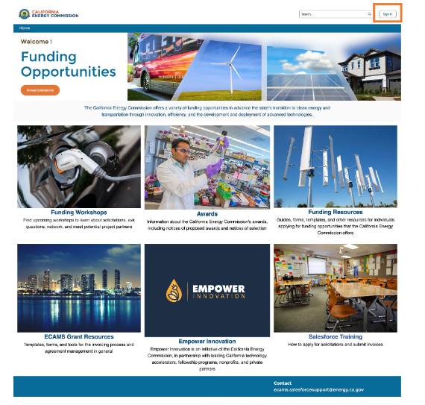
GFO Submission Requirements
Applicants must have or must create a user account to submit a solicitation application. To create an account, please see the guidance User Registration Instructions at: https://www.energy.ca.gov/media/7893
Note: One account manager per organization, but users can be added by account manager
Applications must be submitted through the Energy Commission Agreement Management System (ECAMS) at: https://ecams.energy.ca.gov/

Slide 32
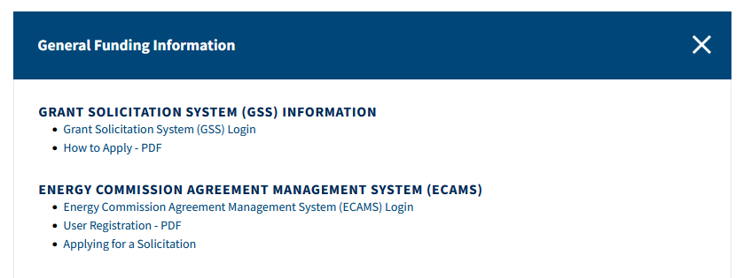
GFO Submission Requirements (cont.)
For detailed instructions on application submittal, please see the Applying for a Solicitation at: https://www.energy.ca.gov/media/7956
Both referenced guidance documents are available at: https://www.energy.ca.gov/funding-opportunities/funding-resources under General Funding Information.
Questions with the ECAMS system should be directed to: ECAMS.SalesforceSupport@Energy.ca.gov

Slide 33
GFO Submission Requirements (cont.)
Electronic files, other than those requiring signatures, must be consistent with the specific file format provided in the solicitation.
Application documents should meet formatting requirements, and page recommendations as specified in the solicitation manual.
Attachments requiring signatures (Application Form and Support/Commitment Letters) may be signed, scanned, and submitted in PDF format.

Slide 34
Submission Warning
START THE PROCESS EARLY!
Applications must be fully submitted BEFORE the deadline listed in the solicitation manual.
The ECAMS system will reject applications submitted after the deadline.
Applications in the process of being submitted prior to the deadline will NOT be accepted after the deadline.
ECAMS support is ONLY available from 8am – 5pm Monday-Friday.

Slide 35
Application Submission
Register as a New User (if applicable)
Log In
4-Step Application Submittal Process:
Select Solicitation
Enter Application Information
Upload Files
• Select documents for upload
Tag files with document type
Designate confidential documents (if applicable)
Review and Submit
Confirmation from ECAMS system that submission was successful
All steps must be complete BEFORE the submission deadline

Slide 36
Application Reminders
We recommend you carefully review your application before submission.
Verify that all necessary documents have been uploaded.
Verify that all documents uploaded are the accurate version you intend to submit as your final.
Verify that your documents are not marked "confidential" unless the solicitation allows specific material to be confidential. Most solicitations do not allow submission of confidential information.
Verify that your match commitment letters accurately reflect the match amounts included in your budgets, including the match provided by the prime applicant.
Verify that support and commitment letters are included, if required.
Verify that amounts entered within the system's budget (if any) concur with information included on uploaded budget worksheets.

Slide 37
How will my Application be Evaluated? Application Screening
Admin Screening Process
Energy Commission staff screens applications per criteria in Section IV.E.
Criteria are evaluated on a pass/fail basis.
Applicants must pass all screening criteria, or the application will be disqualified.
Some Reasons for Disqualification
Application is not submitted by the specified due date and time.
Application does not include one or more support letters.
Application contains confidential material.

Slide 38
How will my Application be Evaluated? Application Scoring
Evaluation Committee applies the scoring scale to the scoring criteria.
Applications must obtain a minimum passing score of 52.5 points for Criteria 1-4 in order to continue evaluation.
Applications must obtain a minimum passing score of 70 points for Criteria 1-7 in order to be considered for funding.
Review Section IV of the manual and ensure the application provides a clear and complete response to each scoring criteria.
Scoring Criteria | Maximum Points
1. Technical Merit | 15
2. Technical Approach | 25
3. Impacts and Benefits for CA IOU Ratepayers | 20
4. Team Qualifications, Capabilities, and Resources | 15
5. Budget and Cost-Effectiveness | 10
6. CEC Funds Spent in California | 10
7. Ratio of Direct Labor Costs to Indirect Costs | 5
Total | 100
Minimum Points to Pass | 70

Slide 39
How will my Application be Evaluated? Application Scoring – Preference Points
Passing applications (score of 70 or more from Criteria 1-7) will be considered for bonus points. Criteria for bonus points include:
Match Funding
Scoring Criteria | Maximum Points
8. Match Funds | 5
Total Bonus Points | 5

Slide 40
Match Funding Points
Applicants may receive up to 5 additional preference points based on the criteria below:
Up to 5 points will be awarded based on the percentage of proposed cash relative to the total match contributions using the Match Scoring Table in the Scoring Criteria.
Refer to the Solicitation Manual for more details on the match funding scoring criteria.

Slide 41
Next Steps After Grant Award
Notice of Proposed Award: Shows total proposed funding amounts, rank order of applicants by project group, and the amount of each proposed award.
Agreement Development: Proposal documents will be processed into a legal agreement.
Failure to Execute: The Energy Commission reserves the right to cancel the pending award if an agreement cannot be successfully executed with an applicant.
Project Start: Recipients may begin work on the project only after the agreement is fully executed (approved at an Energy Commission business meeting and signed by the Recipient and the Energy Commission).

Slide 42
Key Dates
Activity | Date
Solicitation Release | August 12, 2024
Pre-Application Workshop | August 28, 2024, at 10:00 a.m.
Deadline for Written Questions | September 13, 2024 at 5:00 pm
Anticipated Distribution of Questions and Answers | Week of September 30, 2024
Deadline for ECAMS Submission Support | Ongoing until November 8, 2024 at 5:00 pm
Deadline to Submit Applications | November 8, 2024 at 11:59 pm
Anticipated Notice of Proposed Award Posting | Week of January 27, 2024
Anticipated Energy Commission Business Meeting | April 10, 2025
Anticipated Agreement Start Date | May 26, 2025
Anticipated Agreement End Date | May 26, 2028

Slide 43
Questions and Answers
Please chat your question in the Question and Answers window or raise your hand and you will be called on to unmute yourself. Please remember to introduce yourself by stating your name and affiliation. (Feature found under the Participants panel)
Keep questions under 2 minutes to allow time for others.
Note that our official response will be given in writing and posted on the GFO webpage.

Slide 44
Additional Questions
Please send all questions related to GFO-24-301 to:
Crystal Willis
Commission Agreement Officer
1516 Ninth Street, MS-18
Sacramento, CA 95814
crystal.willis@energy.ca.gov
Deadline to submit questions:
Friday, September 13, 2024, 5:00 PM

Slide 45
Thank You!

