Slide 1
RFP-24-401 Pre-Bid Conference
Building Energy Performance Strategy Report & Benchmarking Support
Presenter: Elizabeth Butler, Contract and Grant Manager
Date: Wednesday, September 4, 2024

Slide 2
Welcome and Introductions
Efficiency Division:
Elizabeth Butler, Contract and Grant Manager
Lien Huynh, Grants Analyst
Brent Kelsey, Supervisor, Building Performance & Metrics
Gabriel D. Taylor, P.E., Senior Engineer, Decarbonization & Load Flexibility
Contracts, Grants, and Loans Office:
Diana Grady, Commission Agreement Officer
Phil Dyer, Commission Agreement Officer

Slide 3
Agenda
TIME | TOPIC
9:00 a.m. | Welcome and Introductions
9:07 a.m. | Solicitation Overview
9:16 a.m. | Scope of Work
9:22 a.m. | Proposal Format, Required Documents, and Method for Delivery
9:28 a.m. | Evaluation Process and Criteria
9:35 a.m. | Business Participation Programs (Preferences/Incentives)
9:40 a.m. | Questions and Answers (Q&A)

Slide 4
Housekeeping Items
Webinar is being recorded
Participants are muted during presentation
Virtual participation options during Q&A period:
Enter questions in Q&A window
Raise hand
Press *9 on telephone

Slide 5
Commitment to Diversity
CEC conducts outreach efforts & activities to:
Engage with disadvantaged and underrepresented groups
Notify potential new bidders about funding opportunities
Assist bidders in understanding how to apply
Survey participants to measure progress
CEC adopted the JAEDI Framework:
Address climate change
Ensure all Californians have dignity, health, and prosperity
5

Slide 6
We Want to Hear from You!
One Minute Survey
Anonymous and voluntary
Used for public reporting purposes
To access:
Use the survey link in the chat on Zoom
Scan the QR code with a phone or tablet
Survey will be closed at the end of the day
https://forms.office.com/g/Sf8n2P5VuG?origin=lprLink

Slide 7
Solicitation Overview
RFP-24-401: Building Energy Performance Strategy Report & Benchmarking Support
7

Slide 8
Solicitation Process
Solicitation Release
August 20, 2024
Deadline for Written Questions
September 4, 2024
Proposals Due
October 1, 2024
CEC Business Meeting
December 11, 2024
Notice of Proposed Award (NOPA)
October 22, 2024
Agreement Start
January 1, 2025
8

Slide 9
Background Information
CARB lead agency for developing State Implementation Plan
PRC section 25402.10 authorizes Building Energy Benchmarking Program
SB 48 requires development of a strategy for using benchmarking data to achieve goals
Must adopt final report before July 1, 2026
Solicitation Manual pages 10-12

Slide 10
Purpose of this Solicitation
Select an experienced contractor team to provide technical support services for:
Existing Benchmarking Program
SB 48 Implementation Proceeding
Solicitation Manual page 5

Slide 11
Key Activities and Dates
ACTIVITY | ACTION DATE | TIME
Solicitation Release | August 20, 2024 | N/A
Pre-Bid Conference | September 4, 2024 | 9:00 a.m. (PDT)
Deadline for Written Questions | September 4, 2024 | 5:00 p.m. (PDT)
Anticipated Distribution of Questions/Answers | September 18, 2024 | N/A
Deadline to Submit Proposals | October 1, 2024 | 11:59 p.m. (PDT)
Anticipated Posting of NOPA | October 22, 2024 | N/A
Anticipated CEC Business Meeting | December 11, 2024 | N/A
Anticipated Agreement Start Date | January 1, 2025 | N/A
Agreement End Date | December 31, 2026 | N/A
Solicitation Manual page 5

Slide 12
Available Funding
$9,000,000 maximum
24-month term
Hourly rate plus cost reimbursement contract
Solicitation Manual page 6
12

Slide 13
How Award is Determined
Pass administrative and completeness screening
Attain at least 70% of total possible points during technical and cost evaluation
Awarded to bidder receiving highest points
Solicitation Manual pages 6, 37
13

Slide 14
Eligible Bidders
Open solicitation for public and private entities
Must register and be in good standing with Secretary of State before CEC business meeting
http://www.sos.ca.gov
Sole proprietors using a fictitious business name must register with appropriate county
Solicitation Manual page 6

Slide 15
Solicitation Webpage
All RFP documents are available on the solicitation webpage:
https://www.energy.ca.gov/solicitations/2024-08/rfp-24-401-building-energy-performance-strategy-report-benchmarking-support
Updates will also be posted at that location

Slide 16
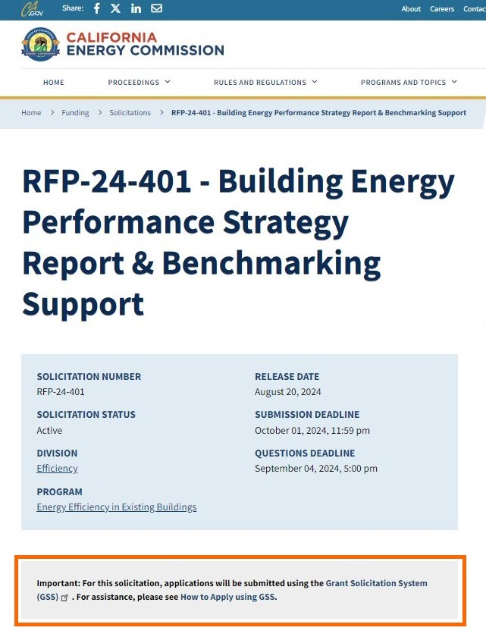
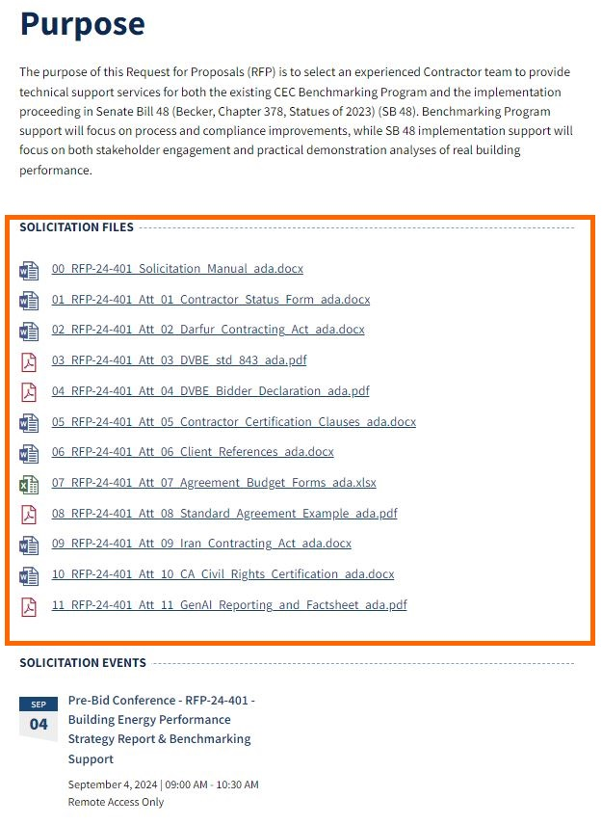
Solicitation Webpage (continued)

Slide 17
Scope of Work
RFP-24-401: Building Energy Performance Strategy Report & Benchmarking Support
17

Slide 18
Scope of Work Tasks
Task # | TASK NAME
1 | Agreement Management
2 | Building Performance Strategy Stakeholder Outreach and Engagement
3 | California Building Performance and Decarbonization Field Study
4 | Assess the Benchmarking Program and Develop a Roadmap for Benchmarking Program Compliance Improvements
5 | Assess Benchmarking Data Quality and Recommend Methods for Improving Benchmarking Data Quality
6 | Improve Benchmarking Program Outreach and Engagement Strategies
7 | Contingencies and Additional Topic Areas for the Benchmarking Program and SB 48 Implementation Proceeding
Solicitation Manual pages 14-28

Slide 19
Task 1: Requirements
Maximum budget:
10% of total Agreement budget
Work and deliverables:
Cannot be assigned to a technical staff person
Must be assigned to a dedicated, experienced, and qualified administrative staff person
Solicitation Manual pages 15, 31, and 40

Slide 20
Task 1: Receipt of Confidential Info
Confidential Information/Personal Information:
Building owner and stakeholder contact information
Building energy usage information
Required deliverables:
ISPP and Signed ISPP Attestation Form
Signed NDAs
Employee Security Awareness Training Certificates
Solicitation Manual pages 16-17, 25; Standard Agreement Example (Attachment 8), Exhibit D pages 8-15

Slide 21
Task 1: Form 805
Form 805
Due within 5 days of Agreement start date
Identifies individuals designated as consultants
Employees working strictly on administrative tasks, including Task 1, are not consultants
Employees working on Tasks 2-7 are consultants
Solicitation Manual page 16; Standard Agreement Example (Attachment 8), Exhibit E pages 1-5

Slide 22
Task 1: Form 700
Form 700
All consultants must file a Form 700
Due within 30 days of starting work on the Agreement
Before submitting a proposal, confirm all Task 2-7 team members agree to this requirement
Required deliverables:
Form 700s
Solicitation Manual pages 16-17, 25; Standard Agreement Example (Attachment 8), Exhibit E pages 1-5

Slide 23
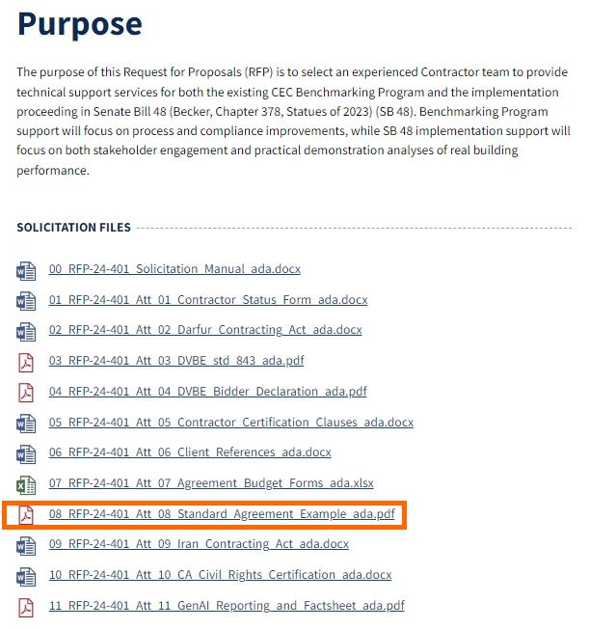
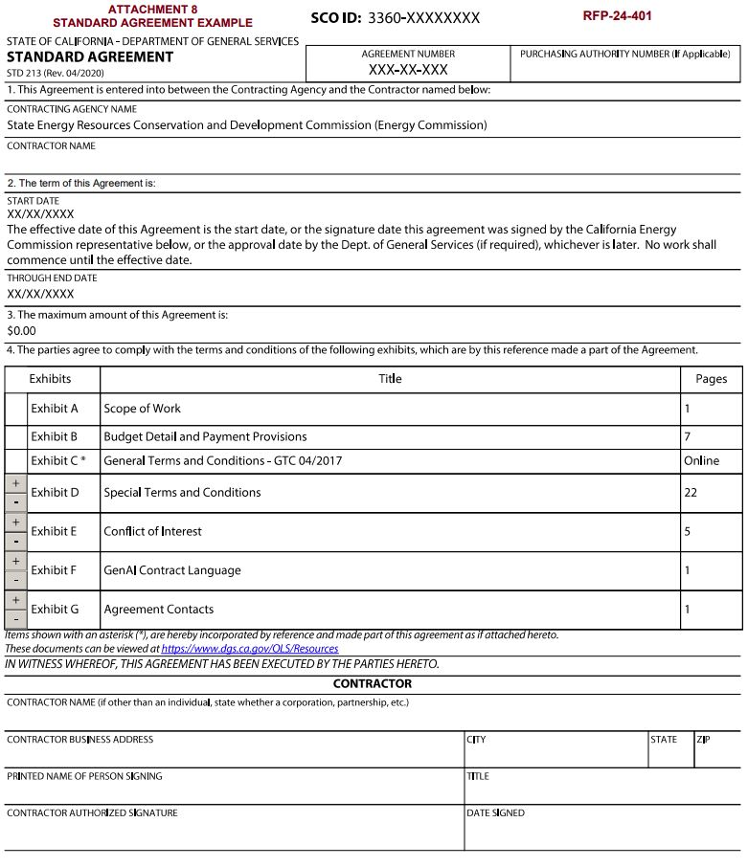
Standard Agreement Example (Attachment 8)

Slide 24
Proposal Format, Required Documents, and Method for Delivery
RFP-24-401: Building Energy Performance Strategy Report & Benchmarking Support
24

Slide 25
Method for Delivery
Start the process early!
GSS Link: https://gss.energy.ca.gov/
Automatically closes on October 1st at 11:59 p.m. (PDT)
Proposals in the process of being submitted prior to the deadline will NOT be accepted after the deadline
“GSS How to Apply: Tutorial and Tips for Applicants” Document Link: https://www.energy.ca.gov/media/1654
Solicitation Manual pages 29-30

Slide 26
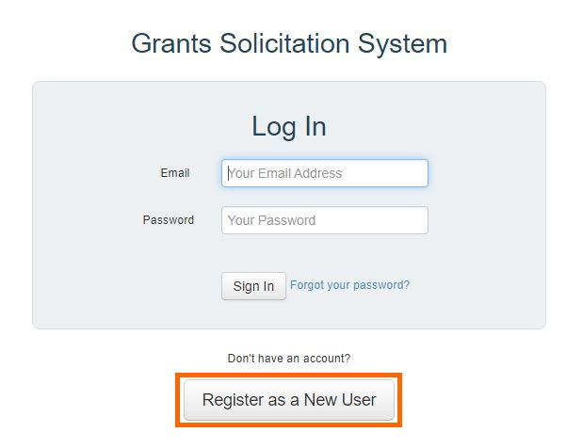
Method for Delivery (continued)
First time users must register
Submit each document as a separate file
Hard copies or submissions via email or fax will not be accepted
Solicitation Manual pages 29-30

Slide 27
Proposal Format & Organization
Format
Typed using standard 11-point font
Single-spaced with a blank line between paragraphs
Pages must be numbered
Sections must be titled
Organization
Section 1, Administrative Response
Section 2, Technical and Cost Proposal
Solicitation Manual pages 29-35

Slide 28
Section 1, Administrative Response
REQUIRED ITEMS | ATTACHMENT #
Cover Letter | None
Table of Contents | None
Contractor Status Form | Attachment 1
Darfur Contracting Act Form | Attachment 2
Small Business Certification (only if applicable) | None
DVBE Declarations Form (Std. 843) | Attachment 3
Bidder Declaration Form (GSPD-05-105) | Attachment 4
Contractor Certification Clauses | Attachment 5
Target Area Contract Preference Act Forms (only if applicable) | None
Iran Contracting Act Form | Attachment 9
Civil Rights Law Certification | Attachment 10
GenAI Reporting & Factsheet Form | Attachment 11
Solicitation Manual page 30

Slide 29
Section 2, Technical & Cost Proposal
REQUIRED ITEMS | ATTACHMENT #
Approach to Tasks in the SOW | None
Organizational Structure | None
Relevant Experience and Qualifications | None
Labor Hours by Personnel and Task | None
Client References | Attachment 6
Previous Work Products | None
Budget Forms | Attachment 7
Solicitation Manual pages 30-35

Slide 30
Confidential Information
Proposals that contain confidential information or have any portion marked confidential will not be accepted
Solicitation Manual pages 55, 59

Slide 31
Modifying or Withdrawing Proposals
Before the deadline, bidders may request to withdraw or modify a submitted proposal
After the deadline, bidders may only request to withdraw a submitted proposal
Proposals cannot be timed to expire on a specific date
Solicitation Manual page 58

Slide 32
Evaluation Process and Criteria
RFP-24-401: Building Energy Performance Strategy Report & Benchmarking Support
32

Slide 33
Proposal Evaluation
Stage One: Administrative & Completeness Screening
Pass/fail
Must pass all criteria
Stage Two: Technical & Cost Evaluation of Proposals
100 total possible points available
Minimum passing score is 70% or 70 points
Solicitation Manual pages 36-37

Slide 34
Grounds for Rejection
A proposal shall be rejected if:
Submitted after the deadline
A bidder or subcontractor is suspended for violating DVBE law
A required attachment is missing or incomplete
Fails to disclose GenAI
Contains false or intentionally misleading statements
Intends to mislead the State in its evaluation
There is a conflict of interest
Contains confidential info or has any portion marked confidential
Bidder does not agree with Terms and Conditions
Solicitation Manual page 59

Slide 35
Grounds for Rejection (continued)
A proposal may be rejected if:
Unsigned or was not prepared in the mandatory format
Bidder submitted multiple proposals
Does not comply or contains caveats that conflict with the solicitation or is otherwise non-responsive
Bidder has not responded to a PIER Royalty Review Letter
Budget forms are incomplete
Includes GenAI that presents an unacceptable level of risk
Solicitation Manual page 60

Slide 36
Technical & Cost Evaluation
Must pass Stage One screening
CEC may schedule clarification interviews
Final total score will be a combined average
Solicitation Manual page 37

Slide 37
Evaluation Criteria
CRITERIA | MAX POINTS
1. Approach to Tasks in the SOW | 20
2. Organizational Structure | 20
3. Relevant Experience and Qualifications | 20
4. Client References | 5
5. Previous Work Products | 5
Total Possible Points (Minimum Passing Score 70%) | 70
6. Total Expected Labor Costs (Cost Points) | 15
7. Cost Justification (Cost Points) | 15
Final Score (Maximum Points Possible) | 100
Solicitation Manual pages 39-44

Slide 38
Notice of Proposed Award (NOPA)
Upon completion of the evaluation process, the NOPA will be posted to the RFP website:
https://www.energy.ca.gov/solicitations/2024-08/rfp-24-401-building-energy-performance-strategy-report-benchmarking-support
Solicitation Manual page 39

Slide 39
Business Participation Programs (Preferences/Incentives)
RFP-24-401: Building Energy Performance Strategy Report & Benchmarking Support
39

Slide 40
Business Participation Programs
DVBE Participation Compliance Requirements
DVBE Incentive
Small Business/Microbusiness Preference
Non-Small Business Preference
Target Area Contract Preference Act
State of California Certification Search: https://www.caleprocure.ca.gov/pages/PublicSearch/supplier-search.aspx
Solicitation Manual pages 45-50

Slide 41
Disabled Veteran Business Enterprise (DVBE)
DVBE Participation Compliance Requirements
Required participation waived for this solicitation
DVBE Incentive
Optional participation of 0.01% or greater will receive incentive points
Business must be formally certified by OSDS
Perform a Commercially Useful Function (CUF)
DVBE firm cannot be currently suspended for violating DVBE law
If awarded, contract must adhere to DVBE participation level identified in the proposal
Solicitation Manual pages 45-46; Standard Agreement Example (Attachment 8), Exhibit D pages 4-6

Slide 42
Small Business/Microbusiness
Optional participation
Business must be formally certified by OSDS
5% preference points
Perform a CUF
Solicitation Manual pages 46-49

Slide 43
Non-Small Business
Optional participation
Commit to small business or microbusiness subcontractor participation of 25%
Business must be formally certified by OSDS
5% preference points
Cannot take away award from certified small business or microbusiness
Solicitation Manual page 49

Slide 44
Target Area Contract Preference Act (TACPA)
Optional participation
Created to stimulate economic growth and employment opportunities in designated areas
DRU oversees program and evaluates all TACPA applications
A TACPA preference request denial will not cause the proposal to be rejected
https://www.documents.dgs.ca.gov/dgs/fmc/pdf/std830.pdf
Solicitation Manual pages 49-50

Slide 45
Questions & Answers (Q&A)
RFP-24-401: Building Energy Performance Strategy Report & Benchmarking Support
45

Slide 46
Written Questions
Submit written questions to:
Diana.Grady@energy.ca.gov
Assigned CAO & primary POC during RFP process
Subject line: RFP-24-401 – Benchmarking
Deadline to submit:
Wednesday, September 4th at 5:00 p.m. (PDT)
Q&A document will be posted September 18th
https://www.energy.ca.gov/solicitations/2024-08/rfp-24-401-building-energy-performance-strategy-report-benchmarking-support
Solicitation Manual pages 5, 8
46

Slide 47
Question and Answers
Use the raise hand function in Zoom Zoom Phone Controls:
*6 – Toggle mute/unmute
*9 – Raise hand
Type questions in the Zoom Q&A Box
Submit written questions
Send written questions to Diana.Grady@energy.ca.gov
Deadline: September 4th at 5:00 p.m. (PDT)
47

Slide 48
Thank you!
Proposals due October 1st by 11:59 p.m. (PDT)
48

