Slide 1
RFQ-24-401 Pre-Bid Conference
Energy Code Development Support
Presenter: Elizabeth Butler, Contract and Grant Manager
Date: Wednesday, October 2, 2024

Slide 2
Welcome and Introductions
Efficiency Division:
Elizabeth Butler, Contract and Grant Manager
Lien Huynh, Grants Analyst
Will Vicent, Building Standards Deputy Director
Che Geiser, Standards Compliance Program Manager
Contracts, Grants, and Loans Office:
Carissa Peri, Commission Agreement Officer
Phil Dyer, Commission Agreement Officer

Slide 3
Agenda
TIME | TOPIC
10:00 a.m. | Welcome and Introductions
10:07 a.m. | Solicitation Overview
10:17 a.m. | Scope of Work
10:22 a.m. | SOQ Format, Required Documents, and Method for Delivery
10:27 a.m. | Evaluation Process and Criteria
10:37 a.m. | Business Participation Programs
10:40 a.m. | Questions and Answers (Q&A)

Slide 4
Housekeeping Items
Webinar is being recorded
Participants are muted during presentation
Virtual participation options during Q&A period:
Enter questions in Q&A window
Raise hand
Press *9 on telephone

Slide 5
Commitment to Diversity
CEC conducts outreach efforts & activities to:
Engage with disadvantaged and underrepresented groups
Notify potential new applicants about funding opportunities
Assist applicants in understanding how to apply
Survey participants to measure progress
CEC adopted the JAEDI Framework:
Address climate change
Ensure all Californians have dignity, health, and prosperity
5

Slide 6
We Want to Hear from You!
One Minute Survey
Anonymous and voluntary
Used for public reporting purposes
To access:
Use the survey link in the chat on Zoom
Scan the QR code with a phone or tablet
Survey will be closed at the end of the day
https://forms.office.com/g/8ffk3XrpXZ

Slide 7
Solicitation Overview
RFQ-24-401: Energy Code Development Support
7

Slide 8
Solicitation Process
Solicitation Release
September 18, 2024
Deadline for Written Questions
October 2, 2024
Deadline to Submit
October 30, 2024
CEC Business Meeting
February 12, 2025
Notice of Proposed Award (NOPA)
December 20, 2024
Agreement Start
April 1, 2025
8

Slide 9
Background Information
Warren-Alquist Act established CEC as primary energy policy and planning agency
Mandated CEC create and update Building Energy Efficiency Standards (Energy Code)
Updated on a three-year cycle
CBECC and CBECC-Res
CEC administers a robust compliance program
Solicitation Manual pages 4-5

Slide 10
Goals
2028 Energy Code will pursue three major goals:
Reducing wasteful, uneconomic, inefficient, or unnecessary consumption of energy used by buildings
Building decarbonization in newly constructed and existing buildings
Encouraging load flexibility and grid reliability
Solicitation Manual page 4

Slide 11
Purpose of this Solicitation
Developing, updating, and maintaining:
Energy Code for residential and nonresidential buildings
Energy Code reference compliance software, CBECC and CBECC-Res
Energy Code compliance data infrastructure, compliance documents, and other supporting documentation that aids the compliance program
Solicitation Manual page 5

Slide 12
Key Activities and Dates
ACTIVITY | ACTION DATE | TIME
Solicitation Release | September 18, 2024 | N/A
Pre-Bid Conference | October 2, 2024 | 10:00 a.m. (PDT)
Deadline for Written Questions | October 2, 2024 | 5:00 p.m. (PDT)
Anticipated Distribution of Questions/Answers | October 16, 2024 | N/A
Deadline to Submit SOQs | October 30, 2024 | 11:59 p.m. (PDT)
SOQ Discussions with Firms | November 14, 2024 | N/A
Anticipated Notice of Selection | November 25, 2024 | N/A
Anticipated Cost Negotiations | November 25, 2024 – December 13, 2024 | N/A
Anticipated NOPA | December 20, 2024 | N/A
Anticipated CEC Business Meeting | February 12, 2025 | N/A
Solicitation Manual page 6

Slide 13
Available Funding
Maximum of $10,550,000 available to fund 3-year contract resulting from this solicitation
FISCAL YEAR | AMOUNT
2024-2025 | $3,250,000
2025-2026 | $3,650,000
2026-2027 | $3,650,000
Solicitation Manual page 6
13

Slide 14
Work Authorizations (WAs)
Resulting contract conducted as WA Agreement​
Work must be authorized via an executed WA​
Each WA defines scope of work, budget, and schedule
Solicitation Manual pages 14, 19-20

Slide 15
Retainer Contract
Resulting agreement a no-fee “retainer” contract​
Contractor held on retainer and assigned work via WA​s
No guarantee for any minimum or maximum amount of work or contract funds
Solicitation Manual page 14

Slide 16
Eligible Firms
Open solicitation for public and private entities
Prime Contractor must be a single entity, not a group of representatives
Must register and be in good standing with Secretary of State before CEC business meeting
http://www.sos.ca.gov
Sole proprietors using a fictitious business name must register with appropriate county
Solicitation Manual page 7

Slide 17
Solicitation Webpage
All RFQ documents are available on the solicitation webpage:
https://www.energy.ca.gov/solicitations/2024-09/rfq-24-401-energy-code-development-support
Updates will also be posted at that location
Subscribe to email notifications from the “Solicitations, Awards, and Funding Workshops Announcements Only” Listserv:
https://public.govdelivery.com/accounts/CNRA/signup/31874

Slide 18
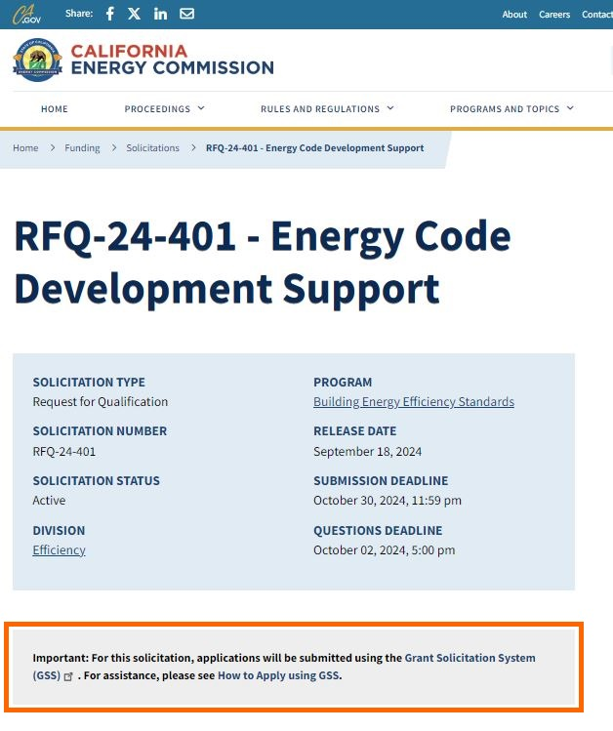
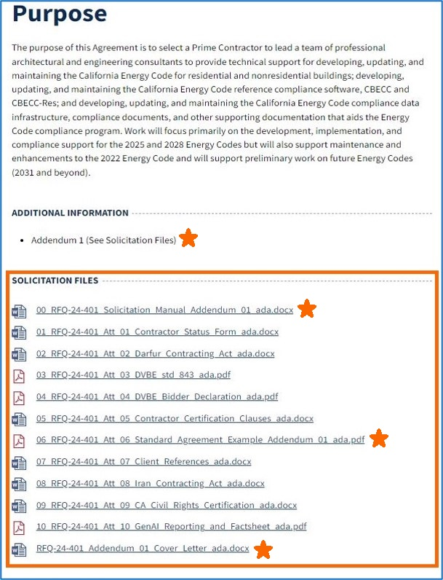
Solicitation Webpage (continued)

Slide 19
Scope of Work
RFQ-24-401: Energy Code Development Support
19

Slide 20
Scope of Work Tasks
Task # | TASK NAME
1 | Agreement Management
2 | Energy Code Update Measure Identification and Analysis
3 | Energy and Climate Accounting Methodologies for the Energy Code
4 | Energy Code Software Tools Development and Maintenance
5 | Energy Code Software Tools Documentation and Deployment
6 | Energy Code Compliance Documentation, Compliance Analysis & Compliance Data Infrastructure Support
7 | Contingencies
Solicitation Manual pages 16-29

Slide 21
Task 1: Requirements
Maximum budget:
10% of total Agreement budget
Work and deliverables:
Cannot be assigned to a technical staff person
Must be assigned to a dedicated, experienced, and qualified administrative staff person
Solicitation Manual pages 17, 36-37, and 46

Slide 22
Task 1: Form 805
Form 805
Due within 5 days of Agreement start date
Identifies individuals designated as consultants
Employees working strictly on administrative tasks, including Task 1, are not consultants
Employees working on Tasks 2-7 are consultants
Solicitation Manual page 17; Standard Agreement Example (Attachment 6), Exhibit E pages 1-5

Slide 23
Task 1: Form 700
Form 700
All consultants must file a Form 700
Due within 30 days of starting work on the Agreement
Before submitting SOQ, confirm all Task 2-7 team members agree to this requirement
Required deliverables:
Form 700s
Solicitation Manual pages 17-18, 30; Standard Agreement Example (Attachment 6), Exhibit E pages 1-5

Slide 24
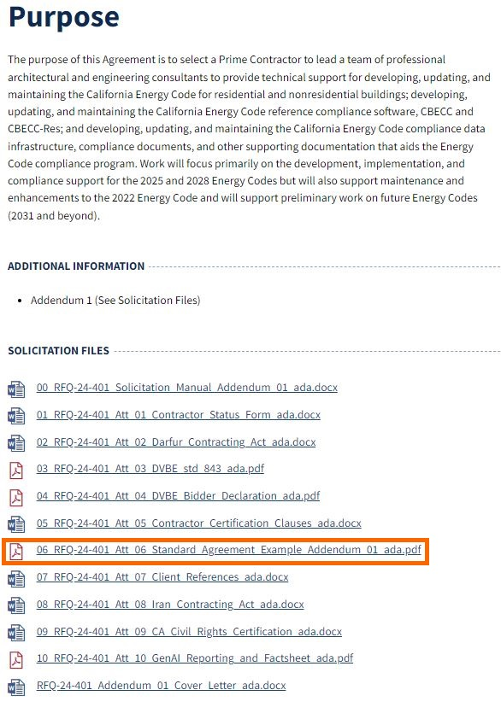
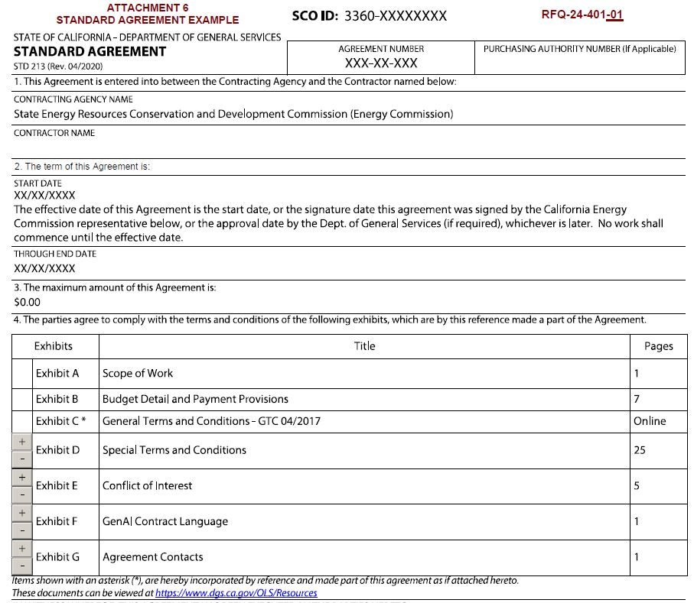
Standard Agreement Example (Attachment 6)

Slide 25
SOQ Format, Required Documents, and Method for Delivery
RFQ-24-401: Energy Code Development Support
25

Slide 26
Method for Delivery
Start the process early!
GSS Link: https://gss.energy.ca.gov/
Automatically closes on October 30th at 11:59 p.m. (PDT)
SOQs in process of being submitted prior to deadline will NOT be accepted after deadline
“GSS How to Apply: Tutorial and Tips for Applicants” Document Link: https://www.energy.ca.gov/media/1654
Solicitation Manual pages 34-35

Slide 27
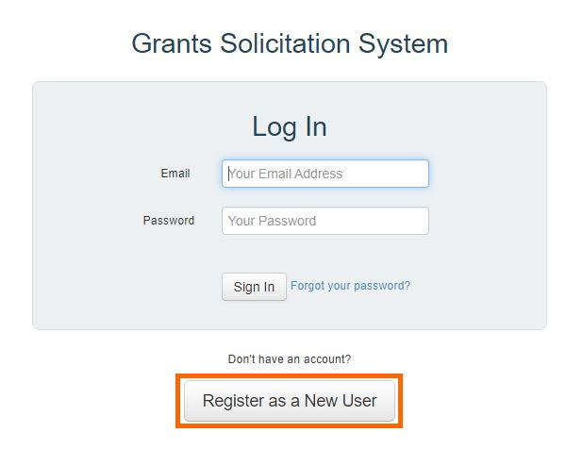
Method for Delivery (continued)
First time users must register
Submit each document as a separate file
Hard copies or submissions via email or fax will not be accepted
Solicitation Manual pages 34-35

Slide 28
SOQ Format & Organization
Format
Typed using standard 11-point font
Single-spaced with a blank line between paragraphs
Pages must be numbered
Sections must be titled
Organization
Section 1, Administrative Response
Section 2, Technical Response
Solicitation Manual pages 34-39

Slide 29
Section 1, Administrative Response
REQUIRED ITEMS | ATTACHMENT #
Cover Letter | None
Table of Contents | None
Contractor Status Form | Attachment 1
Darfur Contracting Act Form | Attachment 2
DVBE Declarations Form (Std. 843) | Attachment 3
Bidder Declaration Form (GSPD-05-105) | Attachment 4
Contractor Certification Clauses | Attachment 5
Iran Contracting Act Form | Attachment 8
Civil Rights Law Certification | Attachment 9
GenAI Reporting & Factsheet Form | Attachment 10
Solicitation Manual page 35

Slide 30
Section 2, Technical Response
REQUIRED ITEMS | ATTACHMENT #
Approach to Tasks in SOW | None
Project Team Organizations Structure and Cost Minimization | None
Project Team Relevant Experience and Qualifications | None
Analytical Tools | None
Client References | Attachment 7
Solicitation Manual pages 34-39

Slide 31
Confidential Information
SOQs that contain confidential information or have any portion marked confidential will not be accepted
Solicitation Manual pages 40, 59

Slide 32
Modifying or Withdrawing SOQs
Before deadline, Firms may request to withdraw or modify submitted SOQ
After deadline, Firms may only request to withdraw submitted SOQ
SOQs cannot be timed to expire on a specific date
Solicitation Manual page 62

Slide 33
Evaluation Process and Criteria
RFQ-24-401: Energy Code Development Support
33

Slide 34
SOQ Evaluation
Stage One: Administrative & Completeness Screening
Pass/fail
SOQs that fail or do not fully comply may be disqualified and eliminated
Stage Two: Evaluation of Qualifications
100 total possible points available
Solicitation Manual pages 40-41

Slide 35
Administrative & Completeness Screening Criteria
Received before deadline
Responsive to DVBE participation requirements
Firm or subcontractors are not suspended for violating DVBE law
All required attachments are included and properly executed
Does not contain false or intentionally misleading statements or references
Does not intend to mislead State in its evaluation
No conflict of interest
Does not contain confidential info or any portion marked confidential
Firm agrees to Terms and Conditions
Solicitation Manual page 40

Slide 36
Grounds for Rejection
An SOQ may be rejected if:
Unsigned or not prepared in mandatory format
Firm submitted multiple SOQs
Does not comply or contains caveats conflicting with solicitation or is otherwise non-responsive
Firm has not responded to PIER Royalty Review Letter
Includes GenAI presenting an unacceptable level of risk
Solicitation Manual page 41

Slide 37
Evaluation of Qualifications
Pass Administrative & Completeness Screening
Review and score based on Evaluation Criteria
Preliminary technical score average of combined scores
Discussions with top 3 scoring Firms
Notice of Selection
Cost negotiations
Include all team members in SOQ
Solicitation Manual page 40-43

Slide 38
Evaluation Criteria
CRITERIA | MAX POINTS
1. Approach to Tasks in SOW | 30
2. Project Team Organizational Structure and Cost Minimization | 30
3. Project Team Relevant Experience and Qualifications | 15
4. Analytical Tools | 15
5. Client References | 5
Written Evaluation Criteria Maximum Total Points | 95
6. Evaluation of Discussion | 5
Maximum Total Points | 100
Solicitation Manual pages 45-48

Slide 39
Notice of Proposed Award (NOPA)
Upon completion of cost negotiations, NOPA will be posted to the RFQ webpage:
https://www.energy.ca.gov/solicitations/2024-09/rfq-24-401-energy-code-development-support
Solicitation Manual page 39

Slide 40
Business Participation Programs
RFQ-24-401: Energy Code Development Support
40

Slide 41
Applicable Business Participation Programs
DVBE Participation Compliance Requirements
State of California Certification Search: https://www.caleprocure.ca.gov/pages/PublicSearch/supplier-search.aspx
DVBE Incentive
Solicitation Manual pages 49-54

Slide 42
Disabled Veteran Business Enterprise (DVBE)
DVBE Participation Compliance Requirements
Mandatory DVBE participation of at least 3%
DVBE firm cannot be currently suspended for violating DVBE law
Perform Commercially Useful Function (CUF)
Business must be formally certified by OSDS
If awarded, contract must adhere to DVBE participation level identified in SOQ
DVBE Incentive
Participation of 3.01% or greater will receive incentive points
Solicitation Manual pages 49-54; Standard Agreement Example (Attachment 6), Exhibit D pages 4-6

Slide 43
Questions & Answers (Q&A)
RFQ-24-401: Energy Code Development Support
43

Slide 44
Written Questions
Submit written questions to:
Carissa.Peri@energy.ca.gov
Assigned CAO & primary contact during RFQ process
Subject line: RFQ-24-401 – Energy Code
Deadline to submit:
Wednesday, October 2nd at 5:00 p.m. (PDT)
Q&A document will be posted October 16th
https://www.energy.ca.gov/solicitations/2024-09/rfq-24-401-energy-code-development-support
Solicitation Manual pages 6, 9
44

Slide 45
Question and Answers
Use the raise hand function in Zoom Zoom Phone Controls:
*6 – Toggle mute/unmute
*9 – Raise hand
Type questions in the Zoom Q&A Box
Submit written questions
Send written questions to Carissa.Peri@energy.ca.gov
Deadline: October 2nd at 5:00 p.m. (PDT)
45

Slide 46
Thank you!
SOQs due October 30th by 11:59 p.m. (PDT)
46

