Slide 1
Identification of
Extreme Case Studies
Using CA LOCA2-Hybrid Projections
Dan Cayan Josh Mumford Lu Su Julie Kalansky David Pierce
Scripps Institution of Oceanography UCSD
CEC contract EPC-20-006
November 5, 2024

Slide 2
Extreme Case Study Identification
Database of extremes based on the LOCA2-Hybrid Models
Received feedback from CEC, IOUs, and downstream grants
User can decide on region, duration time period, SSP
Basins: Northern, Central and Southern
Time periods: 1950-2014, 2015-2040, 2041 -2070, 2071-2100
Tmax, Tmin, and Precipitation
GCMs that are also WRF-dynamically downscaled are indicated; these could be investigated via dynamically consistent variables

Slide 3
Climate Extremes
historical, early-, mid-, late-21st Century
Drought: Driest 1, 2, 3, 5, 10 water years
Wet: Wettest , 2, 3, 5, 10 water years
Cold Snap: Lowest 1, 2, 3, 7, 14, 30 day average Tmin temperature
Heatwave: Highest 1, 2, 3, 7, 14, 30 day average Tmax temperature
Flood: Wettest 1, 2, 3, 7, 14, 30 day accumulated precipitation
2 year Drought and 1 day max Temperature
And, associated Extreme Runoff and other VIC Hydrologic Model Variables for selected cases and special regions

Slide 4
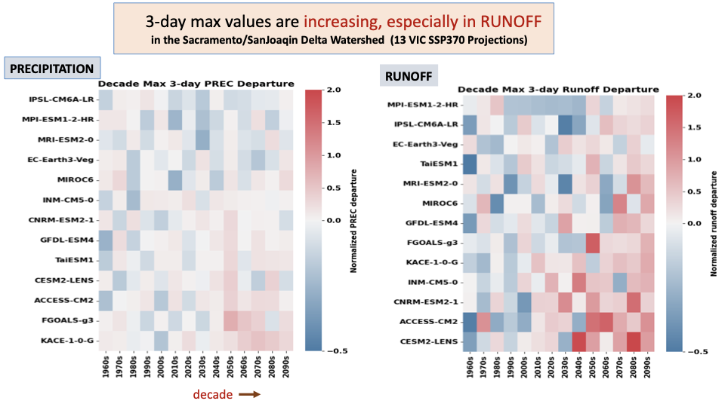
3-day max values are increasing, especially in Runoff
Lu Su

Slide 5
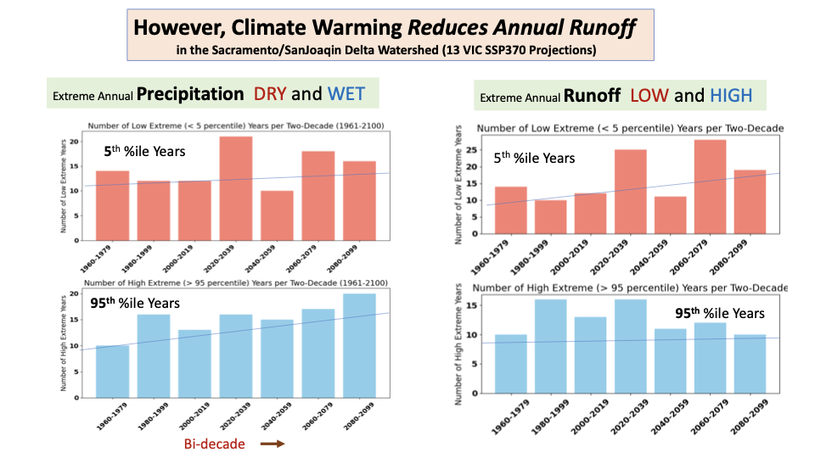
Climate warming is reducing annual runoff
Lu Su

Slide 6
Thank you!

