Slide 1

Opportunities for downscaled climate projections to support planning to the bulk grid reliability standard & role of weather extremes
Prepared by Mariko Geronimo Aydin and Onur Aydin
CEC C-DAWG Meeting
November 5, 2024

Slide 2
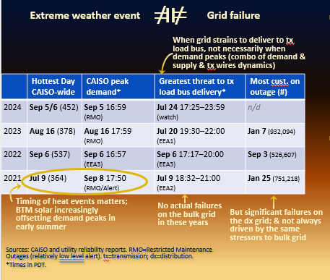
The impact of extreme weather on the grid’s ability to serve customers is complex
  To translate weather into grid failure risks, electricity system models need:
    Spatially-granular data, with hourly precision
    Time series data, across planning years
    Internally-consistent weather metrics, to understand dynamics among demand, supply, delivery
  Planning aims to balance risks vs. costs to ratepayers
    We don’t build for worst case (but do plan for it)
    Systematic over-mitigation, by even 1,000 MW, commits ratepayers to $Billions in procurements
    Most significant impact to ratepayers is in near- and mid-term procurements
Becoming more complicated w/ variable & energy-limited resources; needed for stochastic modeling; big reason planners stick with historical data
Notes:
EEA threats:
2024-fire on NoCal intertie, threatens imports
2023-high loads and temps (Jul 20 demand 1.6GW lower, renewable 2GW higher, storage 1 GW higher, but gen outages 2GW higher, imports 3GW lower, hydro slightly lower)
2022-high loads and temps
2021-loss of resources and transmission facilities due to fire
Cust on outage
2023-Atmospheric rivers
2022-Heat event
2021-Atmospheric rivers

Slide 3
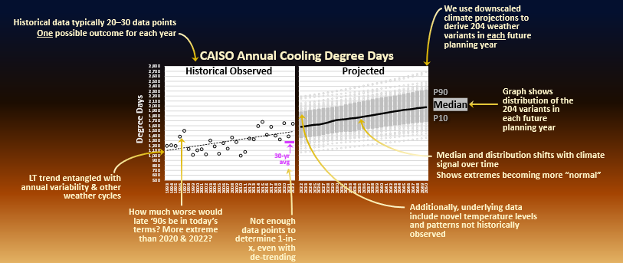
Weather extremes that cannot be well understood through actual historical outcomes and patterns are of most concern

Slide 4
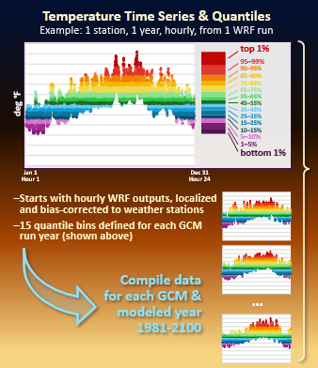
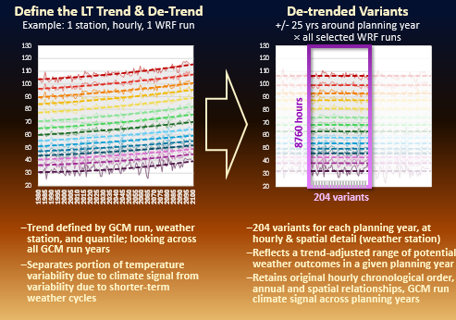
De-trending enables downscaled climate projections to inform a trajectory of potential weather outcomes across grid planning years

Slide 5
Thank you
Thank you
Learn more about WARP to Resilience and join our mailing list for study updates
www.lumenenergystrategy.com/resilience

Slide 6
Final slide
Notes:
Alt text:
Photo by Rene Böhmer on Unsplash.

