Slide 1
Quality Controlled Weather Data Archive Calibrated for California’s Electricity and Gas Sector
November 5, 2024
Dr. Victoria Ford
Eagle Rock Analytics, Inc.
Primary funding provided by
CEC (PIR-19-006)

Slide 2
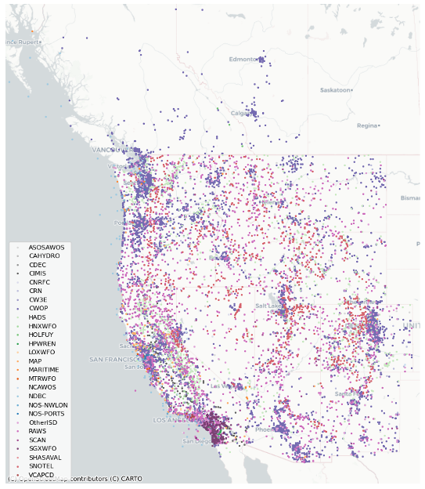
Need for a high-quality historical weather observations platform
Hourly weather station observations are critical inputs for many energy sector applications:
State priorities aligned with better climate information
Open and transparent QA/QC protocols calibrated for with extreme events in mind for CA + Western US
Data will be publicly accessible and applicable
No IOU weather stations included in v1
analytics.cal-adapt.org/
Notes:
16,079 weather stations spanning 1980 to 2022
Our data covers 27 different networks of 3.7 billion weather obs up to near real-time
Supporting energy needs: 73% coverage of at least one wind speed obs per station; 40% solar radiation coverage, drastic improvement over any one individual input network

Slide 3
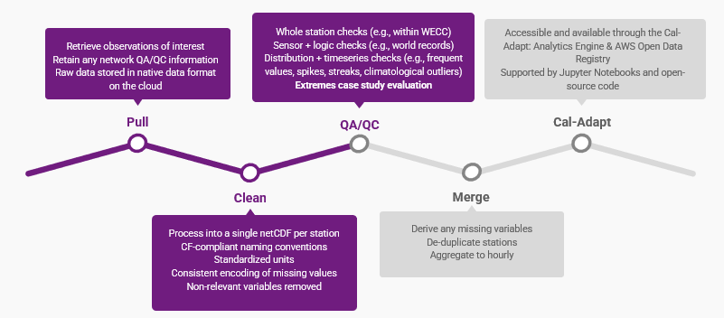
Need for a high-quality historical weather observations platform (2)

Slide 4
Events the electricity sector cares about
Extreme Heat
August 2020 Heatwave
September 2020 Heatwave
Labor Day 2022 Heatwave
Extreme Wind
February 1988 Santa Ana wind
October 2007 Santa Ana wind + wildfires
January 2011 offshore wind
Extreme Cold
December 1990 freeze & winter storm
Extreme Precipitation
January 2017 AR
January 2018 Montecito mudslide
Notes:
Identified from feedback from our stakeholder partners, IOUs, CPUC, CEC, CaISO

Slide 5
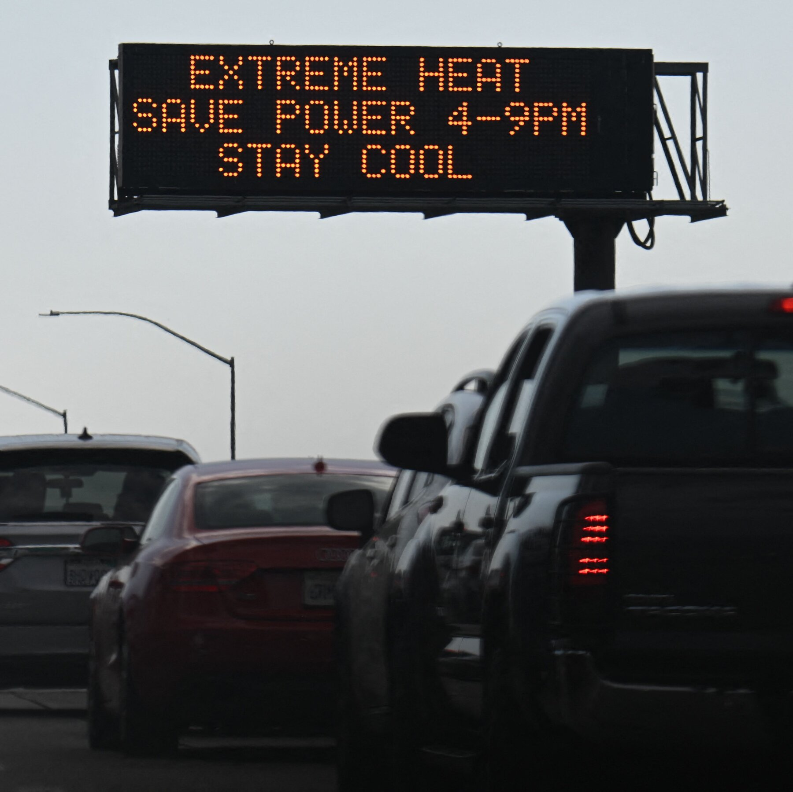
Extreme event implications for the energy sector
Extreme event implications for the energy sector
Extreme outliers may be sensor malfunctions or real meteorological events
Labor Day Heatwave 2022
Death Valley hit 127°F
Sacramento hit 116°F
San Francisco hit 97°F
Sept 2022 hottest on record for North America
CalOES
NYT

Slide 6
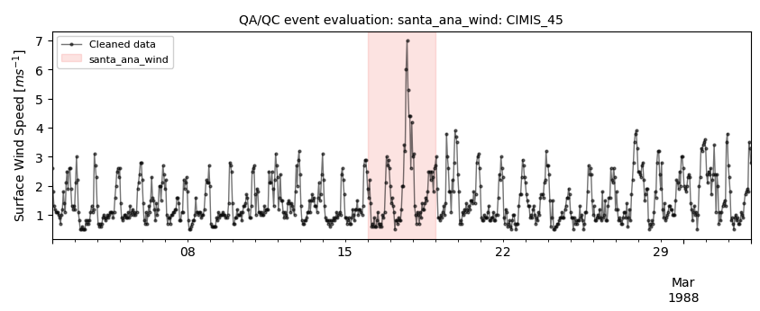
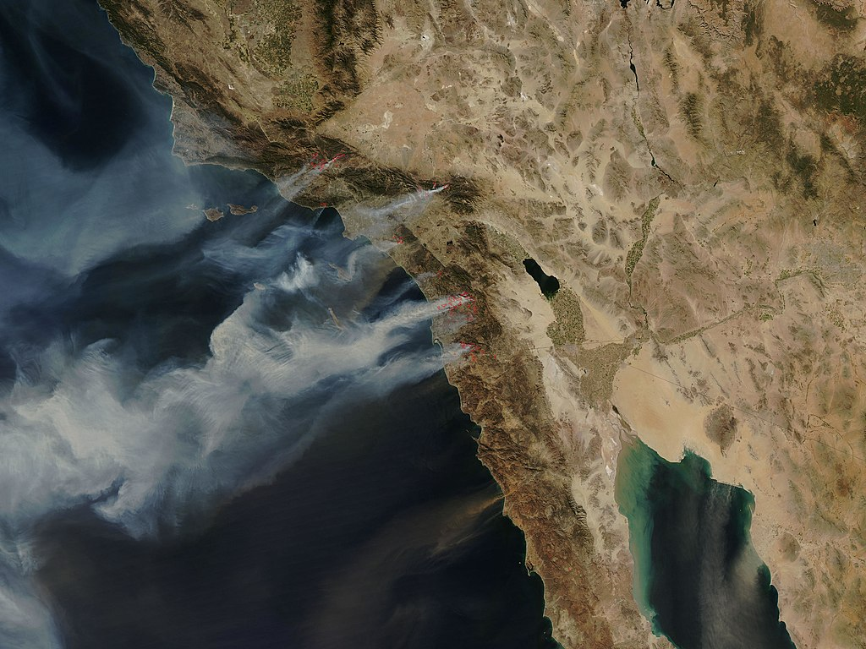
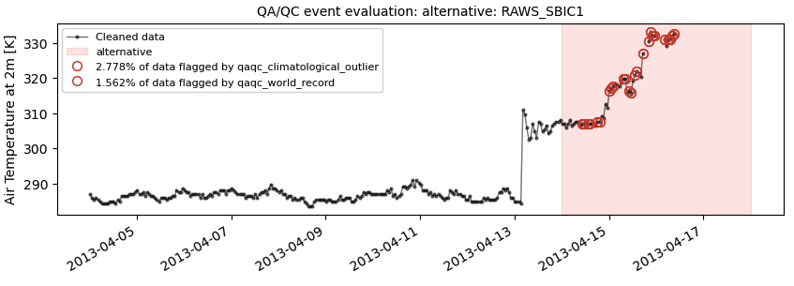
Event evaluations
NASA
No observations flagged!
Santa Ana wind event captured well
135°F
Flagged data to resolve
Global record check
Climatological outliers
Notes:
GHCNh - global historical climatology network hourly – next generation of hourly synoptic data that replaces the ISD (integrated surface dataset)

Slide 7
Extreme event implications for the energy sector (2)
Data with purpose
Calibrated for CA energy sector through weather extremes
Open and transparent
Code, data, methods, pipeline
Data access
Cal-Adapt: Analytics Engine
Cal-Adapt: Data Explorer
AWS Open Data Registry

Slide 8
Questions? Feedback?
Contact us:
owen@eaglerockanalytics.com
victoria@eaglerockanalytics.com

