Slide 1
PIR-19-007 Historical Downscaled Reanalysis
PIR-19-007 Historical Downscaled Reanalysis
Development of a recent history of high resolution weather and climate for California
Objectives
Use WRF models to produce high-res (6km, 2km, hourly) atmospheric DRY and WET reanalyses 1981-2021.
parent global reanalyses: DRY: NWS FNL, ERA5 interim WET: ERA5 ( 1982 – 2022 )
“Dry” downscaled reanalysis will inform fire and smoke management community (DRI CEFA).
Using WET meteorological variables to drive VIC hydrologic model, produce associated hydrologic variables
over California and surrounds.
Validate modeled results against available observations.
Investigate extreme events, investigate multi-decade trends.
Distribute and explain datasets.
Provide appropriate weather/climate variables at partner sites and at SIO and DRI.
“Wet” and “Dry” because WRF is known to require tuning to best capture certain phenomena:
“Dry” reanalysis configured for wildfire and smoke impacts meteorology).
“Wet” reanalysis configured for atmospheric rivers and other California-important meteorological phenomena

Slide 2
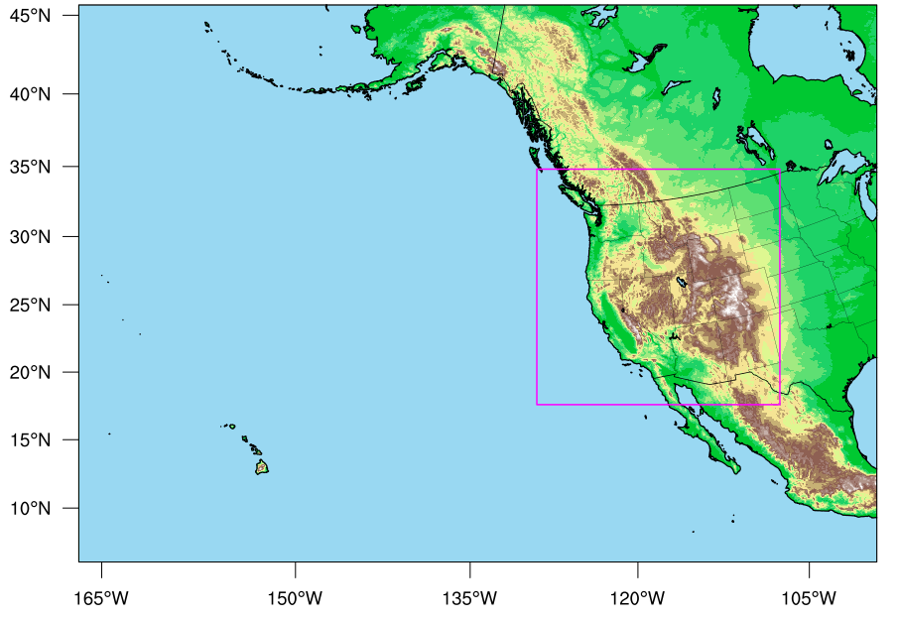
WET REANALYSIS West-WRF domain and model settings
from satellite era period (1981-near current)
Input fields:
ERA5 (0.25º)
ERA5 Land (initial soil and surface fields, 0.1º)
OSTIA SST and sea ice (0.1º)
Each year (Sept-Sept) run in parallel
6-km and 2-km simulations and domains
Very large 6-km: 1390x971 = 1,349,690 grid cells
Westwide 2-km: 1270x1231 = 1,563,370 grid cells
Hourly output for each of 2km and 6km domains 11Gb full (6 and 2km), 1.7Gb postprocessed
Output (41yrs, ultimately) 359,406 hrs ~2Pb full ~290Tb post processed
79 vertical levels, 12 below 1000m
6-km
2-km

Slide 3
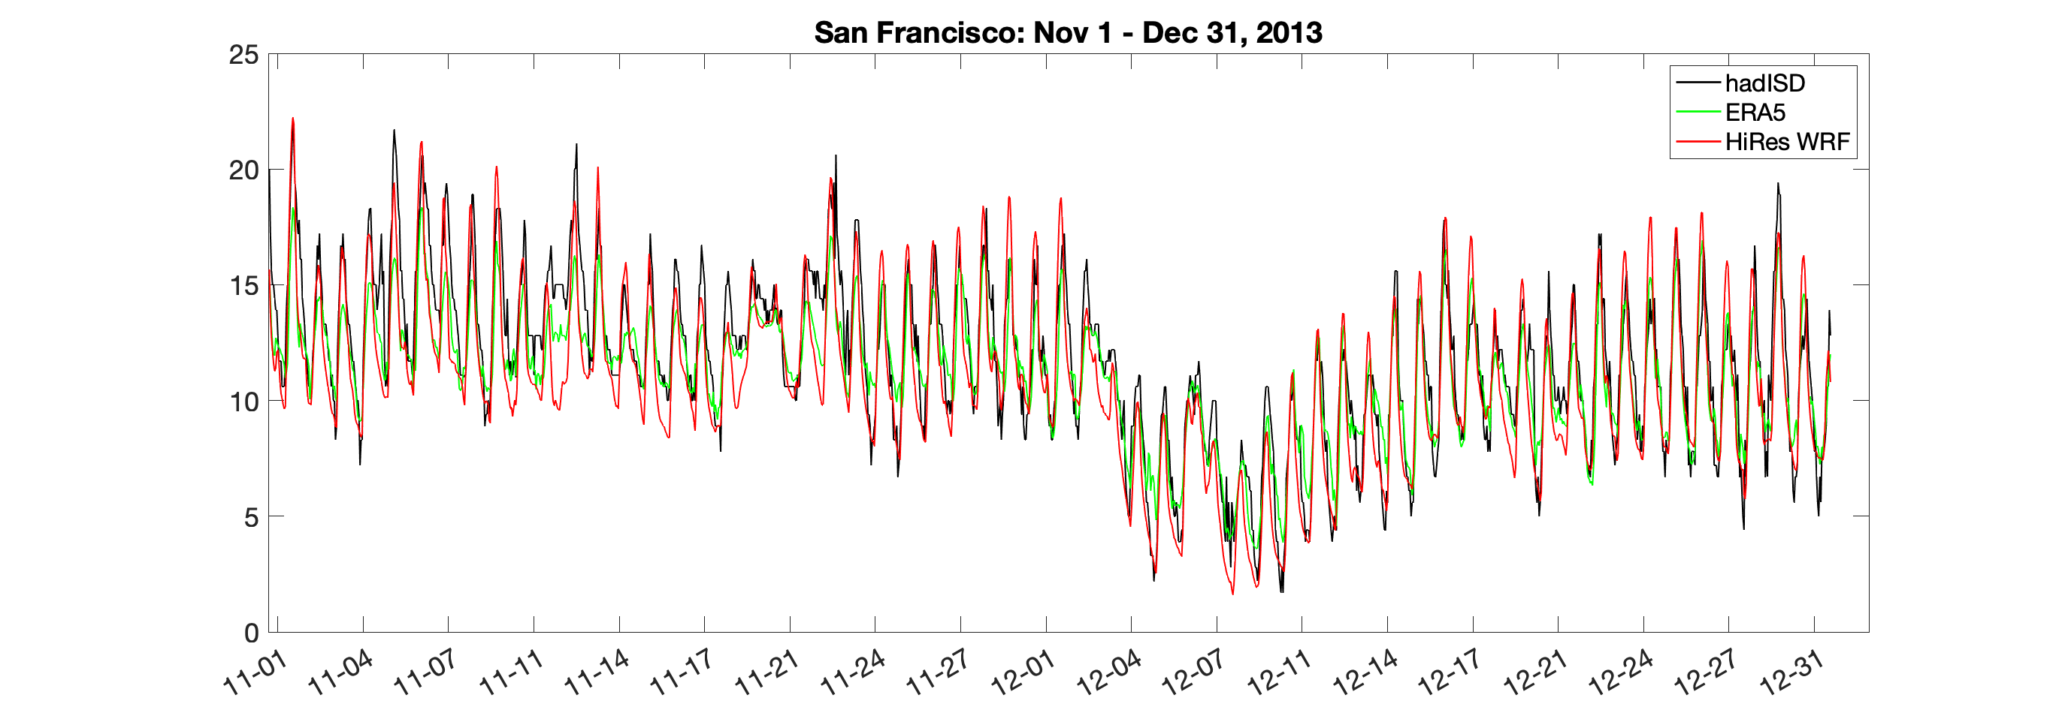
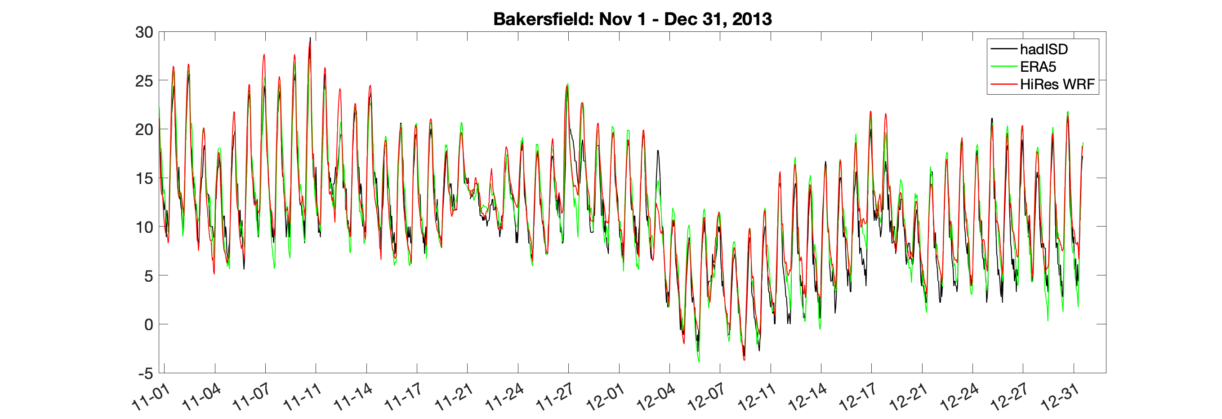
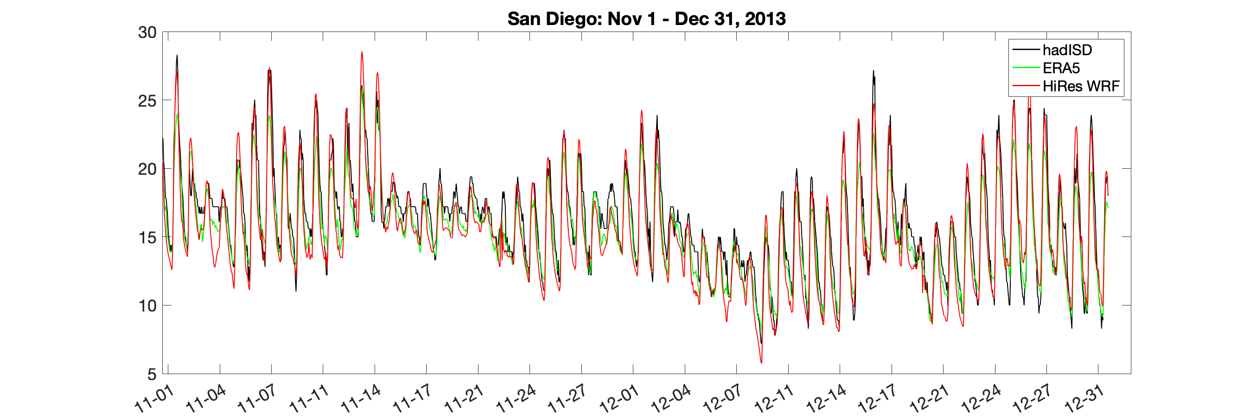
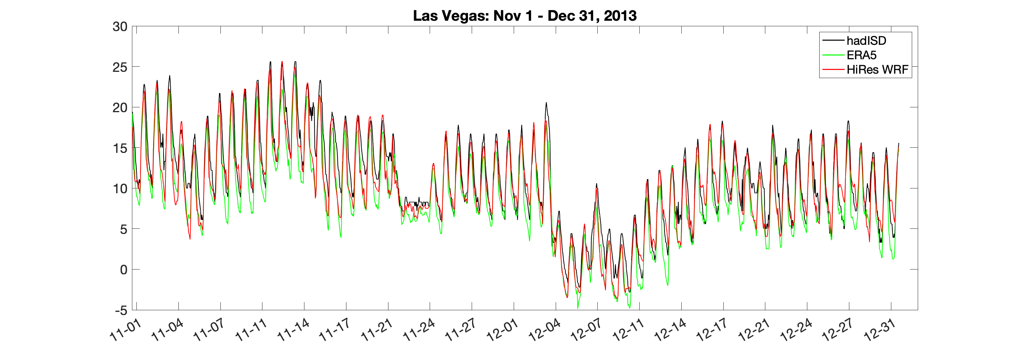
Hourly Temperatures during December 2013 Cold Outbreak
San Francisco
Bakersfield
December 2013
cold snap
San Diego
Las Vegas

Slide 4
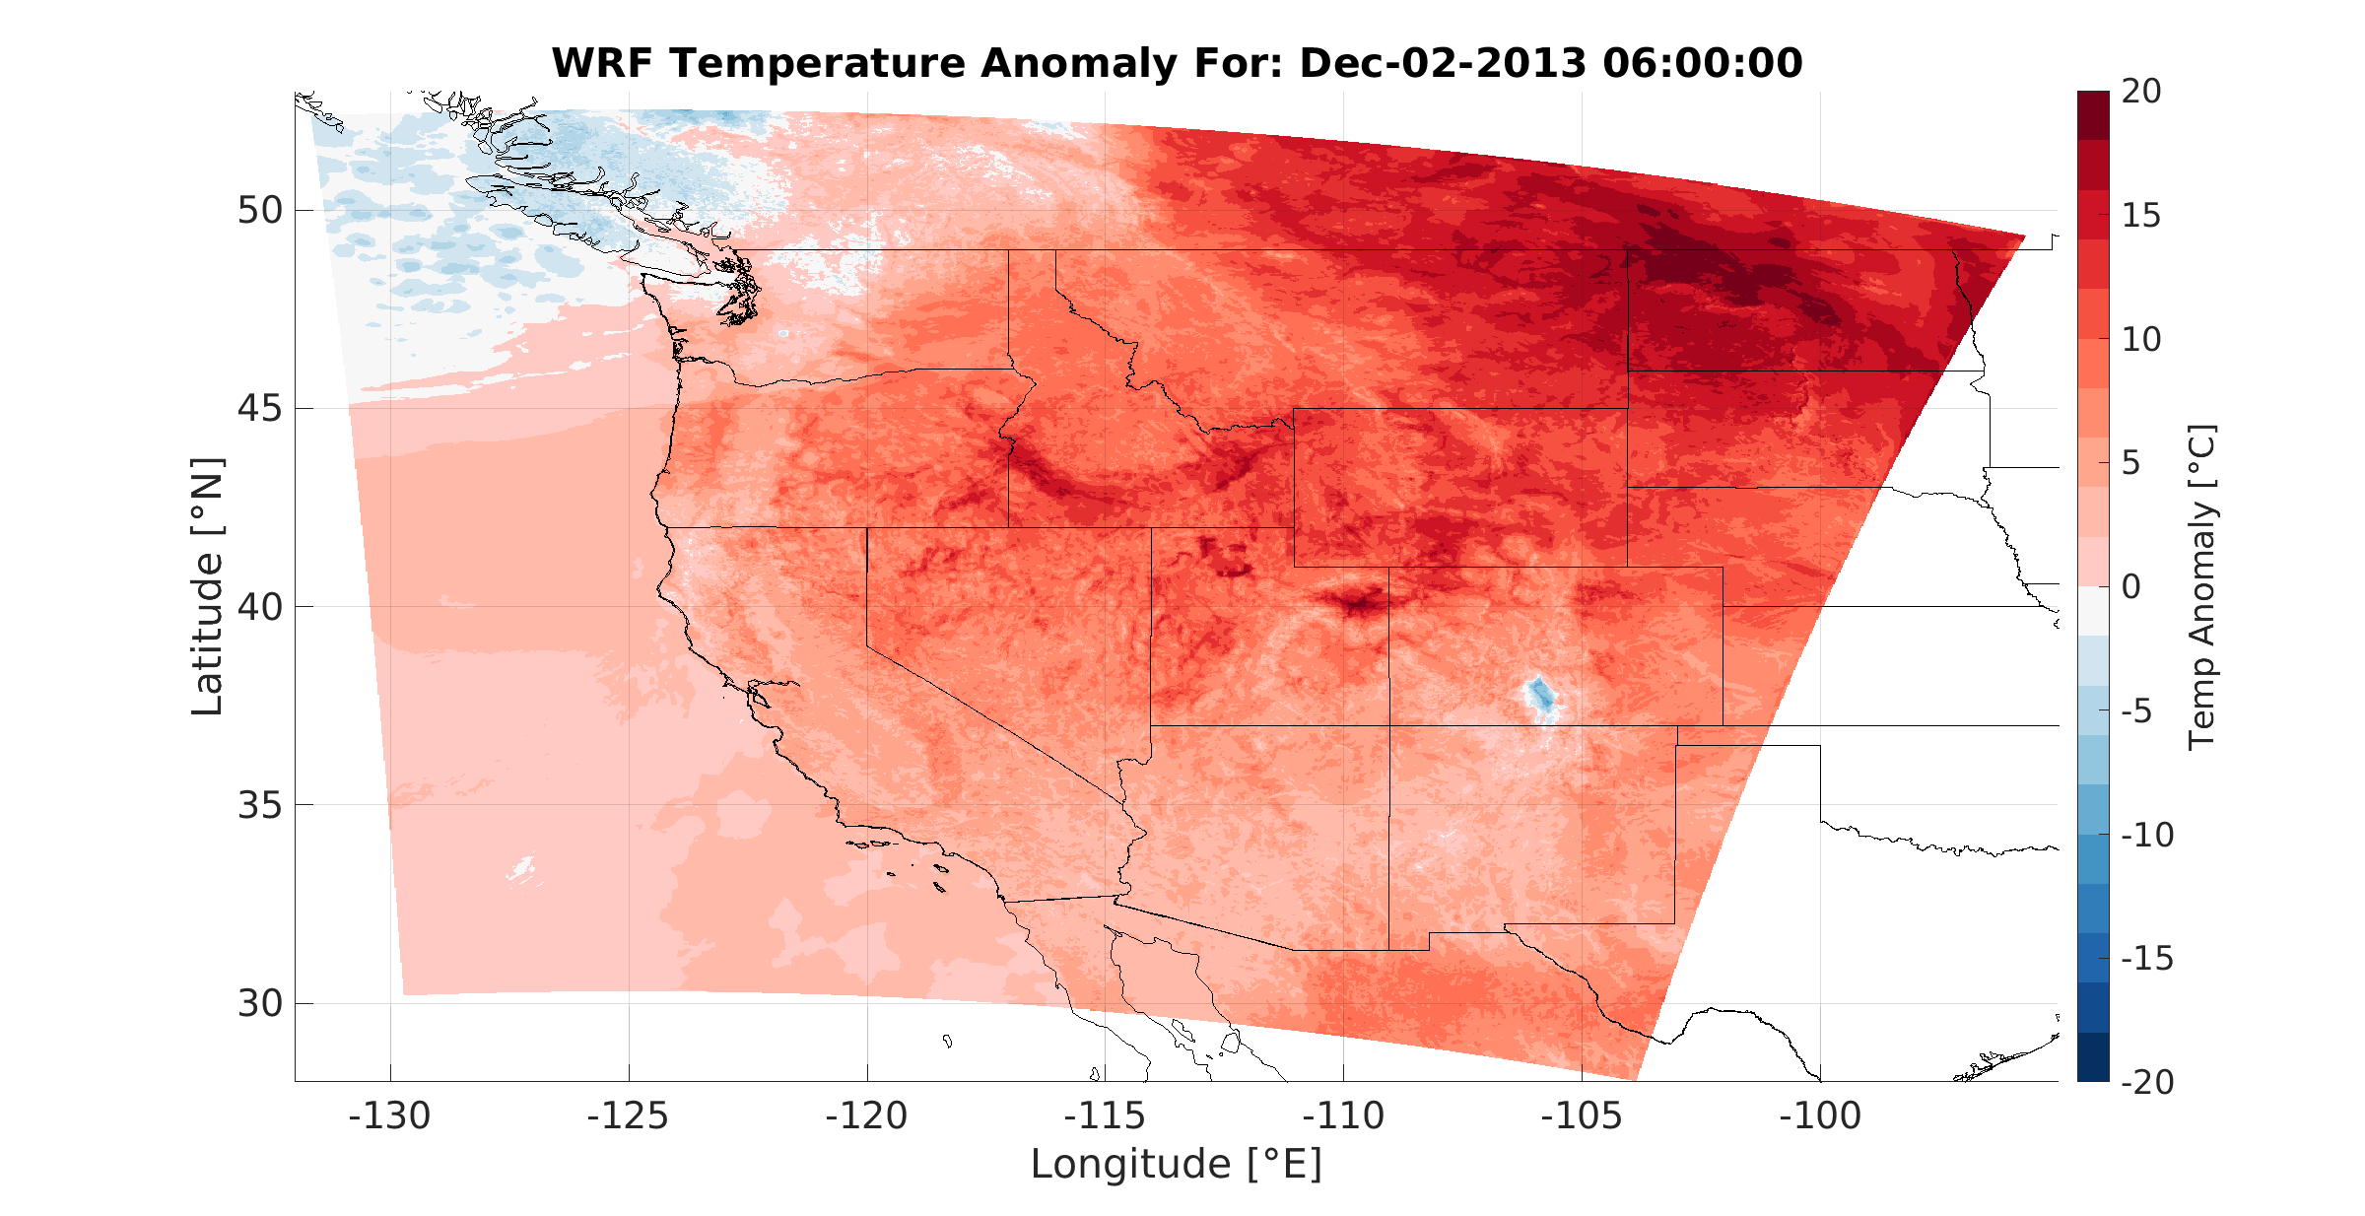
Development of December 2013 Cold Snap
“Anomaly” is departure of daily 06:00 PST temperature
from December 2013 06:00 mean 6km WRF

Slide 5
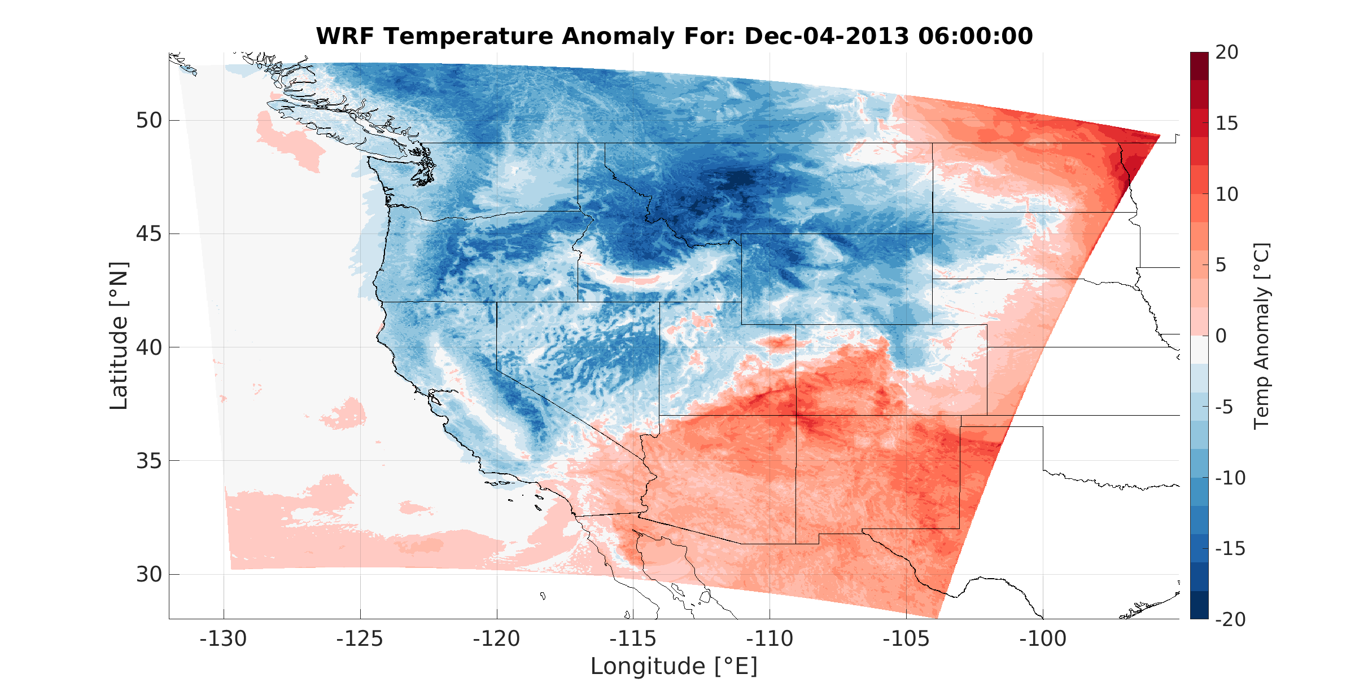
WRF Temperature Anomaly for December 4, 2013 6:00:00

Slide 6
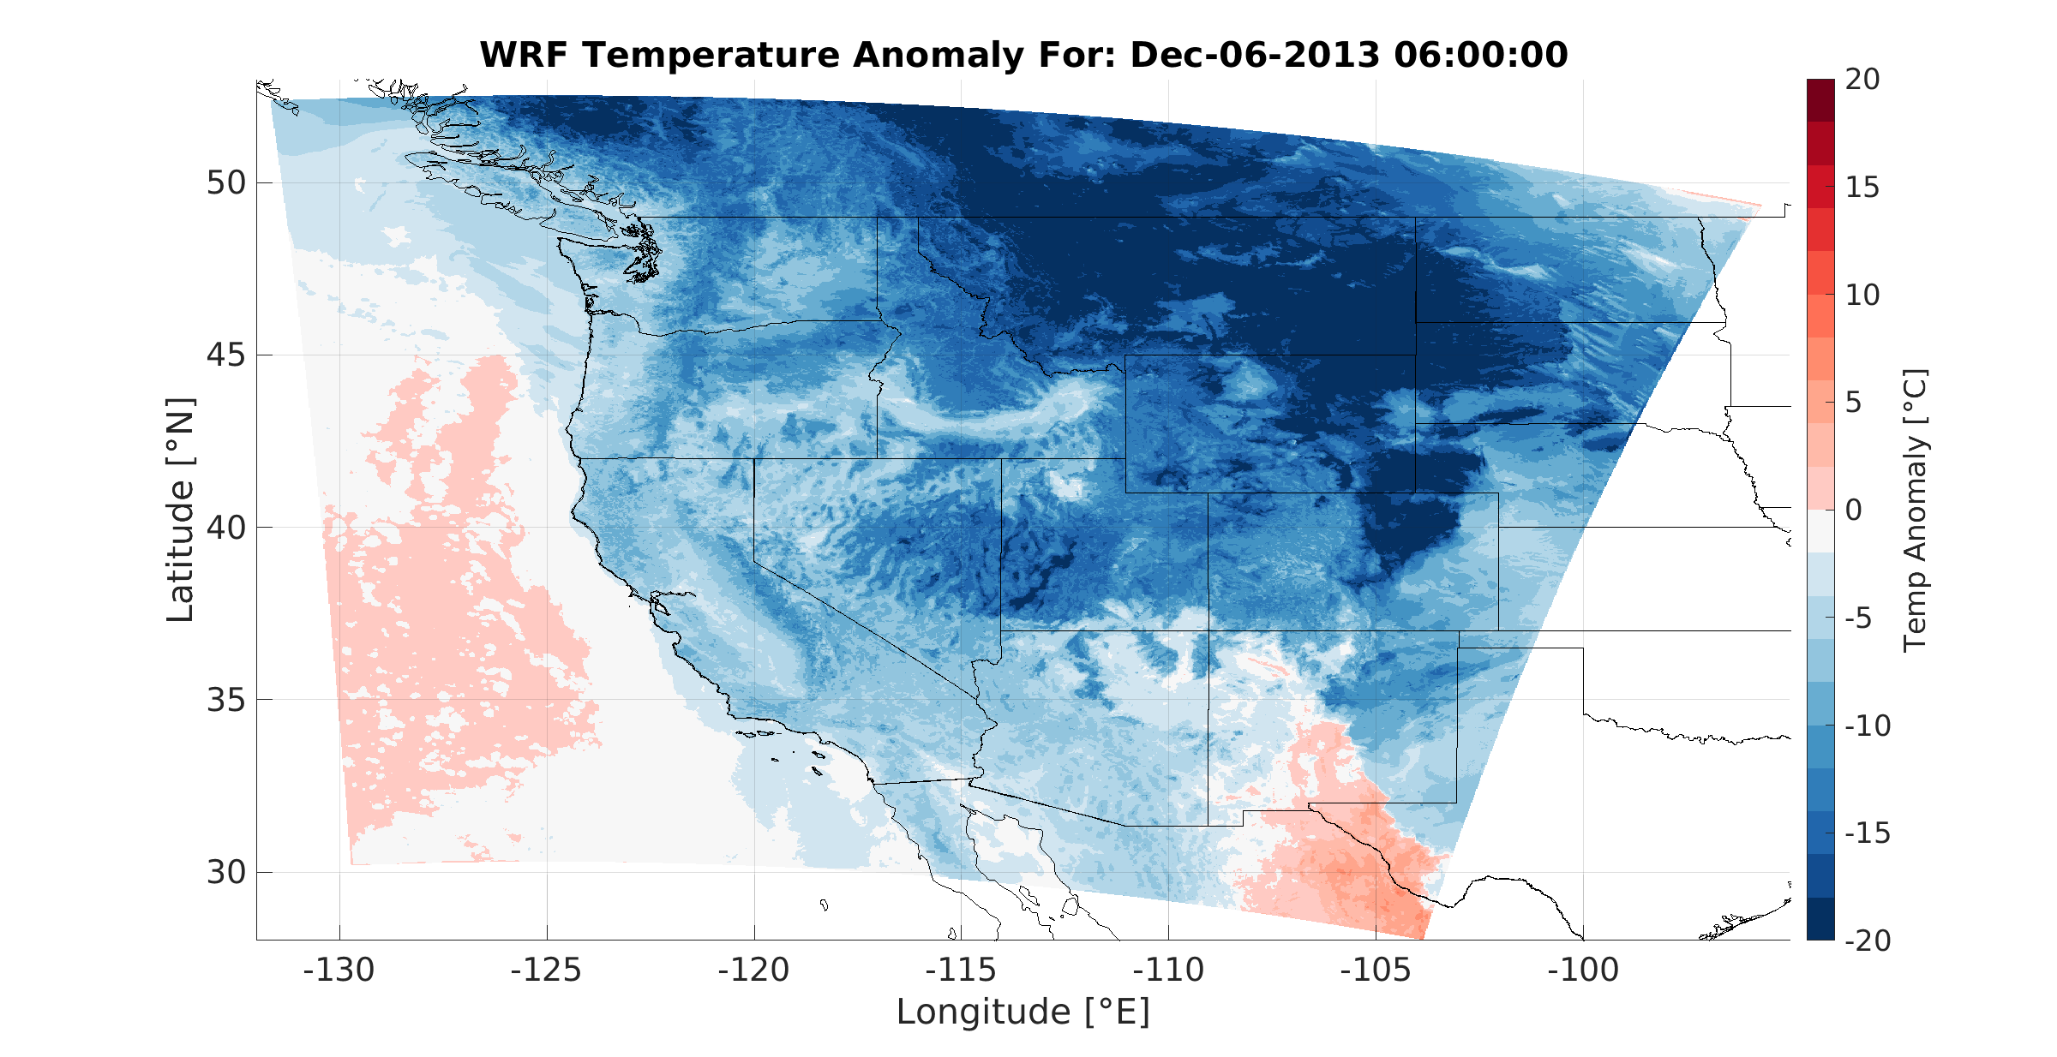
WRF Temperature Anomaly for Dec 6, 2013 6:00:00

Slide 7
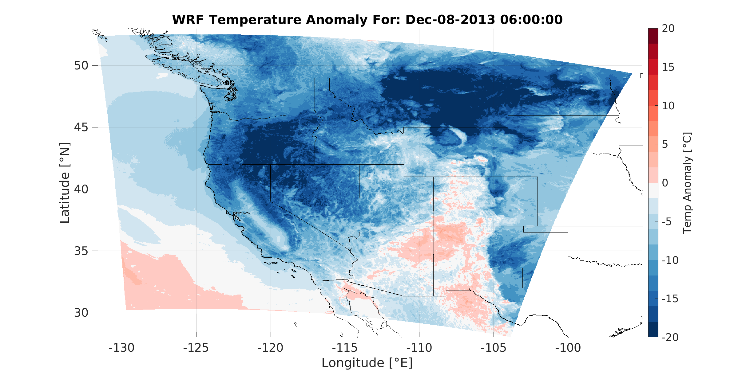
WRF Temperature Anomaly for Dec 8, 2013 6:00:00

Slide 8
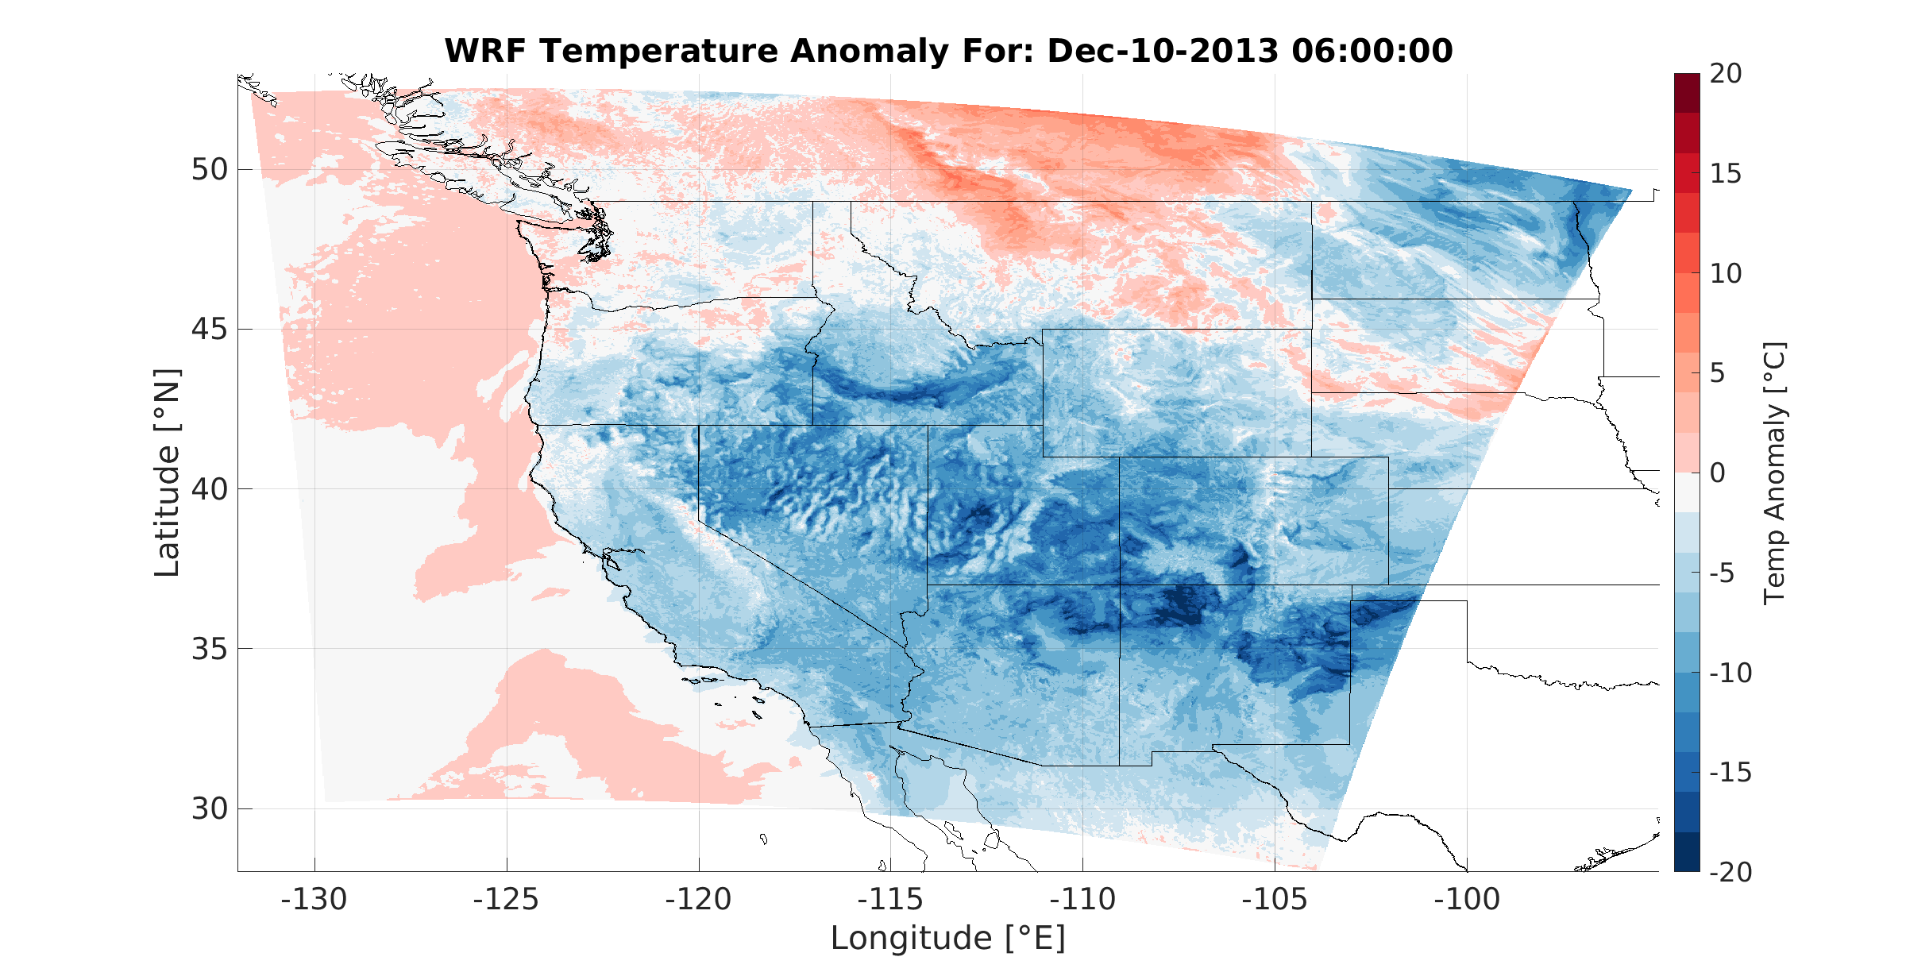
WRF Temperature Anomaly for Dec 10, 2013 6:00:00

Slide 9
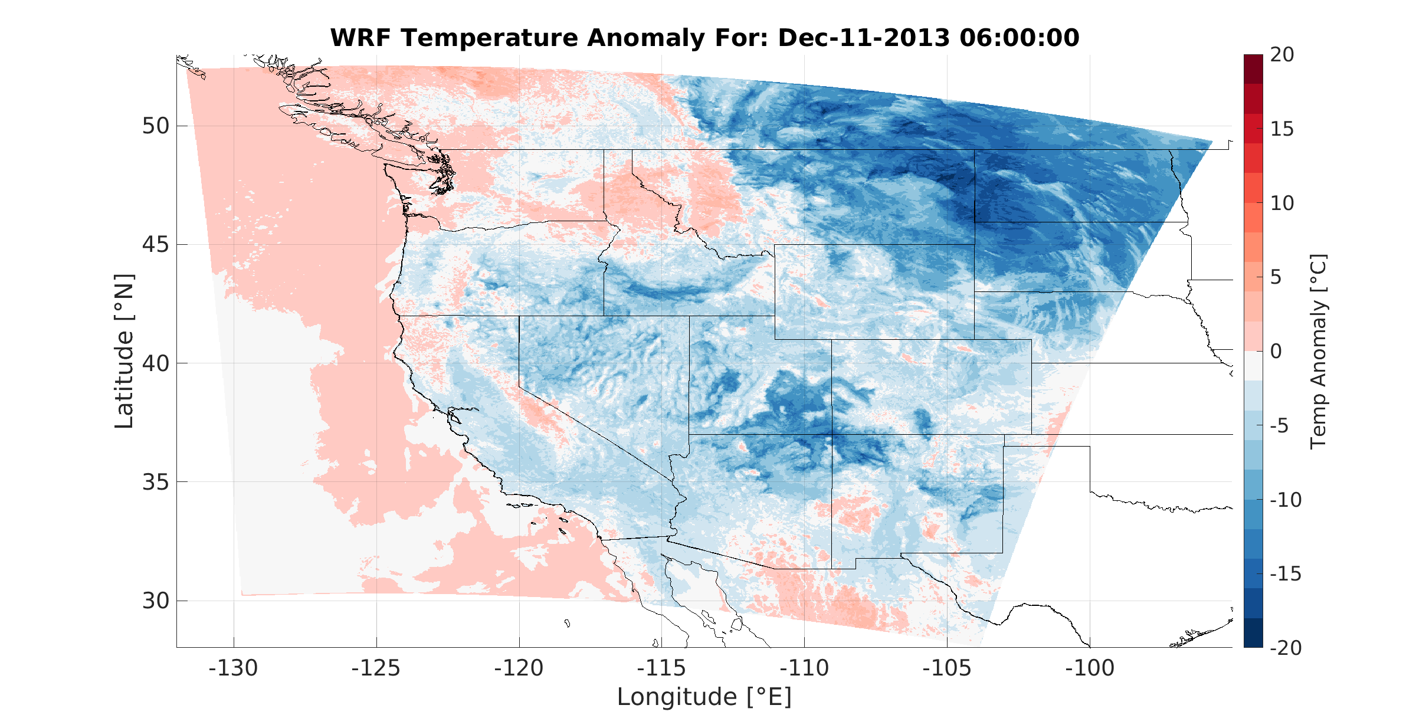
WRF Temperature Anomaly for Dec 11, 2013 6:00:00

Slide 10
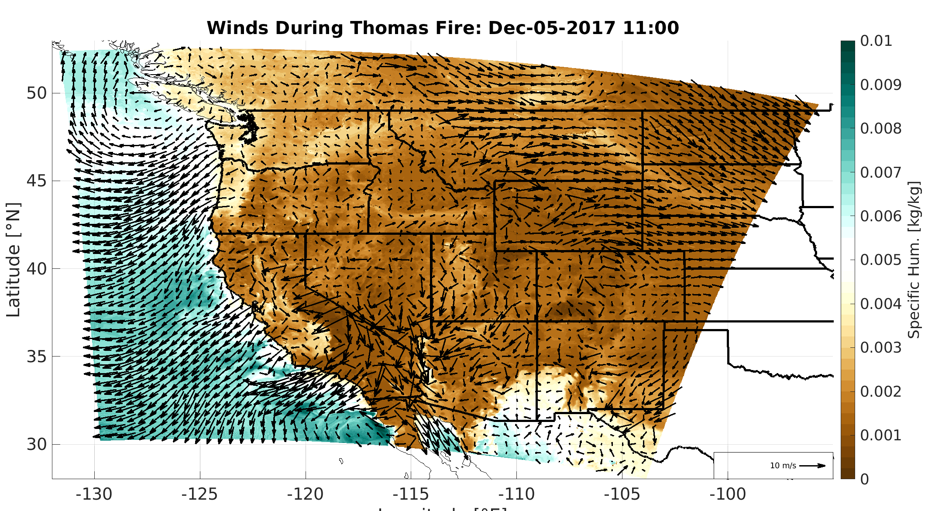
Winds during Thomas Fire: Dec 5, 2017 11:00

Slide 11
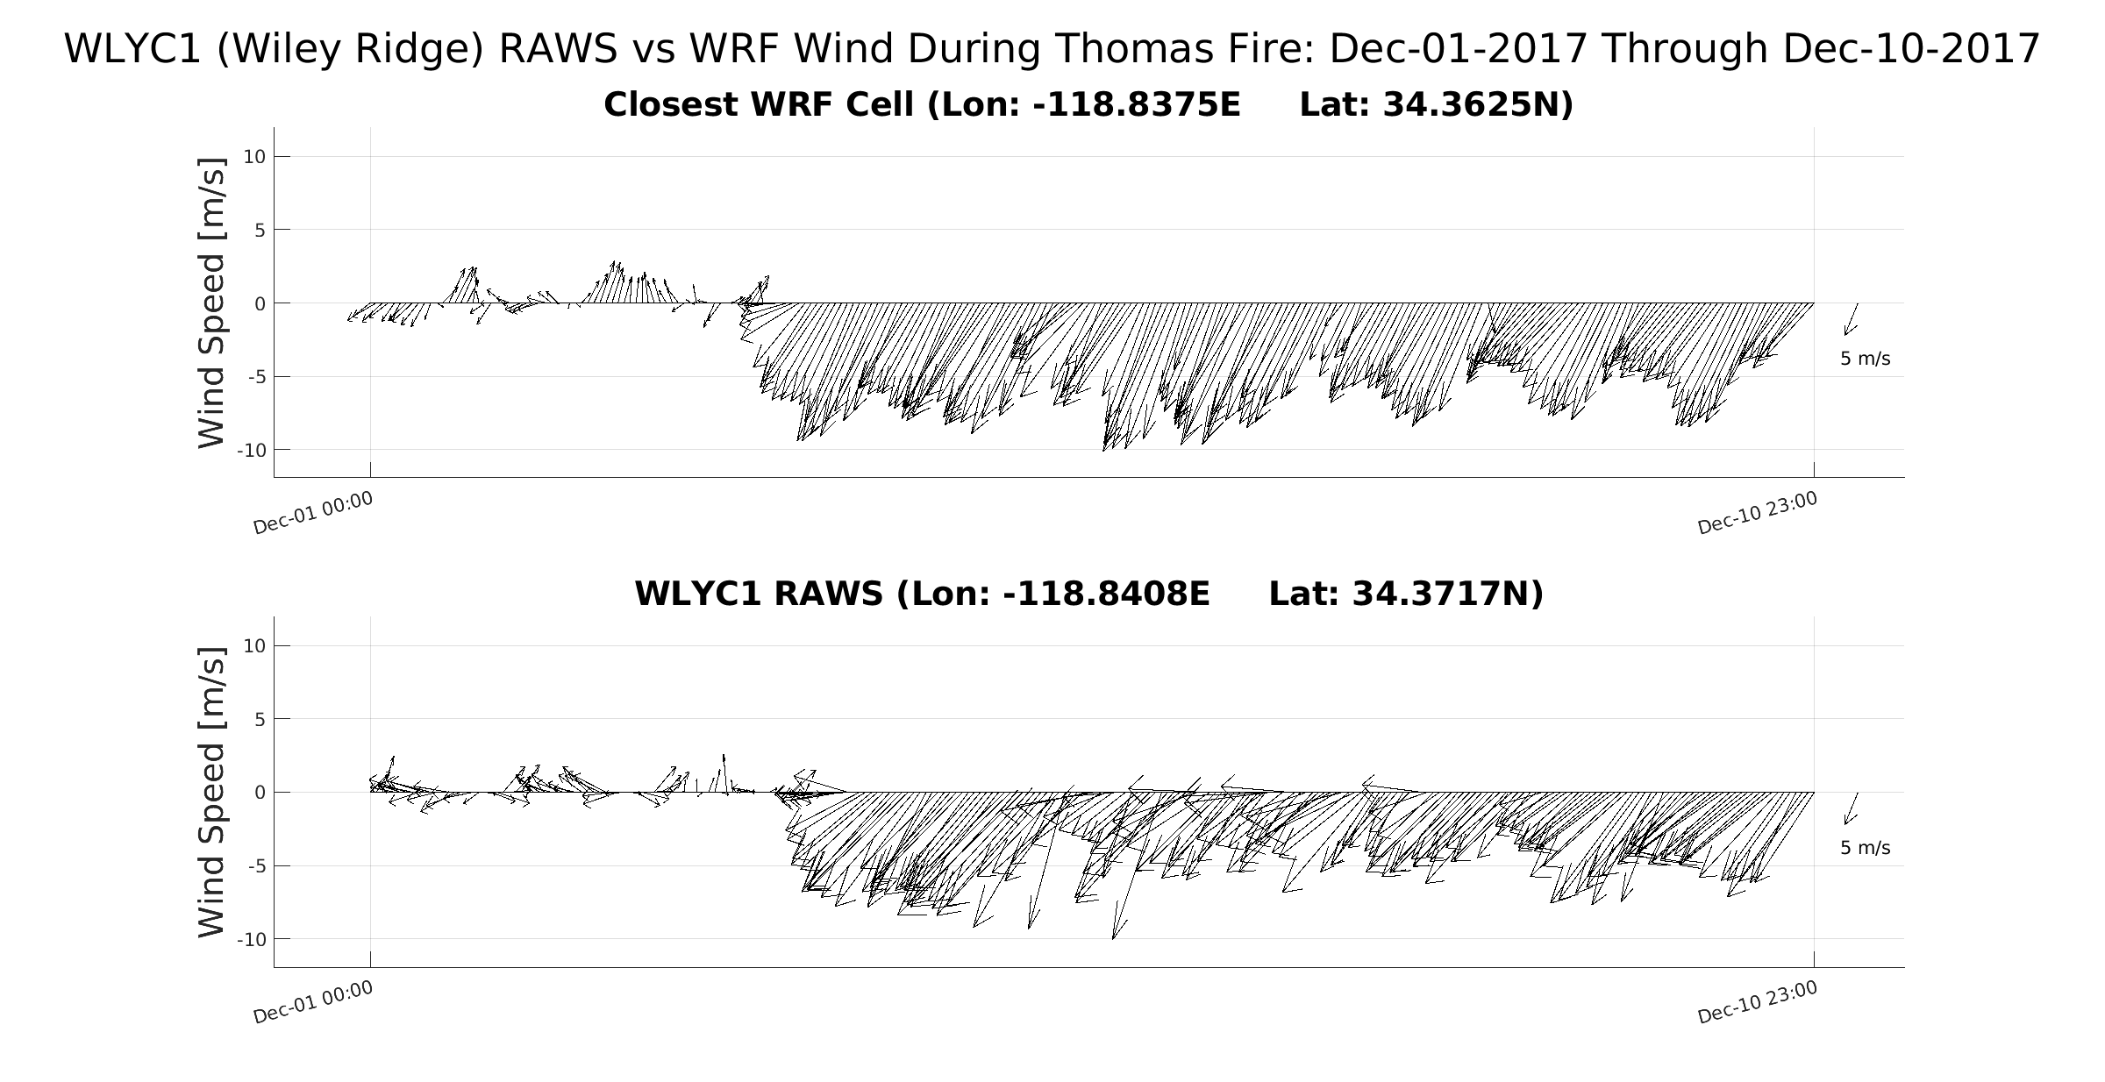
Hourly Winds during Thomas Fire
2km wet-WRF winds 10m elevation
RAWS winds 6.1m
WRF 2km
Dec 5
RAWS obs
Dec 5

Slide 12
“Dry” WRF Reanalysis -- runs completed, bias corrections ongoing
“Wet” WRF Reanalysis -- runs in progress, validations ongoing

Slide 13
Commonly used data subset for WET reanalysis
WET reanalysis commonly used data subset
All variables are output hourly
3-dimensional variables (*) are output on 8 standard pressure levels from 1000-200
Precipitation and Moisture
precipitation
specific humidity* (including 2m)
relative humidity (2m)
soil moisture
evaporation (AET)
CAPE & CIN (convective inhibition)
integrated vapor transport (U&V components & IWV)
total precipitable water
Temperature
air temp* (including 2m)
dew point temp
sea surface temp
freezing level
Clouds and Boundary Layer
albedo (ToA, clear sky & surface)
boundary layer height
cloud water mixing ratio (3 levels)
cloud water path & cloud fraction
cloud top temperature
lifting condensation level
longwave up & shortwave down (direct & diffuse) irradiance
low cloud TKE
inversion properties (top & base height, and strength)
Wind
instantaneous* (including 10, 80, 120 & 150m)
+ 6 low-level eta levels
speed & direction at 10m, gust estimate
vertical velocity at selected levels
Basic Meteorology
geopotential height* (+ 6 low-level eta levels)
surface pressure
sea level pressure
latent and sensible heat flux

Slide 14
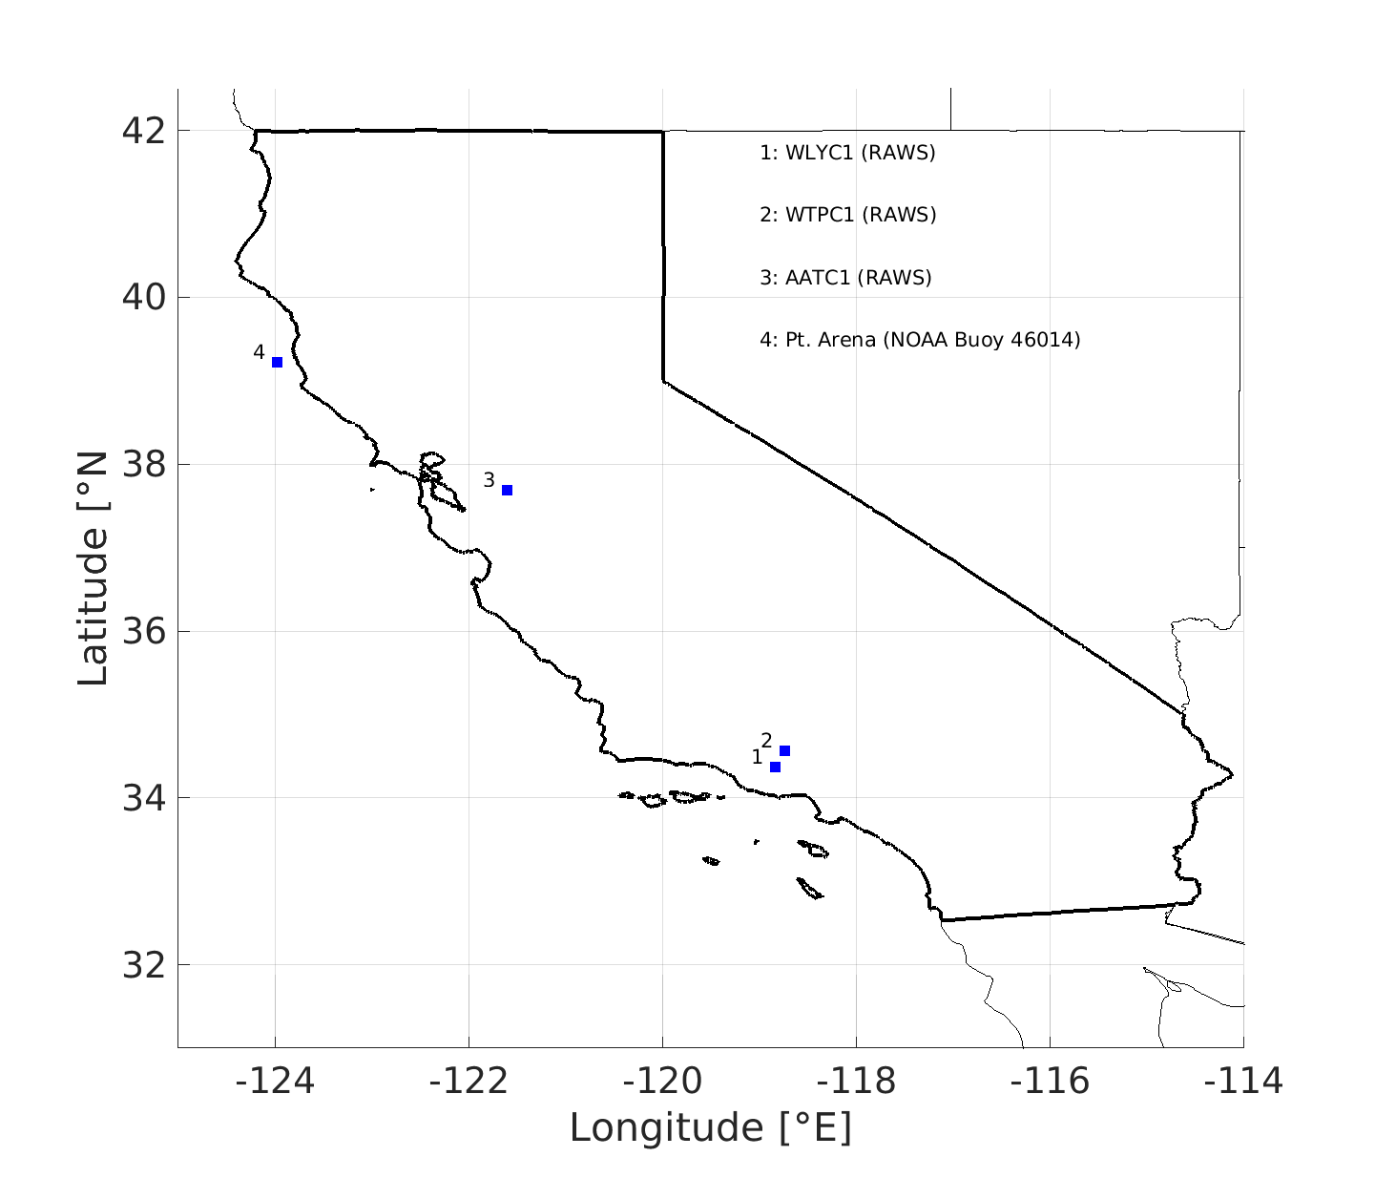
Locations of observation stations
Pt Arena
NDBO Buoy
Altamont Pass
RAWS
Wyley Ridge
RAWS

