Slide 1
Title 24 Energy Code Weather Files

Slide 2
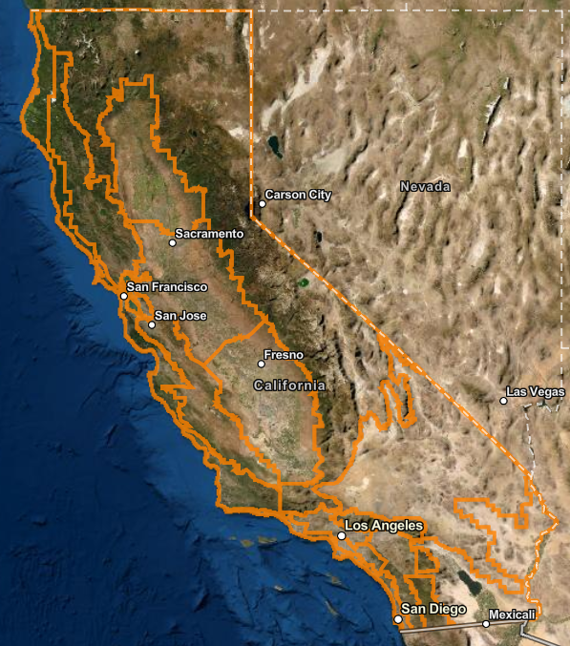
Background
Weather files are used for all energy calculations in Energy Code development
Weather is a component of Long-term System cost (LSC)
Present value of costs to California’s energy systems over a period of 30 years
Energy Budget used for Title 24 compliance and code development

Slide 3
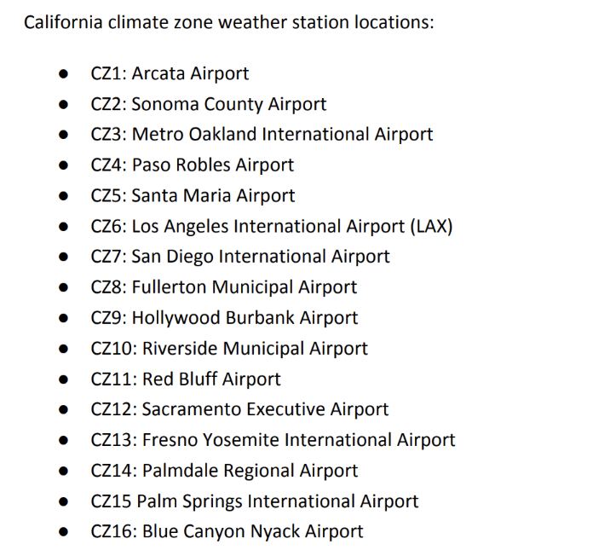
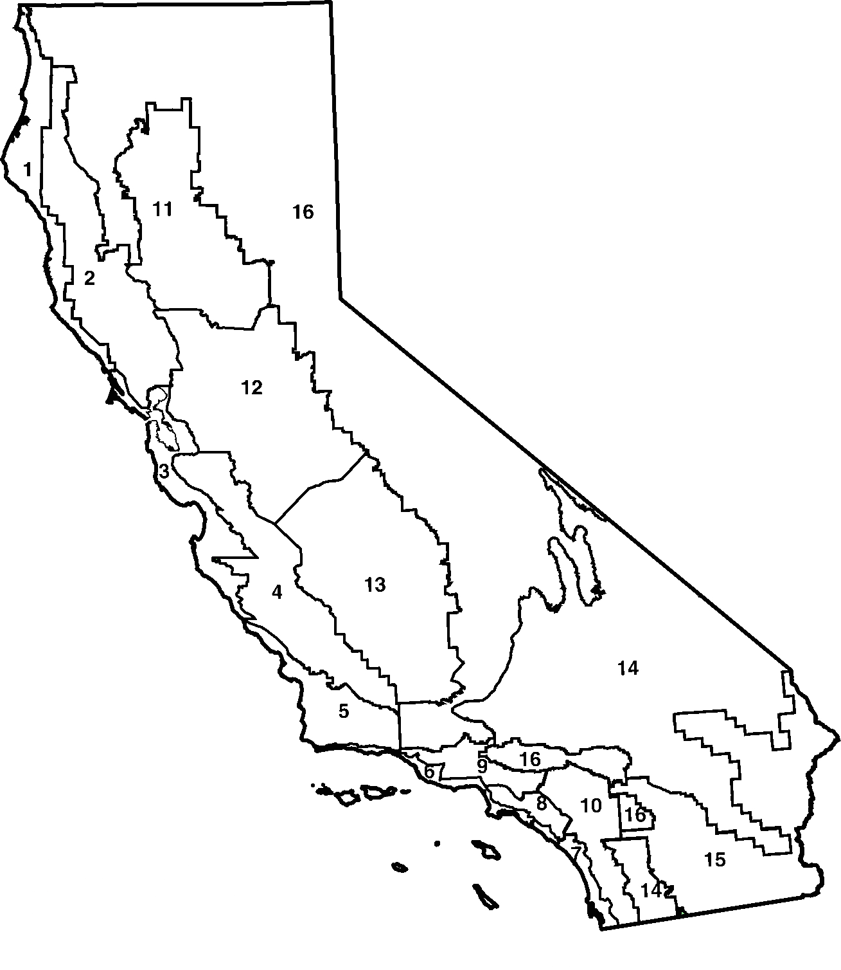
California Climate Zones
Notes:
Source: Weather Files and Climactic Data for 2025 Standards, April 6, 2023, Energy Solutions

Slide 4
Basics of TMY used for the Energy Code - I
Typical Meteorological Year (TMY)
Weather data selection method developed by NREL.
Elements of selection includes global horizontal insolation, direct normal insolation, dry bulb temp, dew point, and wind speed
2025 Energy Code used 2000-2020
Statewide TMY
Selection of TMY is based on most representative statewide rather than a location
Using a statewide TMY allows development of weather-correlated electricity market price shapes
Notes:
Source for approach for developing weather-correlated electricity prices: Time Dependent Valuation of Energy for Developing Building Efficiency Standards, 2013 Time Dependent Valuation (TDV) Data Sources and Inputs, February 2011, E3.

Slide 5
Basics of TMY used for the Energy Code - II
Hourly data is used to evaluate a statewide Finkelstein-Shafer statistic for each month of each year
For each weather station:
Evaluate each index for each month for 21 years
Calculate 21-year cumulative frequency distribution (CDF) of each index
Compare each year’s CDF vs. 21-year CDF through Finkelstein-Shafer statistic
Calculate a weighted sum of all FS statistics for each index
To develop a state-wide FS statistic, calculate a population-weighted sum of FS for all stations
Notes:
Meteorological data are provided by NOAA’s Integrated Surface Database (ISD) while solar data are
provided from NREL’s National Solar Radiation Database (NSRDB) Physical Solar Model (PSM) version 3.

Slide 6
Weights for different weather components
Notes:
Source: Weather Files and Climactic Data for 2025 Standards, April 6, 2023, Energy Solutions

Slide 7
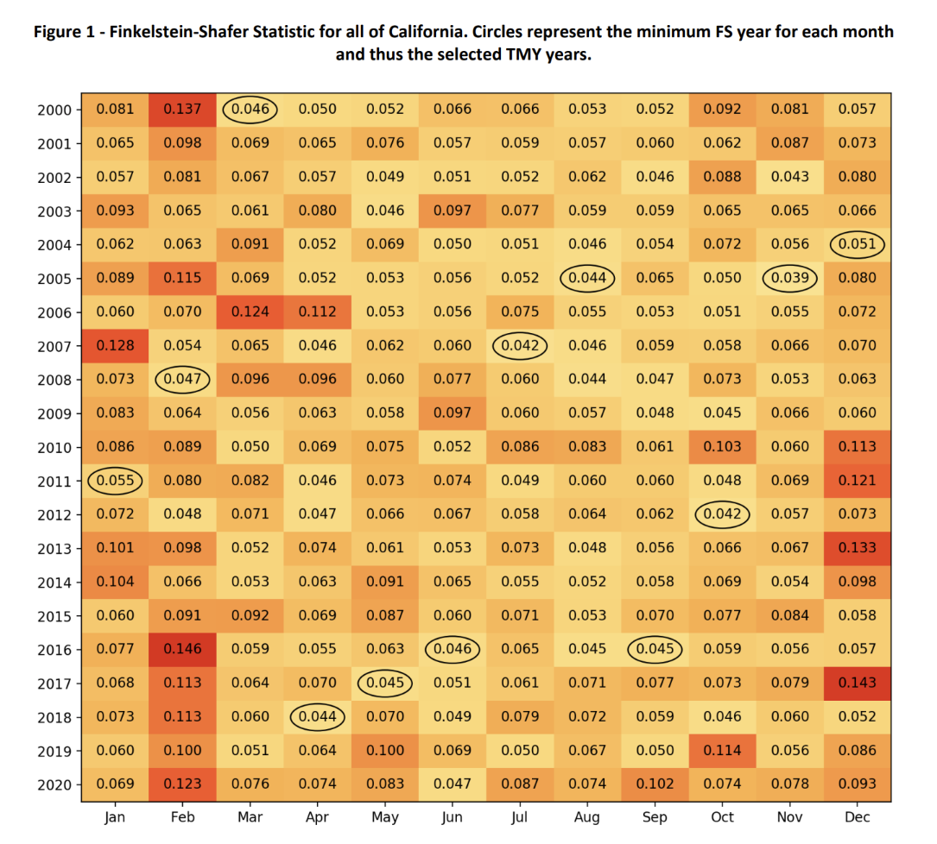
Minimum Finkelstein-Shafer statistic drives TMY month selection
Notes:
Source: Weather Files and Climactic Data for 2025 Standards, April 6, 2023, Energy Solutions

Slide 8
Each month in TMY is derived from a historical year
Month | 2022 TMY (1998-2017) | 2025 TMY (2000-2020)
1 | 2004 | 2011
2 | 2008 | 2008
3 | 2014 | 2000
4 | 2011 | 2018
5 | 2017 | 2017
6 | 2013 | 2016
7 | 2011 | 2007
8 | 2008 | 2005
9 | 2006 | 2016
10 | 2012 | 2012
11 | 2005 | 2005
12 | 2004 | 2004
Red represents different year selected for the month
July and August were based on relatively cool historical years
Notes:
Source: Slide 55, https://efiling.energy.ca.gov/GetDocument.aspx?tn=244139&DocumentContentId=78046

Slide 9
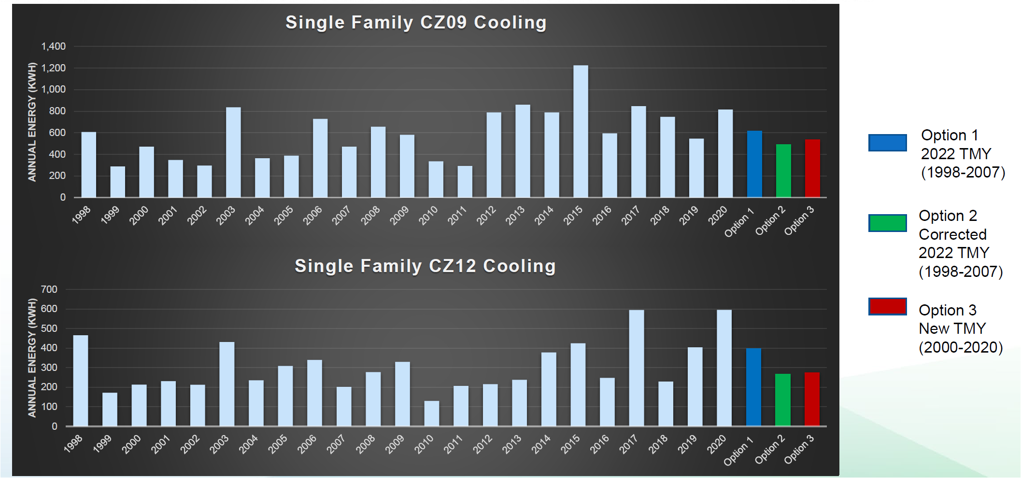
Cooling loads for SF prototype in Burbank, Sacramento
Burbank
Sacramento
Option 3 was used for 2025
Results for 2,700 sf SF prototype, all electric, no whole house fan
August
July
TMY 2025
Notes:
Source: Slide 57, https://efiling.energy.ca.gov/GetDocument.aspx?tn=244139&DocumentContentId=78046

Slide 10
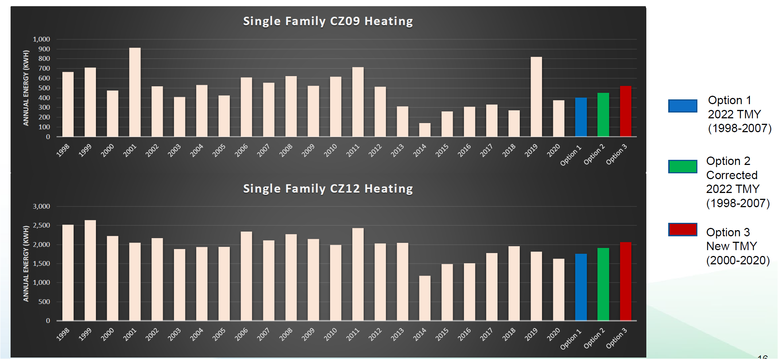
Heating loads for SF prototype in Burbank, Sacramento
Burbank
Sacramento
Results for 2,700 sf SF prototype, all electric, no whole house fan
Notes:
Source: Slide 58, https://efiling.energy.ca.gov/GetDocument.aspx?tn=244139&DocumentContentId=78046

Slide 11
Weather Files for the 2028 Energy Code
Staff is evaluating forward looking weather files base on projected climate impact over the next 30 years.
The CEC Cal-Adapt project provides estimates of future weather that can be the basis of the new files
Public workshop first half of 2025

