Slide 1
GFO-24-306 Pre-Application Workshop
Applications of Open Data to Support Climate Resilience in California’s Electricity Sector
Energy Research and Development Division
Date: February 13, 2025

Slide 2
Agenda
Time | Item
10:00 am | Welcome and Introduction
10:05 am | Solicitation Background EPIC Research Program Purpose of Solicitation Available Funding
10:25 am | Application Requirements Project Group Requirements Attachments Submission Process Evaluation Process
11:00 am | Q&As
12:00 pm | Adjourn

Slide 3
Housekeeping
This workshop will be recorded and posted to the CEC website.
Attendees will be muted during the presentation. Please chat your question using the Q&A window.
Updates to solicitation documents will be posted at the Grant Funding Opportunity’s webpage: https://www.energy.ca.gov/solicitations/2025-01/gfo-24-306-applications-open-data-support-climate-resilience-californias?utm_medium=email&utm_source=govdelivery

Slide 4
Commitment to Diversity
The Energy Commission adopted a resolution strengthening its commitment to diversity in our funding programs. The CEC continues to encourage disadvantaged and underrepresented businesses and communities to engage in and benefit from our many programs.
To meet this commitment, Energy Commission staff conducts outreach efforts and activities to:
Engage with disadvantaged and underrepresented groups throughout the state.
Notify potential new applicants about the Energy Commission’s funding opportunities.
Assist applicants in understanding how to apply for funding from the Energy Commission’s programs.
Survey participants to measure progress in diversity outreach efforts.

Slide 5
We Want to Hear From You!
Participation Survey
Survey responses will be summarized anonymously to track attendance of underrepresented groups in our workshops for public reporting purposes.
Online participants, please use this link: https://forms.office.com/g/3w3BRCyBcv
Thanks!

Slide 6
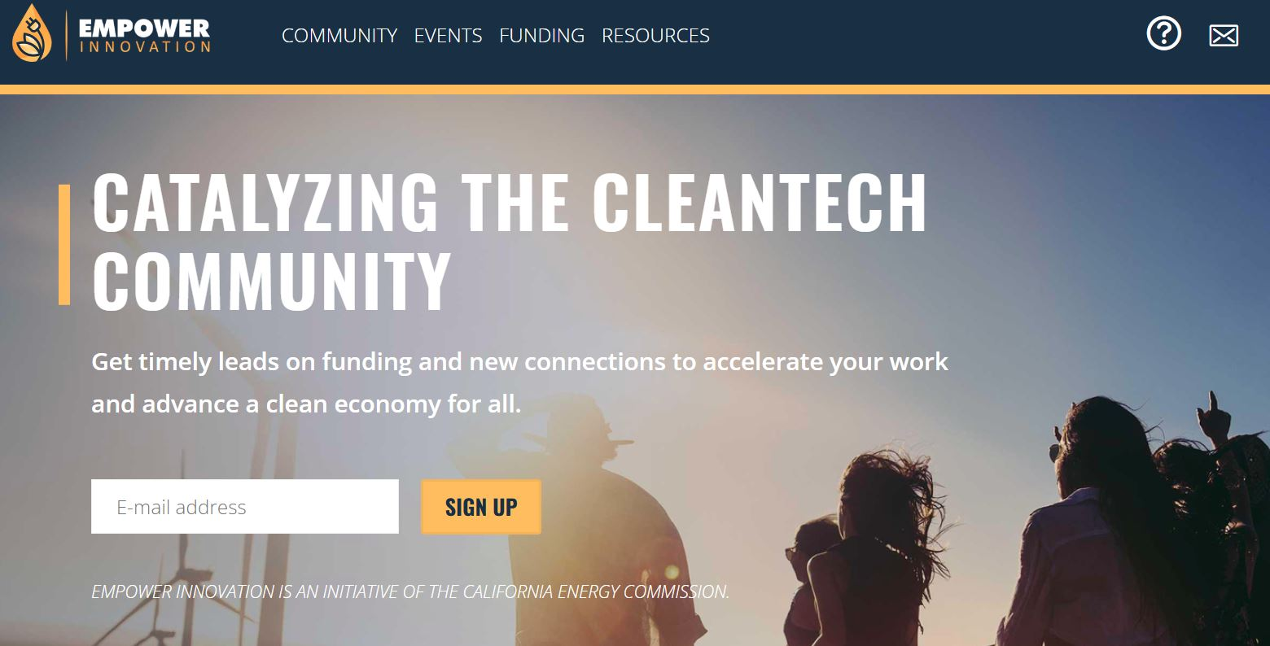
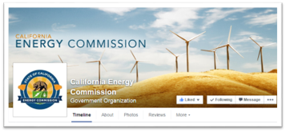
Connect With Us

Slide 7
Find a Partner on EmpowerInnovation.net
Empower Innovation strives to accelerate your clean tech journey with easy access to funding opportunities from the Energy Commission and other funding providers, curated resources and events, and connections to people and organizations.
FIND A PARTNER
Announce your interest in this funding opportunity and message other interested parties to find potential partners.
RESOURCES & TOOLS
Browse the collection of resources for clean tech innovators including Resource Libraries, Funding Sources, Tools, and Databases.
https://www.empowerinnovation.net/en/custom/funding/view/46109

Slide 8
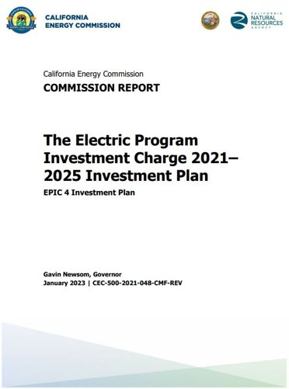
Research Program Background
This solicitation will award and fund projects from the Electric Program Investment Charge (EPIC) Program, an electricity ratepayer surcharge established by the California Public Utilities Commission (CPUC) in December 2011. ​
EPIC Investment Plan 2021-25, Strategic objective: “Inform California’s transition to an equitable, zero-carbon energy system that is climate-resilient and meets environmental goals” (Chapter 7).​
Initiative: Climate Resiliency​
Topic: 44, Integrating Climate Resilience in Electricity System Planning (pp. 212-218)
The purpose of the EPIC program is to benefit the ratepayers of three investor-owned utilities (IOUs)​ by funding clean energy technology projects that promote greater electricity reliability, lower costs, and increased safety.
To access report: https://www.energy.ca.gov/publications/2021/electric-program-investment-charge-proposed-2021-2025-investment-plan-epic-4

Slide 9
Policy Drivers
Assembly Bill (AB) 32 – Global Warming Solutions Act of 2006
Senate Bill (SB) 32 – California Global Warming Solutions Act of 2006
Senate Bill (SB) X1-2 – Renewables Portfolio Standard
AB 758 – Building Efficiency
AB 3232 – Zero-Emissions Buildings and Sources of Heat Energy
SB 350 – Clean Energy and Pollution Reduction Act of 2015
Senate Bill (SB) 100 – The 100 Percent Clean Energy Act of 2018
SB 1020 – Clean Energy, Jobs, and Affordability Act of 2022
Assembly Bill (AB) 1279 – The California Climate Crisis Act of 2022
Senate Bill (SB 379) – Land use: general plan: safety element
Integrated Energy Policy Report (Biennial)
Exec. Order B-29-15 – CEC to invest in new technologies to achieve water and energy savings, GHG reductions
The Governor's State of Emergency Proclamation on Tree Mortality
CPUC Rulemaking 18-04-019 – Climate Change Adaptation
CPUC Decision 19-10-054 (2019) – Points to Cal-Adapt as key data source
CPUC D. 20-08-046 (2020) – Defines vulnerable communities, requires vulnerability assessments and outreach
CPUC D. 24-08-005 (2024) – Articulates updated modeling requirements, refers to Cal-Adapt

Slide 10
Purpose of Solicitation
Deliver open-source climate and wildfire tools that:
Leverage best-available science and data for California
Curate science and data for ease of use
Assist stakeholders with building resilience

Slide 11
Available Funding
Project Group | Available Funding | Minimum Award Amount | Maximum Award Amount
Group 1: Development of Tools and Visualizations for an Updated Cal-Adapt Data Explorer | $2,800,000 | $2,500,000 | $2,800,000
Group 2: Wildfire Planning Tool Leveraging Long-Term Scenarios Developed for California’s Fifth Climate Change Assessment | $800,000 | $640,000 | $800,000
Group 3: Integration of Climate-Informed Science into Open Near-Term Wildfire Modeling Platform | $1,000,000 | $800,000 | $1,000,000

Slide 12
Match Funding
Match funding is optional.
Applications that include match funding may receive a higher score for criterion 5, “Budget”.
Match funding contributors must submit match funding commitment letters that meet the requirements. Failure to do so will disqualify the match funding commitment from consideration.
Refer to the Solicitation Manual for more details on match funding.

Slide 13
Group 1: Development of Tools and Visualizations for the Updated Cal-Adapt Data Explorer*
Funding Amount: $2,800,000
Background:
Fifth Assessment data is two orders of magnitude larger than data from the prior generation of climate projections
The Cal-Adapt Data Explorer currently houses tools that leverage Fourth Assessment Data
The Cal-Adapt Data Explorer platform is undergoing updates supported by CEC funding (EPC-21-038) to align with this data
Work is needed to develop open-source tools for the Cal-Adapt Data Explorer that leverage Fifth Assessment data, in a manner that is responsive to participant needs
*The Cal-Adapt Data Explorer is an easy-to-use, web-based data exploration and visualization tool. It is distinct from the Cal-Adapt Analytics Engine, which couples a powerful data platform with analytical resources, scientific guidance, and cloud compute.

Slide 14
Group 1: Development of Tools and Visualizations for the Updated Cal-Adapt Data Explorer
Requirements:
Engage with energy stakeholders and leverage feedback to date to identify development priorities for existing and potential new tools for the Cal-Adapt Data Explorer using Fifth Assessment climate data
Design and develop user-friendly tools that leverage and accurately portray Fifth Assessment data and respond to the needs identified by energy-sector participants
Perform quality assurance and quality control tests on new tools
Provide for operation and maintenance of the cal-adapt.org website for the duration of the project
Sustain a web presence that provides information regarding other CEC grants associated with Cal-Adapt and hosts static content (e.g., wikis, notebooks, blogs, documentation)
Develop a strategy for long-term data storage management. Support from Amazon’s Sustainable Data Initiative currently provides for data storage through January 2026.

Slide 15
Group 1: Development of Tools and Visualizations for the Updated Cal-Adapt Data Explorer
Additional requirements to include in Project Narrative:
How the Cal-Adapt tool will be transferred to the CEC or its designee at the end of the agreement term, including training, user guides, and documentation
Appropriate qualifications, experience, financial stability, and capability to complete the project
experience with web application development and working with multi-petabyte datasets, as well as familiarity with climate change impacts and planning processes in California
Allocation for the expected funding needed to support the transfer of management, operations, and maintenance of the Cal-Adapt Data Explorer from the current team (funded by EPC-21-038) to the applicant. Describe how the following efforts will be covered by the budget:
Orientation to the Cal-Adapt Data Explorer, including, but not limited to, securing access to the web domain and navigating hosted content and existing tools.
Additional elements that would merit dedicated funding (e.g., ongoing working relationships with other Cal-Adapt Enterprise grantees).

Slide 16
Group 2: Wildfire Planning Tool Leveraging Long-Term Scenarios Developed for California’s Fifth Climate Change Assessment
Funding Amount: $800,000
Background:
Long-term wildfire scenarios in production under agreement EPC-18-026
Dataset will include fire size, fire severity, smoke emissions, fire presence, and number of fires over the California domain through the year 2100 under various climate, vegetation, and land-use scenarios developed as part of the Fifth Assessment
Work is needed to create an open-source tool that enables users to query and analyze dataset in a manner that can inform mid- and long-term planning for wildfire mitigation and grid adaptation projects

Slide 17
Group 2: Wildfire Planning Tool Leveraging Long-Term Scenarios Developed for California’s Fifth Climate Change Assessment
Requirements:
Engage with energy sector participants to identify planning horizons, functions, interface designs, and other characteristics of a wildfire planning tool that would be both useful and feasible given the available data
Design and develop a wildfire planning tool that can explore historic and projected future wildfire risk and exposure model outputs, as well as any other feasible functions that respond to participant-identified gaps or needs
Identify other potential energy applications of the available data
Perform quality assurance and control tests to ensure proper functionality and data portrayal by the tool
Ensure open access to the wildfire planning tool and provide operation and maintenance of the platform for the duration of the project

Slide 18
Group 2: Wildfire Planning Tool Leveraging Long-Term Scenarios Developed for California’s Fifth Climate Change Assessment
Additional requirements to include in Project Narrative:
How the proposed tool could provide ratepayer benefits not currently provided by those currently used by IOUs and other entities responsible for wildfire response.
How the wildfire planning tool will be transferred to the CEC or its designee at the end of the agreement term, including training, user guides, and documentation
Appropriate qualifications, experience, financial stability, and capability to complete the project
Experience with web application development and working with large datasets, expertise in climate and wildfire science, and familiarity with utility wildfire planning processes in California

Slide 19
Group 3: Integration of Climate-Informed Science into Open Near-Term Wildfire Modeling Platform
Funding Amount: $1,000,000
Background:
Scientific advancements made in climate-driven weather wildfire behavior provided by EPC-18-026
Scientific advancements not yet incorporated into an open, near-term wildfire modeling platform
Work needed to integrate a dynamic coupled weather-wildfire behavior model into an open-source platform that produces near-term, climate-informed outputs that support situational awareness and respond to participant-identified needs

Slide 20
Group 3: Integration of Climate-Informed Science into Open Near-Term Wildfire Modeling Platform
Requirements:
Engage with energy sector participants to identify best use cases and data outputs of the platform, and to determine the spatial and temporal resolution of outputs that would best support relevant planning horizons and more efficient and targeted dispatch of wildfire mitigation solutions
Design and implement a methodology for incorporating a dynamic coupled weather-wildfire behavior model into an open-source platform that produces near-term, climate-informed outputs that support situational awareness and respond to participant-identified needs
Continue to advance the next generation of wildland fuels data across California
Ensure open accessibility and user-friendliness of the platform
Incorporate capacity to benchmark the platform’s forecasts against actual fire size, spread, and other metrics to track accuracy of the model and develop a methodology for analysis and recalibration based on these results

Slide 21
Group 3: Integration of Climate-Informed Science into Open Near-Term Wildfire Modeling Platform
Additional requirements to include in Project Narrative:
How the platform could provide ratepayer benefits not currently provided by those currently used by IOUs and other entities responsible for wildfire response.
Whether the project will either a) develop a new modeling platform, or b) leverage an existing modeling platform.
Describe the proposed process for incorporating best available wildfire behavior science into the modeling platform, including EPIC-funded science produced by EPC-18-026 as well as any other advancements deemed relevant
How the modeling tool will be transferred to the CEC or its designee at the end of the agreement term, including training, user guides, and documentation
Appropriate qualifications, experience, financial stability, and capability to complete the project
Experience with web application development, wildfire modeling, and familiarity with climate change impacts and planning processes in California

Slide 22
Eligible Applicants
This is an open solicitation for public and private entities.
Applicants must accept applicable EPIC terms and conditions.
Standard, UC, and DOE T&Cs available online: https://www.energy.ca.gov/funding-opportunities/funding-resources
Applicants are encouraged to register with the California Secretary of State, as all recipients must be registered and in good standing to enter into an agreement with the Energy Commission: http://www.sos.ca.gov

Slide 23
Application Requirements
Each Applicant must complete and | include the following:
1. Executive Summary (.docx) | 8. Past Projects Information Form (.docx, .pdf)
2. Project Narrative (.docx) | 9. Commitment and Support Letters (.pdf)
3. Project Team (.docx, .pdf) | 10. Project Performance Metrics
4. Scope of Work (.docx) | 11. Applicant Declaration (.docx)
5. Project Schedule (.xlsx)
6. Budget (.xlsx)
7. CEQA Compliance Form (.docx)

Slide 24
Project Narrative (Attachment 2)
This is your opportunity to explain the entirety of the project. The narrative should explain:
Why is your project necessary and important to California?
What is your project approach and how will each major task be implemented?
How will the project be completed in the term proposed?
Does the project have the appropriate resources (team and budget) to complete successfully?
How will the project outcomes benefit electric ratepayers?
Address the requirements for your group as described in Section I.C.
Respond to the scoring criteria described in Section IV.F.

Slide 25
Scope of Work (Attachment 4)
Tell us exactly what you are proposing to do in your project.
Identify what will be delivered to the Energy Commission.
Be sure to include in the technical tasks:
At least one product deliverable per task.
Address requirements in Section I.C. under Project Focus.
Be sure to include in the Project Schedule (Attachment 5):
Product deliverables that correspond with the Scope of Work.
Realistic dates on when product deliverables can be completed.

Slide 26
Budget (Attachment 6)
Identify how the Energy Commission funds and match funds (if any) will be spent to complete the project.
Subrecipients receiving $100,000 or more Energy Commission funds must complete a separate budget form.
Ensure that all rates provided are maximum estimated rates for the entire project term and any potential increases are included.
Travel Restrictions:
CEC funds should be limited to project task specific in-state travel.
Travel to conferences is generally not considered applicable travel for projects and should not use CEC funds.

Slide 27
Commitment and Support Letter Forms (Attachment 9)
Follow guidelines provided for commitment and support letters.
Commitment letters are required for entities or individuals that are committing match funding, testing/demonstration sites, including the Applicant (prime).
Support letters describe a project stakeholder’s interest or involvement in the project.
All applicants must submit at least one support letter.
Match funding must be supported by a match fund commitment letter(s).
Any project partners that will make contributions to the project (other than match and sites) must submit a commitment letter.
Limit to two pages per letter, excluding the cover page.

Slide 28
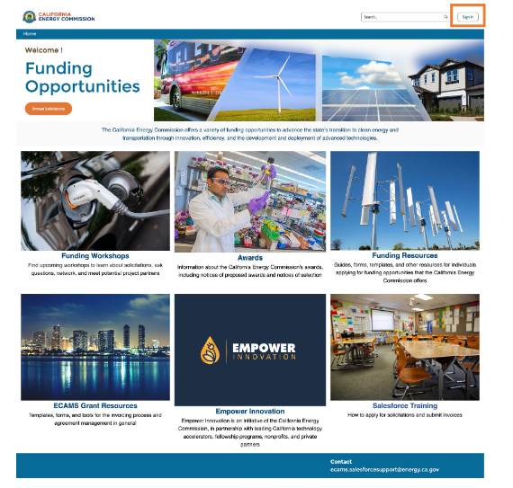
GFO Submission Requirements
Applicants must have or must create a user account to submit a solicitation application. To create an account, please see the guidance User Registration Instructions at: https://www.energy.ca.gov/media/7893
Note: One account manager per organization, but users can be added by account manager
Applications must be submitted through the Energy Commission Agreement Management System (ECAMS) at: https://ecams.energy.ca.gov/

Slide 29
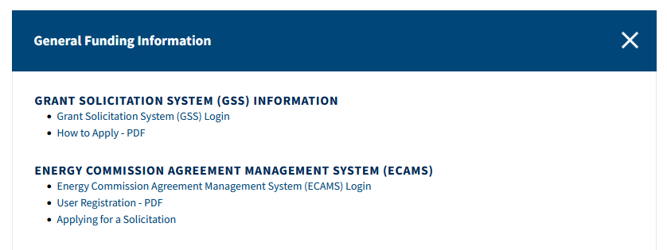
GFO Submission Requirements (cont.)
For detailed instructions on application submittal, please see the Applying for a Solicitation at: https://www.energy.ca.gov/media/7956
Both referenced guidance documents are available at: https://www.energy.ca.gov/funding-opportunities/funding-resources under General Funding Information.
Questions with the ECAMS system should be directed to: ECAMS.SalesforceSupport@Energy.ca.gov

Slide 30
GFO Submission Requirements (cont.)
Electronic files, other than those requiring signatures, must be consistent with the specific file format provided in the solicitation.
Application documents should meet formatting requirements, and page recommendations as specified in the solicitation manual.
Attachments requiring signatures (Application Form and Support/Commitment Letters) may be signed, scanned, and submitted in PDF format.

Slide 31
Submission Warning
START THE PROCESS EARLY!
Applications must be fully submitted BEFORE the deadline listed in the solicitation manual.
The ECAMS system will reject applications submitted after the deadline.
Applications in the process of being submitted prior to the deadline will NOT be accepted after the deadline.
ECAMS support is ONLY available from 8am – 5pm Monday-Friday.

Slide 32
Application Submission
Register as a New User (if applicable)
Log In
4-Step Application Submittal Process:
Select Solicitation
Enter Application Information
Upload Files
• Select documents for upload
Tag files with document type
Designate confidential documents (if applicable)
Review and Submit
Confirmation from ECAMS system that submission was successful
All steps must be complete BEFORE the submission deadline

Slide 33
Application Reminders
We recommend you carefully review your application before submission.
Verify that all necessary documents have been uploaded.
Verify that all documents uploaded are the accurate version you intend to submit as your final.
Verify that your documents are not marked "confidential" unless the solicitation allows specific material to be confidential. Most solicitations do not allow submission of confidential information.
Verify that your match commitment letters accurately reflect the match amounts included in your budgets, including the match provided by the prime applicant.
Verify that support and commitment letters are included, if required.
Verify that amounts entered within the system's budget (if any) concur with information included on uploaded budget worksheets.

Slide 34
How will my Application be Evaluated? Application Screening
Admin Screening Process
Energy Commission staff screens applications per criteria in Section IV.E.
Criteria are evaluated on a pass/fail basis.
Applicants must pass all screening criteria, or the application will be disqualified.
Some Reasons for Disqualification
Application is not submitted by the specified due date and time.
Application does not include one or more support letters.
Application contains confidential material.

Slide 35
How will my Application be Evaluated? Application Scoring
Evaluation Committee applies the scoring scale to the scoring criteria.
Applications must obtain a minimum passing score of 52.5 points (70%) for Criteria 1-4 in order to continue evaluation.
Applications must obtain a minimum passing score of 70 points (70%) for Criteria 1-7 in order to be considered for funding.
Review Section IV of the manual and ensure the application provides a clear and complete response to each scoring criteria.
Scoring Criteria | Maximum Points
1. Technical Merit | 15
2. Technical Approach | 25
3. Impacts and Benefits for CA IOU Ratepayers | 20
4. Team Qualifications, Capabilities, and Resources | 15
5. Budget and Cost-Effectiveness | 10
6. CEC Funds Spent in California | 10
7. Ratio of Direct Labor Costs to Indirect Costs | 5
Total | 100
Minimum Points to Pass | 70

Slide 36
Next Steps After Grant Award
Notice of Proposed Award: Shows total proposed funding amounts, rank order of applicants by project group, and the amount of each proposed award.
Applicant Debriefings: Applicants may request a debrief of their application evaluation within 30 days of the NOPA posting.
Agreement Development: Proposal documents will be processed into a legal agreement.
Failure to Execute: The Energy Commission reserves the right to cancel the pending award if an agreement cannot be successfully executed with an applicant.
Project Start: Recipients may begin work on the project only after the agreement is fully executed (approved at an Energy Commission business meeting and signed by the Recipient and the Energy Commission).

Slide 37
Key Dates
Activity | Date
Solicitation Release | January 30, 2025
Pre-Application Workshop | February 13 at 10:00am PST
Deadline for Written Questions | February 27 at 5:00 pm
Anticipated Distribution of Questions and Answers | Week of March 10
Deadline for ECAMS Submission Support | Ongoing until April 16 at 5:00 pm
Deadline to Submit Applications | April 16 at 11:59 pm
Anticipated Notice of Proposed Award Posting | Week of June 2, 2025
Anticipated Energy Commission Business Meeting | August 13, 2025
Anticipated Agreement Start Date | September 15, 2025
Anticipated Agreement End Date | March 31, 2029

Slide 38
Questions and Answers
Please chat your question in the Question and Answers window or raise your hand and you will be called on to unmute yourself. Please remember to introduce yourself by stating your name and affiliation. (Feature found under the Participants panel)
Keep questions under 3 minutes to allow time for others.
Note that our official response will be given in writing and posted on the GFO webpage.

Slide 39
Additional Questions
Please send all questions related to GFO-24-306 to:
Enrico Palo
Commission Agreement Officer
1516 Ninth Street, MS-18
Sacramento, CA 95814
(916) 957-7856
Enrico.Palo@energy.ca.gov
Deadline to submit questions:
Thursday, February 27, 2025 at 5:00 PM

Slide 40
Thank You!

