Slide 1
GFO-24-311 Pre-Application Workshop
Food Production Investment Program (FPIP) 2025
Energy Research and Development Division, California Energy Commission
Food Production Unit
June 26, 2025 | 10:00 a.m.

Slide 2
Agenda
Solicitation Background
Diversity Survey
Empower Innovation
Food Production Investment Program Background
Solicitation Overview
Purpose
Available Funding
Eligible Technologies and Applicants
Application Overview
Attachments
Submittal Process
Evaluation Process
Next Steps
Questions & Answers

Slide 3
Housekeeping
This workshop will be recorded.
Attendees will be muted during the presentation. Please write your questions in the Q&A window.
Virtual participation options:
Write questions in the Q&A window
Raised hand on Zoom
Press *6 on the telephone during the Q&A period
Updates to solicitation documents will be posted on the Grant Funding Opportunity’s webpage: https://www.energy.ca.gov/solicitations/2025-06/food-production-investment-program-fpip-2025

Slide 4
Commitment to Diversity
The CEC adopted a resolution strengthening its commitment to diversity in our funding programs. The CEC continues to encourage disadvantaged and underrepresented businesses and communities to engage in and benefit from our many programs.
To meet this commitment, CEC staff conducts outreach efforts and activities to:
Engage with disadvantaged and underrepresented groups throughout the state.
Notify potential new applicants about the CEC’s funding opportunities.
Assist applicants in understanding how to apply for funding from the CEC’s programs.
Survey participants to measure progress in diversity outreach efforts.

Slide 5
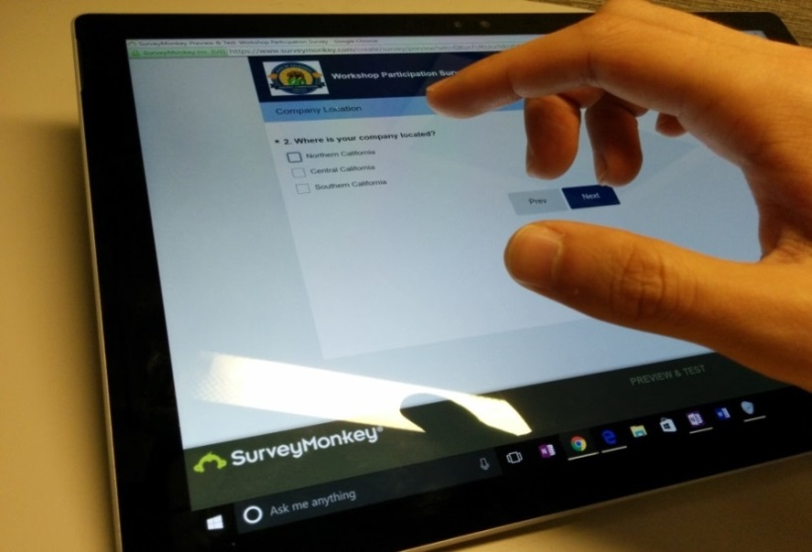
We Want to Hear From You!
One Minute Survey
Survey responses will be summarized anonymously to track attendance of underrepresented groups in our workshops for public reporting purposes.
Please use the link in the chat to access the survey.
The survey will be closed at the end of the day.
Survey Link – https://forms.office.com/g/Nf0cnpZgd5
Notes:
As part of our commitment to diversity, we’re surveying attendees to better understand the participation of underrepresented groups in our workshops. We’d appreciate if you would complete this quick 1-2 minute survey. The link will be placed in the chat and we ask that you please click the link to complete the survey. Thank you for your participation.

Slide 6
Connect With Us
https://www.energy.ca.gov/newsroom
Notes:
We encourage everyone to connect with us on a variety of social media platforms (Twitter, Instagram, LinkedIn, Flicker, Blogger) and the Energy Commission blog.

Slide 7
Find a Partner on EmpowerInnovation.net
Empower Innovation strives to accelerate your clean tech journey with easy access to funding opportunities from the CEC and other funding providers, curated resources and events, and connections to people and organizations.
FIND A PARTNER
Announce your interest in this funding opportunity and message other interested parties to find potential partners.
RESOURCES & TOOLS
Browse the collection of resources for clean tech innovators including Resource Libraries, Funding Sources, Tools, and Databases.
https://www.empowerinnovation.net/en/custom/funding/view/47374
Notes:
Talking Points:
We encourage anyone interested in applying for a CEC grant to join Empower Innovation, the newest tool in the CEC’s Energy Innovation Ecosystem.
Empower Innovation is an online platform designed specifically for the cleantech community, and provides a great networking opportunity for individuals and organizations exploring our funding opportunities.
On Empower Innovation, you will find a community of cleantech entrepreneurs, developers, technology adopters, and community-based organizations. You will also be able to see the latest funding announcements from the CEC.
The "Find a Partner" feature allows you to announce your interest in a specific funding opportunity and view other interested parties to find potential partners in a trusted environment.
The site address for this solicitation with Empower Innovation is at the bottom of the slide.

Slide 8
EmpowerInnovation.net
Notes:
[Prior to Video]
Talking Points:
We will now show a brief video describing the concept behind Empower Innovation and highlighting the various features of the platform.
In this video, you will see how Empower Innovation provides many opportunities to engage with the cleantech community and find resources and funding opportunities.
Again, we hope you will join us on EmpowerInnovation.net.

Slide 9
FPIP Background
Policy Drivers:
Established in 2018 by Assembly Bill 109 (2017)
Extended in 2022 by Assembly Bill 209 (2021)
Program Stats:
Has awarded over $132 million in funding
Encourages investment to help California food producers toward a low-carbon future.
162,000 MTCO₂e annual emission reductions
Emphasizes benefits to priority populations
90% of projects are in disadvantaged and/or low-income communities

Slide 10
Solicitation Overview
GFO-24-311
Food Production Investment Program (FPIP) 2025

Slide 11
Purpose of Solicitation
This solicitation will:
Help California food processors work towards a low-carbon future
Demonstrate reliability and effectiveness of advanced energy and decarbonization technologies and strategies
Enhance and benefit the electrical grid, especially during net peak periods
Benefit or improve public health and the environment, particularly in priority populations
Competitive Grant Solicitation!
Solicitation Manual pp. 1-2, “Purpose of Solicitation”

Slide 12
Available Funding
Project Group | Available Funding | Minimum Award Amount | Maximum Award Amount
Group 1: Heat Pump with option to include Microgrid | $5,000,000 | $1,000,000 | $2,500,000
Group 2: Other Eligible Technologies | $5,000,000 | $1,000,000 | $2,500,000
~$10 million available
Eligible food processors can submit multiple applications:
Each application must be for a distinct project with no overlap​.
Bundling of technologies within the same facility and bundling of multiple facilities within the same company is allowed.
Solicitation Manual pp. 7-8, “Funding”

Slide 13
Match Funding
25% of eligible costs is required for match funding.
Match funding contributors must submit match funding commitment letters in alignment with solicitation requirements. Failure to do so will disqualify the match funding commitment from consideration.
Match Funding Example
FPIP Award Amount | Minimum Match Amount (25% of CEC eligible costs)
$1,000,000 | $250,000
Solicitation Manual pp. 7-8, “Funding” and pp. 16-17, "Match Funding"
Notes:
The match requirement for this solicitation is XX% of requested CEC funds. In addition, applicants that provide match beyond the minimum requirement may receive additional points during scoring. Applicants must provide commitment letters from Match funding contributors in order to qualify, this includes any match the applicant will provide. Please see the solicitation manual for commitment letter requirements and scoring details.

Slide 14
Eligible Costs
Eligible costs for FPIP’s grant funding are limited to the following areas:
Equipment costs - equipment must result in reductions in GHG emissions and/or benefit to the electrical grid.
Third-party subrecipient costs for project-related design and engineering.
Third-party subrecipient costs for measurement and verification (M&V) of project performance.
Solicitation Manual pp. 7-8, “Funding”
Notes:
In house M&V not eligible

Slide 15
Examples of Ineligible vs Eligible Costs
Ineligible Costs
Installation costs (labor)
Equipment warranty
Infrastructure upgrades for future electrification purposes
Solely software
Grant writing and/or management
M&V collection required for applications
Rental equipment
Eligible Costs
Equipment delivery
Equipment tax
Permanent M&V equipment
Software related to eligible technologies
Solicitation Manual pp. 7-8, “Funding”

Slide 16
Project Overview
Projects must include two or more of these goals to:
maximize GHG emissions reductions
maximize energy reductions
provide benefits to support grid reliability
provide benefits to priority populations

Slide 17
Project Requirements
Projects must install and demonstrate the reliability of:
Commercially available technologies:
drop-in replacement or addition(s) to current systems
have higher efficiencies than current best practices and industry standards
Cutting-edge emerging technologies:
with a minimum technology readiness level (TRL) 8
not widely used in California
not drop-in ready replacement equipment or addition
commercially proven elsewhere in food processing applications.
Solicitation Manual pp. 20-24, “Project Requirements”

Slide 18
Technologies
Group 1
Industrial Heat Pumps
Microgrid (optional addition to a Heat Pump project)
Group 2
Microgrid
Mechanical dewatering
Advanced motors and controls, including variable frequency drives
Refrigeration system optimization – Ultra Low GWP Refrigerants (GWP < 10)
Process equipment insulation
Waste heat to power
Onsite wastewater treatment
Fuel switching
Additional technologies that are added as a result of comments received during the Q&A period​.​
Note: Projects that are solely gas efficiency projects will not be eligible. Energy efficiency projects that can work with both fossil fuel and electrification processes are eligible.
Solicitation Manual pp. 21-23, “Technologies”

Slide 19
Eligibility Overview
To be eligible for funding, Applicants must:​
Be an existing food processing facility located in California;
Accept the FPIP terms and conditions without negotiation;
https://www.energy.ca.gov/sites/default/files/2025-05/CEC_Standard_Grant_Ex_C_FPIP_5-2-25_ada.pdf
Register with the California Secretary of State. All recipients and subrecipients must be registered and in good standing to enter into an agreement with the CEC: http://www.sos.ca.gov
Meet all eligibility and other criteria specified in the solicitation;
Solicitation Manual pp. 18-20, “Eligibility Requirements”
Notes:
The solicitation is open to all [public and private entities].
All applicants are required to accept the applicable Terms and Conditions, for this GFO when applying to this solicitation. The link to the all Terms & Conditions is also provided here. If you haven’t worked with the Energy Commission before we strongly encourage you to review these before applying.
The link to the Secretary of State website is provided here, and new applicants are encouraged to register if they haven’t already done so.

Slide 20
Eligible Applicants
Eligible Applicants are food processing facilities located in California. ​
Food processing facilities are those defined by the North American Industry Classification System (NAICS*) codes:
311 (Food Manufacturing)​
3121 (Beverage Manufacturing)
493120 (Refrigerated Warehousing and Storage)
Additional food processing support facilities may be considered
*NAICS: ​https://www.census.gov/naics/?input=31&chart=2022
Food and beverage processers and related support facilities that are receiving funding for the same project or portions of the same project from the CEC’s Industrial Decarbonization and Improvement of Grid Operations (INDIGO) Program or the California Air Resources Board’s F-gas Reduction Incentive Program (FRIP) are ineligible for funding from FPIP.
Solicitation Manual pp. 18-20, “Eligibility Requirements”
Notes:
The solicitation is open to all [public and private entities].
All applicants are required to accept the applicable Terms and Conditions, for this GFO when applying to this solicitation. The link to the all Terms & Conditions is also provided here. If you haven’t worked with the Energy Commission before we strongly encourage you to review these before applying.
The link to the Secretary of State website is provided here, and new applicants are encouraged to register if they haven’t already done so.

Slide 21
Application Overview
GFO-24-311
Food Production Investment Program (FPIP) 2025

Slide 22
Application Requirements
Each application must complete and include the following:
Attachment | Action Required by Applicant
1. Project Overview Form(.docx) | Complete the attachment
2. Project Narrative (.docx) | Complete the attachment
3. Scope of Work (.docx) | Complete the attachment
4. Project Schedule (.xlsx) | Complete the attachment
5. Budget (.xlsx) | Complete the attachment
6. CEQA Compliance Form (.docx) | Complete the attachment
7. Commitment and Support Letters (.pdf) | Create from template
8. FPIP Benefits Calculator (.xlsx) | Complete the attachment
9. Applicant Declaration (.docx) | Complete the attachment
Attachment A, Applicant Submittal Checklist is optional and is not required to be submitted.
Notes:
Provided is a summary of all the application attachments for this solicitation. Please note that attachments have been updated recently. All items listed are required for a complete application. The ECAMS system will prohibit incomplete applications from being submitted. Please refer to Application Manual for additional information including formatting and page limit recommendations.
Remember you can contact the Commission Agreement Officer, if you have any questions.

Slide 23
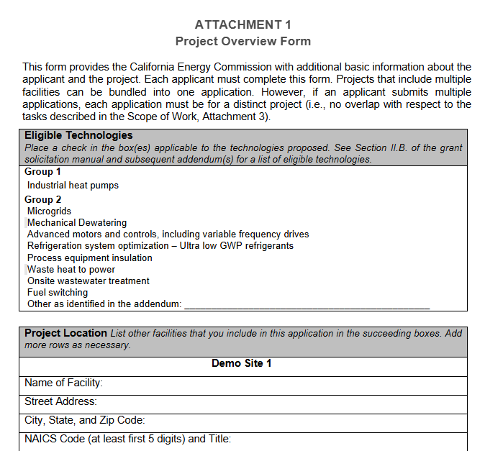
Project Overview Form (Attachment 1)
The Project Overview Form requests basic information about the applicant and the project:
Eligible technologies
Project location
Requested funding & Match source
Estimated emission & energy savings

Slide 24
Project Narrative (Attachment 2)
The Project Narrative form follows the Scoring Criteria defined in Section IV of the Solicitation Manual.​
Provide a detailed description of the proposed project and provide the information requested in each of the following areas:​
Technical Merit and Need - Justifies the need for the project.
Technical Approach - Describes the project approach, risks, M&V plan, and team qualifications.
Impacts and Benefits - Provides quantitative estimates of GHG emission & energy reductions and other benefits, cost-benefit to the state, assumptions​.
Market Potential and Information Sharing – Identify other markets for the technology and information sharing with others​.
California-Based Vendor– Identify the percentage of equipment that will be purchased from a California based vendor. ​
Preference Points: Separate criterion for evaluation of priority populations and electrical grid benefits.
The information in the Project Narrative will be used to score your proposal. Provide enough details so that reviewers can evaluate the proposal against each scoring criterion.

Slide 25
Scope of Work (Attachment 3)
The Scope of Work tells exactly what tasks are proposed for the project. All of the following tasks are mandatory:
Administrative – Do not revise the description.
Task 1 – General Project Tasks
Technical Tasks – Provide information in the “Recipient Shall” section on how you’ll implement the following and the resulting products
Task 2 – Project Engineering Design (if applicable)
Task 3 – Site Preparation and Equipment Procurement
Task 4 – Equipment Installation
Task 5 – Measurement and Verification
Task 6 – Technology/Knowledge Transfer Activities
Indicate additional tasks and actions to be performed and resulting products in the “Recipient Shall” section.
“Products” are major documents, plans, and reports. Tangible items that can be submitted to the CEC.
“Products” are not equipment and other items that cannot be delivered and stored at the CEC.

Slide 26
Measurement and Verification
Awarded projects are required to perform measurement and verification (M&V) as follows:
Pre-Installation:
Year-round and seasonal facilities: 3 months of pre-installation M&V on the equipment or systems to be retrofitted/replaced.
Post-installation:
Year-round facilities: 12 months of post-installation M&V on the equipment/systems installed.
Seasonal Facilities: Two complete seasons with a minimum of 6 months of post-installation M&V on the equipment/systems installed.
Make sure to consider the M&V requirements when creating proposed budgets and schedules.

Slide 27
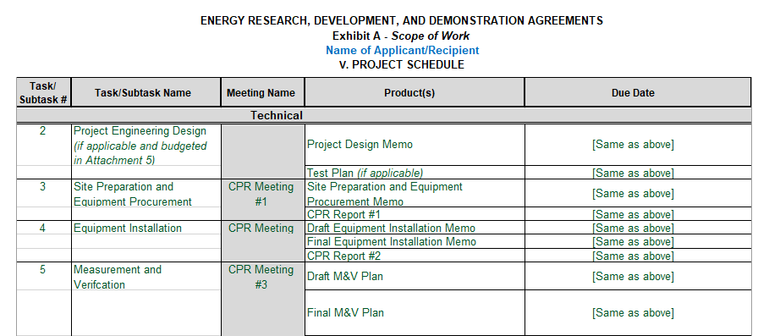
Project Schedule (Attachment 4)
The Project Schedule must be included in the application and must list all products, meetings, and due dates.
All work must be scheduled for completion by the anticipated agreement end date.

Slide 28
Budget (Attachment 5)
The budget identifies how the CEC funds and match funds will be spent to complete the project. Applicants are allowed to procure a third-party subcontractor or utilize in-house staff for M&V and design engineering. Use of in-house staff is NOT reimbursable.
If there is a third-party subcontractor for M&V, the budget cannot exceed $99,999.
If there is a third-party subcontractor for design & engineering, the budget cannot exceed $99,999.
Only complete the white cells, and do not delete sheets or rows.

Slide 29
CEQA Compliance (Attachment 6)
The California Environmental Quality Act (CEQA) Compliance form facilitates the CEC’s evaluation of proposed activities under CEQA.
Requires state and local agencies in California to assess the potential environmental impacts of their proposed actions.
This form must be completed because FPIP projects are considered “projects” under CEQA.
Failure to complete the CEQA process in a timely manner after the CEC’s Notice of Proposed Award may result in the cancellation of a proposed award.

Slide 30
Commitment and Support Letters (Attachment 7)
Commitment Letters are mandatory and will be used for the application screening:
A commitment letter commits an entity or individual to provide the match funding described in the letter – even the applicant.
Letters that are not submitted by the deadline will not be reviewed and counted towards meeting the requirement specified.
Applicants must submit a match funding commitment letter signed by each representative of the entity or individual that is committing to providing match funding.
All letters must total the required match amount. Letter(s) must:
Identify sources of funds
Justify the dollar value claimed
Guarantee the availability of the funds for the project
Identify a strategy for replacing the funds if they are significantly reduced or lost

Slide 31
Commitment and Support Letters (Attachment 7)
Support Letters are optional and may be used for scoring:
A support letter details an entity or individual’s support for the project.
Letters that are not submitted by the application deadline will not be reviewed and counted towards meeting the requirement specified.
Applicants may include support letters from project stakeholders (i.e., an entity or individual that will benefit from or be involved in the project) that:
Describes the stakeholder’s interest or involvement in the project;
Indicates the extent to which the project has the support of the relevant industry and/or community-based organizations; and
Describes any support it intends (but does not necessarily commit) to provide for the project.

Slide 32
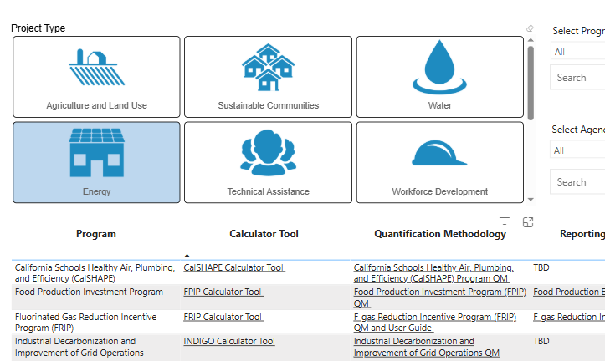
Quantification and Reporting Requirements
The California Air Resources Board (CARB) creates a quantification tool and reporting template for every CCI program.
Awarded projects are required to fill out the tool periodically.
The tool must be filled out with each application.
The quantification tool for FPIP is located in the “Energy” Project Type of the CCI Quantification, Benefits, and Reporting Materials webpage at http://www.caclimateinvestments.ca.gov/tools.

Slide 33
FPIP Benefits Calculator (Attachment 8)
The FPIP Benefits Calculator Tool uses inputs such as energy use and project lifetime to estimate benefits for each project.
MEASUR and AIRMaster+ provide the inputs for most project types.
Motor and low-GWP refrigerant projects have their own input tabs.
Outputs include GHG emission reductions, energy savings, and criteria pollutant emission reductions.

Slide 34
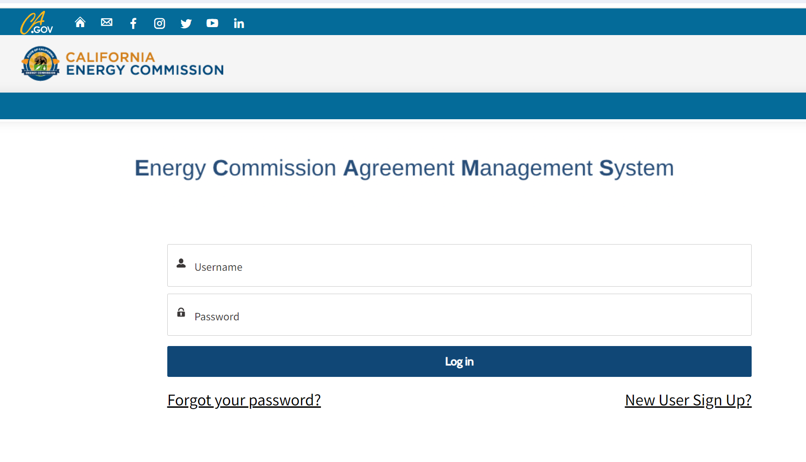
Application Submission Process
Applications will be submitted through the Energy Commission Agreement Management System (ECAMS) at: https://ecams.energy.ca.gov/
Applicants must have or create a user account to submit a solicitation application. To create an account, please see the guidance User Registration Instructions at: https://www.energy.ca.gov/media/7893
Note: One account manager per organization, but users can be added by account manager
Notes:
This solicitation will be using the new ECAMS system to receive applications. All participating applicants will need to create an account if their organization doesn’t already have one. A user guide on how to create an ECAMS account is posted on our website an can be found at the first link on the screen. Although there is only one account manager per organization, there can be multiple users added once an account is created. Applicants are strongly encouraged to register early if they are first time users. Users can submit their application at ECAMS and the link is provide at the bottom of the slide.

Slide 35
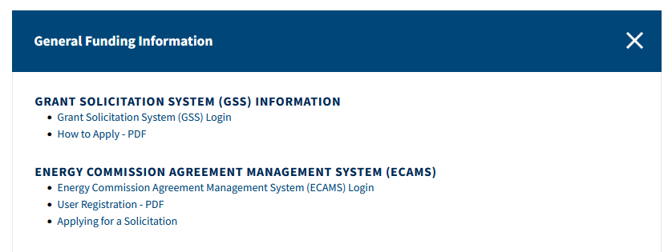
Application Submission Process
For detailed instructions on application submittal, please see the Applying for a Solicitation at: https://www.energy.ca.gov/media/7956
Both referenced guidance documents are available at: https://www.energy.ca.gov/funding-opportunities/funding-resources under General Funding Information.
Questions about the ECAMS system should be directed to: ECAMS.SalesforceSupport@Energy.ca.gov
Notes:
In addition to the User Registration we talked about, we have posted a guide to assist users in application submittal. You can find that at the address provide at the top of the slide. Applicants may find all these references on the CEC’s Funding opportunities page. If users are experiencing issues with the ECAMS system and the application process, they may reach out to our ECAMS Support staff at the email address at the bottom of the slide. Please be aware that support staff is only available during normal business hours Monday-Friday.

Slide 36
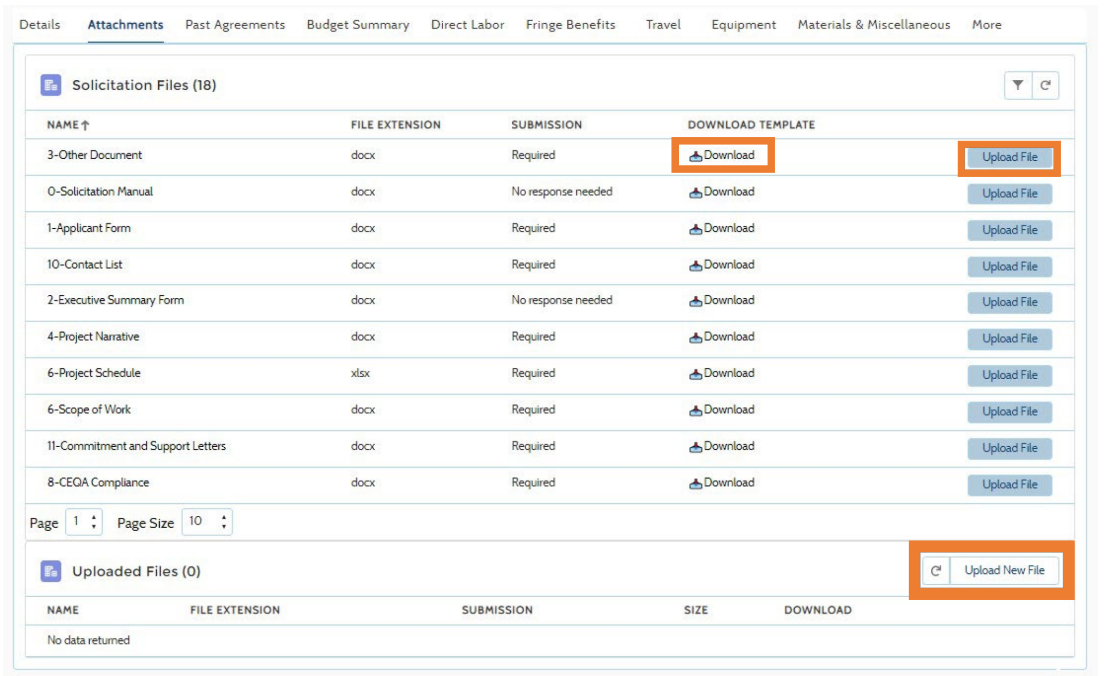
Application Submission Process (con’t)
Electronic files, other than those requiring signatures, must be consistent with the specific file format provided in the solicitation.
Application documents should meet formatting requirements, and page recommendations as specified in the solicitation manual.
Attachments requiring signatures may be signed, scanned, and submitted in PDF format.
Notes:
When submitting an application please member to submittal all attachments in the native version provided unless a signature is needed. All responses should follow the formatting and page recommendations described in the solicitation manual. Lastly, attachments needing signatures may be signed and submitted at a PDF document.

Slide 37
Submission Warning
START THE PROCESS EARLY!
Applications must be fully submitted BEFORE the deadline listed in the solicitation manual.
The ECAMS system will reject applications submitted after the deadline.
Applications in the process of being submitted prior to the deadline will NOT be accepted after the deadline.
ECAMS support is ONLY available from 8am – 5pm Monday-Friday.
Notes:
The ECAMS system will not allow applications to be submitted after the application due date and time. Please submit applications well before the deadline, and ensure all attachments are included. Please be aware that if needed, ECAMS submittal support is only available during business hours of 8am to 5 pm Monday thru Friday. Please plan accordingly.

Slide 38
Application Submission
Register as a New User (if applicable)
Log In
4-Step Application Submittal Process:
Select Solicitation
Enter Application Information
Upload Files
Review and Submit
Confirmation from ECAMS system that submission was successful
All steps must be complete BEFORE the submission deadline
Notes:
The ECAMS system has multiple steps applicants must complete before applications are fully submitted. Applicants will need a user account in order to apply. Once user has logged in they will need to select the solicitation they are applying for. Applicants will enter require information into the system before uploading their application to the system. Applicants will receive a confirmation after all required documents have been successfully uploaded and submitted.

Slide 39
Application Reminders
We recommend you carefully review your application before submission.
Verify that all necessary documents have been uploaded.
Verify that all documents uploaded are the accurate version you intend to submit as your final.
Verify that your documents are not marked "confidential." This solicitation does not allow submission of confidential information.
Verify that your match commitment letters accurately reflect the match amounts included in your budget, including the match provided by the prime applicant.
Verify that amounts entered in ECAMS concur with information included on uploaded budget worksheets.

Slide 40
How will my Application be Evaluated? Application Screening
Admin Screening Process
CEC staff screens applications per criteria in Section IV.E.
Criteria are evaluated on a pass/fail basis.
Applicants must pass all screening criteria, or the application will be disqualified.
Some Reasons for Disqualification
Application is not submitted by the specified due date and time.
Application does not include one or more commitment letters.
Application contains confidential material.
Notes:
Applications will be evaluated in a two stage process. In Stage 1, the applications will be screened according to the criteria found in Section 4 of the GFO Manual. This stage is pass/fail and proposals must pass EACH requirement in order to move on to the Evaluation Committee for further review and scoring.
Some of the reasons for rejecting proposals during Stage 1 include (but are not limited to):
Application:
- is not submitted on time
--includes confidential information

Slide 41
How will my Application be Evaluated? Application Scoring
Evaluation Committee applies the scoring scale to the scoring criteria.
Applications must obtain a minimum passing score of 70 points for Criteria 1-5 in order to be considered for funding.
All passing applications will be considered for preference points. Criteria for preference points include:
Priority Populations
Electric Grid Benefits
Review Section IV of the manual and ensure the application provides a clear and complete response to each scoring criteria.
Scoring Criteria | Maximum Points
1. Technical Merit and Need | 20
2. Technical Approach | 25
3. Impacts and Benefits | 40
4. Market Potential and Information Sharing | 10
5. California-Based Vendor | 5
Total | 100
Minimum Points to Pass | 70
Preference Points | Maximum Points
6. Priority Populations | 10
7. Electric Grid Benefits | 10
Total Bonus Preference Points | 20
Notes:
In Stage 2, the Evaluation Committee will use the Scoring Scale, which can be found in the GFO Manual, as a guide to score each criterion listed.
I want to point out to experienced applicants that the scoring criteria has been updated, so we encourage you all to read carefully the new scoring criteria.
Applicants must then score at least a 70% for the first section of the scoring criteria (this is criterion 1-4), in order be evaluated for the second section (which includes criterion 5-7). Additionally, applicants must pass with a minimum of 70% of the total combined points possible in order to be considered for an award.
An area to highlight is Funds Spent in California which is often confusing for applicants that have not worked with the Energy Commission before. “Spent in California” means that: (1) Funds under the “Direct Labor” category and all categories calculated based on direct labor (Prime and Subcontractor Labor Rates) are paid to individuals who pay California state income taxes on wages received for work performed under the agreement; and/or (2) Business transactions that are entered into with a business located in California. Out of state workers and travel out of state do not count.

Slide 42
California-Based Vendors
Points will be provided for equipment purchased from California-based vendors, defined as: A vendor that has the equipment manufactured in California or has a distribution center in California.
Points are to be awarded based on the following formula:
$$\frac{CEC Funds towards Califonia Based Vendors for Equipment}{Total CEC Funds for Equipment}×5 points=Total Points$$
For example, if the total equipment cost is $1,000,000 and $500,000 is purchased from California vendors, then the points will be 50% of the total points possible for this criteria.
$$\frac{500,000}{1,000,000}×5=2.5 points$$
Notes:
There is up to 10 preference points available for applications who provide match funding and meet minimum passing scores.
5 points for this criterion will be based on the level the type of match funding being committed. Cash will be scored more favorably than in-kind match funding.
The remaining 5 points is calculated by the amount of match funds committed, relative to the amount of CEC funds requested. Applicants should use the tables provided in the scoring section for more details.
Remember that Match funds must be fully committed and expensed during the project term.
Commitment letters are required from all match fund contributors, including the applicant.

Slide 43
Priority Populations
Preference points will be provided for projects located in and benefiting priority populations as indicated in Section III.C.2.b.
The applicant must show efforts to provide direct and meaningful benefits and address important community needs using the following approach:
Identify the priority population: Priority populations include residents of: (1) census tracts identified as disadvantaged by the California Environmental Protection Agency per SB 535; (2) census tracts identified as low-income per AB 1550; or (3) a low-income household per AB 1550.
Address a Need: Approach for determining community need and documentation of broad support from local community-based organizations and/or residents.
Provide a Benefit: Identify at least one direct, meaningful, and assured benefit that the project provides to priority populations. Must meet at least one of those listed in Step 3, on page 27 of the manual.
Refer to the Priority Populations Benefit Assessments Tool located here: https://ww2.arb.ca.gov/sites/default/files/auction-proceeds/energy_bat.pdf
Preference points will be awarded based on if the project meets CARB requirements: https://www.caclimateinvestments.ca.gov/benefit-assessment-guide.
If multiple facilities are bundled under one application, the above areas must be addressed for each location to get preference points. No portion of points will be awarded if some plants meet the requirement and others do not.
Notes:
There is up to 10 preference points available for applications who provide match funding and meet minimum passing scores.
5 points for this criterion will be based on the level the type of match funding being committed. Cash will be scored more favorably than in-kind match funding.
The remaining 5 points is calculated by the amount of match funds committed, relative to the amount of CEC funds requested. Applicants should use the tables provided in the scoring section for more details.
Remember that Match funds must be fully committed and expensed during the project term.
Commitment letters are required from all match fund contributors, including the applicant.

Slide 44
Electric Grid Benefits
Preference points will be provided to facilities that reduce overall electric usage (kWh) during their facility’s utility rate peak periods.
If multiple facilities are bundled under one application, an analysis must be provided for each individual facility.
Preference points will be awarded based on the table below using the facility with the highest percentage reduction:
$$\frac{Electrical energy \left(\frac{kWh}{yr}\right)Reduced+Electrical Energy \left(\frac{kWh}{yr}\right)Generated}{Total Facility Energy Usage (\frac{kWh}{yr})} X 100=$$
$$Facility Electrical Usage$$
$$Reduction Percentage During$$
$$Facily^{′}s Utility Rate Peak Periods$$
Facility Electrical Usage Reduction Percentage During Facility's Utility Rate Peak Periods | Percentage of Possible Points (10)
≥15% | 100%
≥10% to <15% | 80%
≥5% to <10% | 60%
≥1% to <5% | 40%
Notes:
There is up to 10 preference points available for applications who provide match funding and meet minimum passing scores.
5 points for this criterion will be based on the level the type of match funding being committed. Cash will be scored more favorably than in-kind match funding.
The remaining 5 points is calculated by the amount of match funds committed, relative to the amount of CEC funds requested. Applicants should use the tables provided in the scoring section for more details.
Remember that Match funds must be fully committed and expensed during the project term.
Commitment letters are required from all match fund contributors, including the applicant.

Slide 45
Electric Grid Benefits Example
For example: A facility wants to reduce the electrical consumption during its utility rate peak period by 200,000 kWh/yr by installing new energy efficient packaging equipment. Additionally, the facility also plans to build a small battery storage system that can offset peak hours by another 50,000 kWh/yr. Prior to any of the upgrades the facility consumes ~2,500,000 kWh during peak hours. Using the criteria 7 formula and table, the facility would qualify for 8 preference points:
$$\frac{200,000+50,000}{2,500,000}×100=$$
10% Reduction during
utility rate peak periods.
Facility Electrical Usage Reduction Percentage During Facility's Utility Rate Peak Periods | Percentage of Possible Points (10)
≥15% | 100%
≥10% to <15% | 80%
≥5% to <10% | 60%
≥1% to <5% | 40%
Notes:
There is up to 10 preference points available for applications who provide match funding and meet minimum passing scores.
5 points for this criterion will be based on the level the type of match funding being committed. Cash will be scored more favorably than in-kind match funding.
The remaining 5 points is calculated by the amount of match funds committed, relative to the amount of CEC funds requested. Applicants should use the tables provided in the scoring section for more details.
Remember that Match funds must be fully committed and expensed during the project term.
Commitment letters are required from all match fund contributors, including the applicant.

Slide 46
Next Steps After Grant Award
Notice of Proposed Award: Shows total proposed funding amounts, rank order of applicants by project group, and the amount of each proposed award.
Applicant Debriefings: Applicants may request a debrief of their application evaluation within 30 days of the NOPA posting.
Agreement Development: Proposal documents will be processed into a legal agreement.
Failure to Execute: The CEC reserves the right to cancel the pending award if an agreement cannot be successfully executed with an applicant.
Project Start: Recipients may begin work on the project only after the agreement is fully executed (approved at a CEC business meeting and signed by the Recipient and the CEC).
Notes:
A Notice of Proposed Award is posted after all applications have been evaluated and scored by the evaluation team.
Applicants may choose to request a debriefing of their application by the evaluation team. All requests must be made within 30 calendar days of the NOPA posting date. The purpose of these debriefings are to provide feedback to applicants so that they may improve upon their future applications. Debriefings are not intended to be a comprehensive examination of all deficiencies within an application.
After the NOPA posting, the Commission Agreement Manager will work with awardees to develop the agreement. Because of the tight timeline, awardees need to be available and ready to provide needed edits and answers to questions.
The Energy Commission reserves the right to cancel the pending award if an agreement cannot be made.
The project can only begin after both the recipient and the Energy Commission have signed the agreement.
Neither match funding nor Energy Commission funds can be spent before the grant agreement has been fully executed.
Applicants who did not receive an award may request a debrief with the Commission Agreement Officer.

Slide 47
Key Dates
Activity | Date
Solicitation Release | June 6, 2025
Pre-Application Workshop | June 26, 2025 at 10:00 am
Deadline for Written Questions | July 3, 2025 at 5:00 pm
Anticipated Distribution of Questions and Answers | Week of July 28, 2025
Support for Application Submission in ECAMS | Ongoing until September 11, 2025 at 5:00 pm
Deadline to Submit Applications | September 12, 2025 at 11:59 pm
Anticipated Notice of Proposed Award Posting | Week of October 13, 2025
Anticipated Energy Commission Business Meeting | November 12, 2025
Anticipated Agreement Start Date | 45 days after the Business Meeting
Anticipated Agreement End Date | No later than March 30, 2030

Slide 48
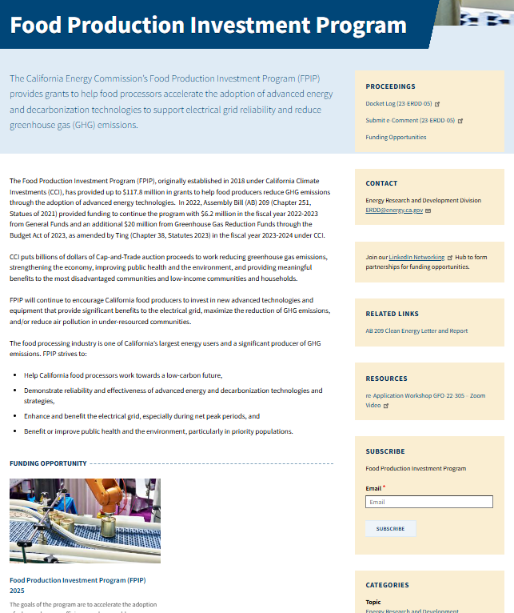
Stay Up-To-Date!
Visit the FPIP webpage at: https://www.energy.ca.gov/programs-and-topics/programs/food-production-program
Please subscribe to the “Food Production” listserv to keep up to date!
Important updates are noticed via email and posted to the FPIP docket.

Slide 49
Questions and Answers
GFO-24-311
Food Production Investment Program (FPIP) 2025

Slide 50
Questions & Answers
Three ways to ask questions:
Use the raise hand feature in Zoom:
Zoom phone controls:
*9 – Raise hand
*6 – Toggle mute/unmute
When called on, unmute and introduce yourself by stating your name and affiliation
Keep questions under 2 minutes to allow time for others
Type questions in the Q&A Box in Zoom:
Please provide your name and affiliation.
Submit written questions:
Send written questions to Chester.Hong@energy.ca.gov by July 3, 2025 at 5pm
Note that an official CEC response will be provided in writing and is anticipated to be posted on the GFO webpage the week of July 28, 2025.
Notes:
We will now start our questions and answers period. We will start with questions in the Q&A and will then move to attendees who would like to ask their questions live. You can also ask your question using the Q&A window. Or you may raise your hand and we will call on you to unmute yourself. Please remember to introduce yourself by stating your name and affiliation and to keep questions under 3 minutes to allow time for other attendees. Please note that our official response will be given in writing and posted on the GFO webpage.

Slide 51
Additional Questions
Please send all questions related to GFO-24-311 to:
Chester Hong
Commission Agreement Officer
715 P Street, MS-1
Sacramento, CA 95814
(916) 890-4694
Chester.Hong@energy.ca.gov
Deadline to submit questions:
Thursday, July 3rd 5:00 PM
Notes:
Additional technical questions can be sent to the Commission Agreement Officer. Their information is listed on this slide.
Just as a reminder, this deadline does not apply to non-technical questions or to questions that address an ambiguity, conflict, discrepancy, omission, or other possible errors in the solicitation. Such questions may be submitted to the Commission Agreement Officer at any time prior to the application deadline.

Slide 52
Thank You!
Notes:
Thank you all for interest and attending this Pre-Application workshop.

