Slide 1
GFO-25-304 Pre-Application Workshop
Modeling and Monitoring Air Quality and Co-Benefits
of Energy interventions
Energy Research and Development Division
Presenter: Dr. Maninder Thind, Air Resources Engineer
Date: February 10, 2026

Slide 2

Housekeeping
This workshop will be recorded and posted to the CEC website.
Attendees will be muted during the presentation.
Please type your question using the Q&A window.
Updates to solicitation documents will be posted at the Grant Funding Opportunity’s webpage: https://www.energy.ca.gov/solicitations/2026-01/gfo-25-304-modeling-and-monitoring-air-quality-and-co-benefits-energy

Slide 3
Agenda
Time | Item
10:00 am | Welcome and Introduction
10:05 am | Solicitation Background EPIC Research Program Purpose of Solicitation Available Funding
10:25 am | Application Requirements Project Group Requirements Attachments Submission Process Evaluation Process
11:00 am | Q&As
12:00 pm (or earlier) | Adjourn

Slide 4
Commitment to Diversity
The Energy Commission adopted a resolution strengthening its commitment to diversity in our funding programs. The CEC continues to encourage disadvantaged and underrepresented businesses and communities to engage in and benefit from our many programs.
To meet this commitment, Energy Commission staff conducts outreach efforts and activities to:
Engage with disadvantaged and underrepresented groups throughout the state.
Notify potential new applicants about the Energy Commission’s funding opportunities.
Assist applicants in understanding how to apply for funding from the Energy Commission’s programs.
Survey participants to measure progress in diversity outreach efforts.

Slide 5
We Want to Hear From You!
Participation Survey
Survey responses will be summarized anonymously to track attendance of underrepresented groups in our workshops for public reporting purposes.
Online participants, please use this link: https://forms.office.com/g/WFivqiCLkq
Thanks!

Slide 6




Connect With Us

Slide 7

Find a Partner on EmpowerInnovation.net
Empower Innovation strives to accelerate your clean tech journey with easy access to funding opportunities from the Energy Commission and other funding providers, curated resources and events, and connections to people and organizations.
FIND A PARTNER
Announce your interest in this funding opportunity and message other interested parties to find potential partners.
RESOURCES & TOOLS
Browse the collection of resources for clean tech innovators including Resource Libraries, Funding Sources, Tools, and Databases.
https://www.empowerinnovation.net/en/custom/funding/view/51456

Slide 8

EmpowerInnovation.net

Slide 9
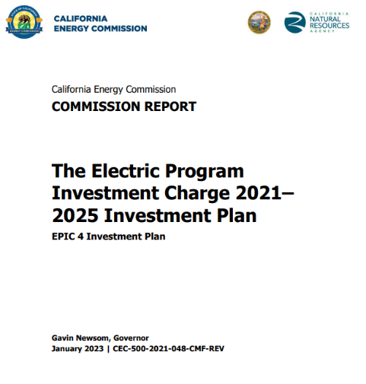
Research Program Background
This solicitation will award and fund projects from the Electric Program Investment Charge (EPIC) Program, an electricity ratepayer surcharge established by the California Public Utilities Commission (CPUC) in December 2011. ​
Electric Program Investment Charge (EPIC) Investment Plan 2021-25 strategic objective: “Inform California's Transition to an Equitable, Zero-Carbon Energy System that is Climate-Resilient and Meets Environmental Goals” (Chapter 7)
Initiative: Environmental Sustainability
Topic 43. Evaluating Air Quality, Health, and Equity in Clean Energy Solutions (pp. 207-212)
The purpose of the EPIC program is to benefit the ratepayers of three investor-owned utilities (IOUs)​ by funding clean energy technology projects that promote greater electricity reliability, lower costs, and increased safety.
To access report: https://www.energy.ca.gov/publications/2021/electric-program-investment-charge-2021-2025-investment-plan-epic-4-investment

Slide 10
Policy Drivers
AB 32 (Nunez, 2006)
Reduce GHG emissions to 1990 levels by 2020.
SB 100 (de León, 2018)
100% clean electricity by 2045.
Order Instituting Informational Proceeding on Non-Energy Impacts (NEI) (CEC, 2024)
2025 California Building Energy Action Plan (CEC, 2025)
Include non-energy benefits in decisions.
Emphasizes to understand health benefits of building decarbonization.
SB 32 (Pavley, 2016)
40% GHG reduction by 2030.

Slide 11






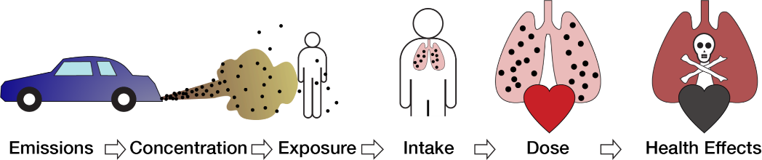




Motivation
Improvements in air quality and human health are core non-energy benefits of clean energy (SB100, building electrification)
Equity in energy transitions is a top priority
Economic & Environmental Justice Effects
Source: Adapted from https://apte.berkeley.edu/research/, Heath (2006)

Slide 12
Purpose of Solicitation
Applied research supported by this solicitation will improve existing ambient air quality modeling approaches, advance low-cost measurement technologies, and conduct analyses to quantify the air quality implications and related human health impacts of clean energy interventions across energy use sectors.
Ultimately, this research will contribute to a foundation for accurate monetization of non-energy impacts of clean energy interventions.

Slide 13
Available EPIC Funding
Project Group | Available Funding | Minimum Award Amount | Maximum Award Amount
Group 1: Advancing Ambient Air Quality Modeling Capabilities and Analysis | $3,000,000 | $2,900,000 | $3,000,000
Group 2: Developing a Low-cost Air Quality Sensor to Assess Household Air Pollution | $3,000,000 | $2,900,000 | $3,000,000

Slide 14
Match Funding
Applicants must bring match funding (at least 5% of requested CEC funds).
Match funding contributors must submit match funding commitment letters that meet the requirements. Failure to do so will disqualify the match funding commitment from consideration.
Refer to the Solicitation Manual for more details on match funding.

Slide 15
Group 1: Advancing Ambient Air Quality Modeling Capabilities and Analysis (Slide 1 of 4)
Funding Amount: $3,000,000
Background:
Air quality models inform energy policy decisions.
AQ models can be improved for: greater efficiency, inclusion of multiple pollutants, improved chemistry, improved accuracy of results.
Potential mismatch between sensor locations and pollution/population locations.
Need of optimal and equitable air quality monitoring network across California.

Slide 16
Group 1: Advancing Ambient Air Quality Modeling Capabilities and Analysis (Slide 2 of 4)
Applicants must, at a minimum include:
Identify an existing ambient air quality model to improve, or justify development of a new model. The applicant must contextualize its proposed focus based on peer reviewed literature.
Use novel methodologies, such as machine learning and artificial intelligence approaches, to improve the existing model or develop the new model, per the proposed project focus. Proposals must include a description of the methods that will be used to improve an existing model or develop a new one.
Use the improved or new model[s] to perform analyses illuminating important policy-relevant questions.
Create a high-resolution spatial tool (e.g., an interactive dashboard) that provides estimates of air quality-related health and monetized impacts for Disadvantaged and Vulnerable Communities of future electrification scenarios across energy sectors. The tool should include estimates of health endpoints (e.g., mortality, respiratory effects) as well as monetized health impacts or benefits.
Test optimal and equitable placement of air quality sensors within California’s current regulatory air quality sensor network for criteria pollutants such as PM_{2.5}, nitrogen dioxide (NO₂), and O₃.
Identify high-priority sensor locations to capture air quality benefits of future clean energy interventions.
Identify what (if any) improvements are needed to the air quality monitoring network.

Slide 17
Group 1: Advancing Ambient Air Quality Modeling Capabilities and Analysis (Slide 3 of 4)
Important policy-relevant questions that must be addressed:
Assess air quality and health impacts of clean energy transitions.
Evaluate air quality impacts on Disadvantaged and Vulnerable Communities.
Assess residential electrification impacts on outdoor air quality and health.
Analyze marginal emission impacts of EVs and renewables.
Assess wildfire aerosol impacts on solar PV generation.
Monetize non-energy impacts and net costs of home electrification.
Analyze air quality impacts of existing and planned gas power plants.

Slide 18
Group 1: Advancing Ambient Air Quality Modeling Capabilities and Analysis (Slide 4 of 4)
It is desirable that funded research addresses additional policy-relevant items below:
Clarify how air quality and health implications of clean energy transitions are affected by climate change and community-specific vulnerability to air pollution.
Estimate the combined climate and health impacts of clean energy interventions.
Assess potential air quality impacts of CEC-proposed activities in Lithium Valley.

Slide 19
Group 2: Developing a Low-cost Air Quality Sensor to Assess Household Air Pollution (Slide 1 of 3)
Funding Amount: $3,000,000
Background:
Electrification changes household exposures.
Need for:
More residential air quality data
Improved low-cost indoor air quality sensors
Performance assessment in real homes and over time
Ex: wearable air quality sensors

Slide 20
Group 2: Developing a Low-cost Air Quality Sensor to Assess Household Air Pollution (Slide 2 of 3)
Applicants must, at a minimum include:
Identify pollutant[s] of concern (e.g., PM_{2.5}, NO₂) for developing the low-cost air quality sensor. The applicant must justify its choice of pollutant[s] of concern.
Identify key performance challenges in the ability of existing low-cost sensors to adequately quantify the pollutant[s] of concerns based on scientific studies, including the peer-reviewed literature.
Develop an improved low-cost air quality sensor addressing the identified challenges. The applicant must describe its approach to developing the improved low-cost air quality sensor. The new sensor will comply to Technology Readiness Level (TRL) 6 (validated in relevant environment).
Validate the improved low-cost air quality sensor. The proposal must describe the approach to validating the new sensor.

Slide 21
Group 2: Developing a Low-cost Air Quality Sensor to Assess Household Air Pollution (Slide 3 of 3)
It is desirable that funded research include development of:
Wearable air quality sensors to advance research for dynamic and real-time measurements of environmental exposures.
A compact, low-cost NO₂ sensor that can be deployed inside homes for monitoring exposure to NO₂, especially during cooking activities.
Methods to link population-based air quality-related health data back into the healthcare system.

Slide 22
Eligible Applicants
This is an open solicitation for public and private entities.
Applicants must accept applicable [EPIC/PIER] terms and conditions.
Standard, UC, and DOE T&Cs available online: https://www.energy.ca.gov/funding-opportunities/funding-resources
Applicants are encouraged to register with the California Secretary of State, as all recipients must be registered and in good standing to enter into an agreement with the Energy Commission: http://www.sos.ca.gov

Slide 23
Application Requirements
Each Applicant must complete and | including the following:
1. Executive Summary (.docx) | 8. Past Projects Information Form (.docx, .pdf)
2. Project Narrative (.docx) | 9. Commitment and Support Letters (.pdf)
3. Project Team (.docx, .pdf) | 10. Project Performance Metrics
4. Scope of Work (.docx) | 11. Applicant Declaration (.docx)
5. Project Schedule (.xlsx)
6. Budget (.xlsx)
7. CEQA Compliance Form (.docx)

Slide 24
Project Narrative (Attachment 2)
This is your opportunity to explain the entirety of the project. The narrative should explain:
Why is your project necessary and important to California?
What is your project approach and how will each major task be implemented?
How will the project be completed in the term proposed
Does the project have the appropriate resources (team and budget) to complete successfully?
How will the project outcomes benefit [electric/natural gas] ratepayers?
Address the requirements for your group as described in Section I.C.
Respond to the scoring criteria described in Section IV.F.

Slide 25
Scope of Work (Attachment 4)
Tell us exactly what you are proposing to do in your project.
Identify what will be deliver to the Energy Commission.
Be sure to include in the technical tasks:
At least one product deliverable per task.
Address requirements in Section I.C. under Project Focus.
Be sure to include in the Project Schedule (Attachment 5):
Product deliverables that correspond with the Scope of Work.
Realistic dates on when product deliverables can be completed.

Slide 26
Budget (Attachment 6)
Identify how the Energy Commission funds and match funds will be spent to complete the project.
Subrecipients receiving $100,000 or more Energy Commission funds must complete a separate budget form.
Ensure that all rates provided are maximum estimated rates for the entire project term and any potential increases are included.
Travel Restrictions:
CEC funds should be limited to project task specific in-state travel.
Travel to conferences are generally not considered applicable travel for projects and should not use CEC funds.

Slide 27
Commitment and Support Letter Forms (Attachment 9)
Follow guidelines provided for commitment and support letters.
Commitment letters are required for entities or individuals that are committing match funding, testing/demonstration sites, including the Applicant (prime).
Support letters describe a project stakeholder’s interest or involvement in the project.
All applicants must submit at least one support letter.
Match funding must be supported by a match fund commitment letter(s).
Any project partners that will make contributions to the project (other than match and sites) must submit a commitment letter.
Limit to two pages per letter, excluding the cover page.

Slide 28

GFO Submission Requirements
Applicants must have or must create a user account to submit a solicitation application. To create an account, please see the guidance User Registration Instructions at: https://www.energy.ca.gov/media/7893
Note: One account manager per organization, but users can be added by account manager
Applications must be submitted through the Energy Commission Agreement Management System (ECAMS) at: https://ecams.energy.ca.gov/

Slide 29
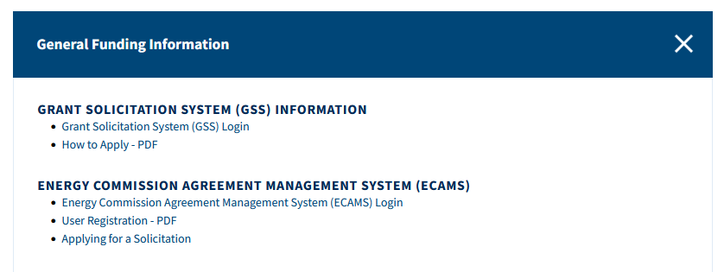
GFO Submission Requirements (cont.)
For detailed instructions on application submittal, please see the Applying for a Solicitation at: https://www.energy.ca.gov/media/7956
Both referenced guidance documents are available at: https://www.energy.ca.gov/funding-opportunities/funding-resources under General Funding Information.
Questions with the ECAMS system should be directed to: ECAMS.SalesforceSupport@Energy.ca.gov

Slide 30
GFO Submission Requirements (cont..)
Electronic files, other than those requiring signatures, must be consistent with the specific file format provided in the solicitation.
Application documents should meet formatting requirements, and page recommendations as specified in the solicitation manual.
Attachments requiring signatures (Application Form and Support/Commitment Letters) may be signed, scanned, and submitted in PDF format.

Slide 31
Submission Warning
START THE PROCESS EARLY!
Applications must be fully submitted BEFORE the deadline listed in the solicitation manual.
The ECAMS system will reject applications submitted after the deadline.
Applications in the process of being submitted prior to the deadline will NOT be accepted after the deadline.
ECAMS support is ONLY available from 8am – 5pm Monday-Friday.

Slide 32
Application Submission
Register as a New User (if applicable)
Log In
4-Step Application Submittal Process:
Select Solicitation
Enter Application Information
Upload Files
Select documents for upload
Tag files with document type
Designate confidential documents (if applicable)
Review and Submit
Confirmation from ECAMS system that submission was successful
All steps must be complete BEFORE the submission deadline

Slide 33
Application Reminders
We recommend you carefully review your application before submission.
Verify that all necessary documents have been uploaded.
Verify that all documents uploaded are the accurate version you intend to submit as your final.
Verify that your documents are not marked "confidential" unless the solicitation allows specific material to be confidential. Most solicitations do not allow submission of confidential information.
Verify that your match commitment letters accurately reflect the match amounts included in your budgets, including the match provided by the prime applicant.
Verify that support and commitment letters are included, if required.
Verify that amounts entered within the system's budget (if any) concur with information included on uploaded budget worksheets.

Slide 34

How will my Application be Evaluated?
Application Screening
Admin Screening Process
Energy Commission staff screens applications per criteria in Section IV.E.
Criteria are evaluated on a pass/fail basis.
Applicants must pass all screening criteria, or the application will be disqualified.
Some Reasons for Disqualification
Application is not submitted by the specified due date and time.
Application does not include one or more support letters.
Application contains confidential material.

Slide 35
How will my Application be Evaluated? (cont.)
Application Scoring
Evaluation Committee applies the scoring scale to the scoring criteria.
Applications must obtain a minimum passing score of 56 points for Criteria 1-4 in order to continue evaluation.
Applications must obtain a minimum passing score of 70 points for Criteria 1-6 in order to be considered for funding.
Review Section IV of the manual and ensure the application provides a clear and complete response to each scoring criteria.
Scoring Criteria | Maximum Points
1. Technical Merit | 15
2. Technical Approach | 25
3. Impacts and Benefits for CA IOU Ratepayers | 25
4. Team Qualifications, Capabilities, and Resources | 15
5. Budget and Cost-Effectiveness | 15
6. Ratio of Direct Labor Costs to Indirect Costs | 5
Total | 100
Minimum Points to Pass | 70

Slide 36
How will my Application be Evaluated? (cont..)
Application Scoring – Preference Points
Passing applications (score of 70 or more from Criteria 1-6) will be considered for bonus points. Criteria for bonus points include:
CEC Funds Spent in California
Scoring Criteria | Maximum Points
7. CEC Funds Spent in California | 5
Total Bonus Points | 5

Slide 37
Next Steps After Grant Award
Notice of Proposed Award: Shows total proposed funding amounts, rank order of applicants by project group, and the amount of each proposed award.
Applicant Debriefings: Applicants may request a debrief of their application evaluation within 30 days of the NOPA posting.
Agreement Development: Proposal documents will be processed into a legal agreement.
Failure to Execute: The Energy Commission reserves the right to cancel the pending award if an agreement cannot be successfully executed with an applicant.
Project Start: Recipients may begin work on the project only after the agreement is fully executed (approved at an Energy Commission business meeting and signed by the Recipient and the Energy Commission).

Slide 38
Key Dates
Activity | Date
Solicitation Release | January 27, 2026
Pre-Application Workshop | February 10, 2026 at 10 a.m.
Deadline for Written Questions | February 17, 2026 at 5:00 pm
Anticipated Distribution of Questions and Answers | Week of February 23, 2026
Deadline for ECAMS Submission Support | Ongoing until April 30, 2026 at 5:00 pm
Deadline to Submit Applications | April 30, 2026 at 11:59 pm
Anticipated Notice of Proposed Award Posting | Week of June 22, 2026
Anticipated Energy Commission Business Meeting | September 9, 2026
Anticipated Agreement Start Date | October 1, 2026
Anticipated Agreement End Date | March 31, 2031

Slide 39
Questions and Answers
Please chat your question into the Q & A window or raise your hand and you will be called on to unmute yourself. Please remember to introduce.
Keep questions under 2 minutes to allow time for others.
Note that our official response will be given in writing and posted on the GFO webpage.

Slide 40
Additional Questions
Please send all questions related to GFO-25-304 to:
Natalie Johnson
Commission Agreement Officer
1516 Ninth Street, MS-18
Sacramento, CA 95814
Natalie.Johnson@energy.ca.gov
Deadline to submit questions:
February 17, 2026 5:00 PM

Slide 41
Thank You!

