Slide 1
Climate Data and Analysis Working Group
Meeting on Climate and Wildfire Workplan and Data Directions
Sustainability & Health Unit, Energy Research & Development Division

Slide 2
Purpose of C-DAWG
Bridge gaps between climate researchers, energy stakeholders who need to use climate-related data, and state agency staff.​
Promote knowledge exchange.
Elicit input on key decisions
Promote deep coordination within our portfolio.

Slide 3
Housekeeping
Meetings are not recorded​
Welcome candid exchange​
Please “raise hand” to speak​
Please mute when not speaking

Slide 4
Agenda
Topic | Time | Presenter
Recent developments from CEC's climate data portfolio | 10 min | Susan Wilhelm
Climate data discussion | 40 min | All, led by Emily Field
Quick 5 min Break | 5 min
Recent developments from CEC's wildfire portfolio | 10 min | Jill Horing
Wildfire discussion | 40 min | All, led by Jill Horing
new! Prioritization & constraints | 5 min | Susan Wilhelm
Closing Remarks | 5 min | Susan Wilhelm

Slide 5
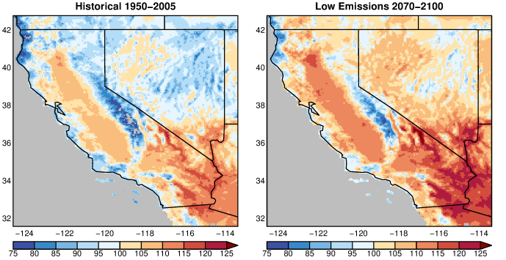
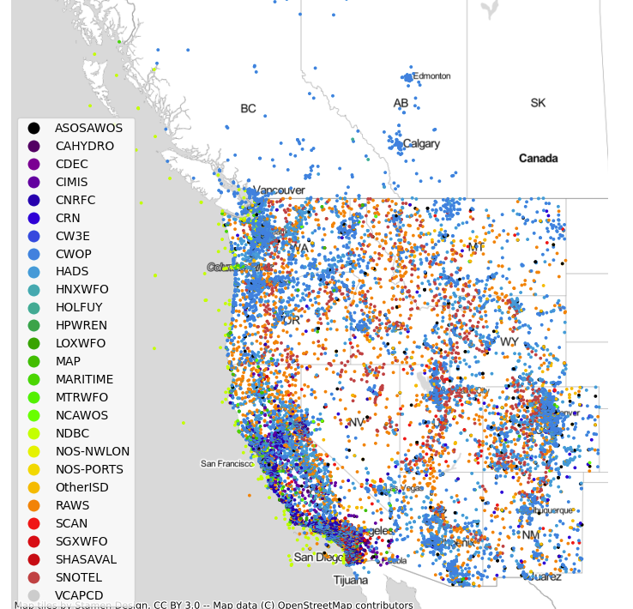
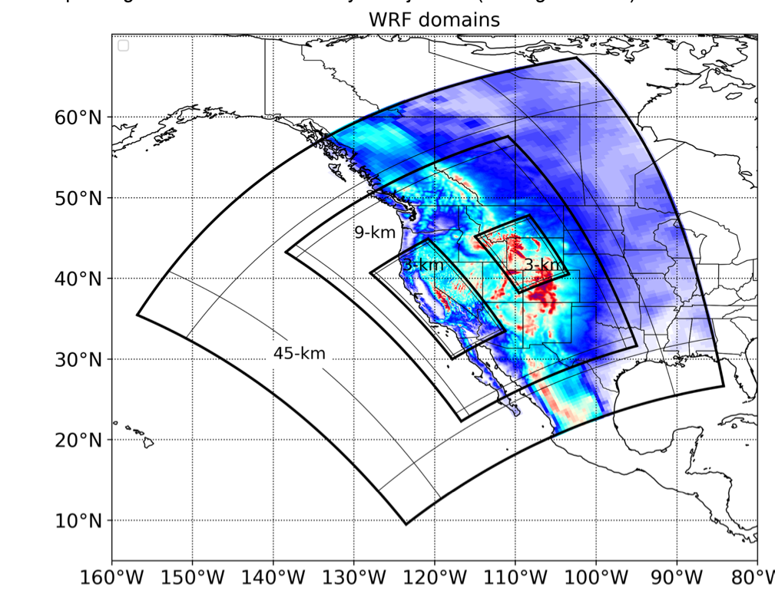
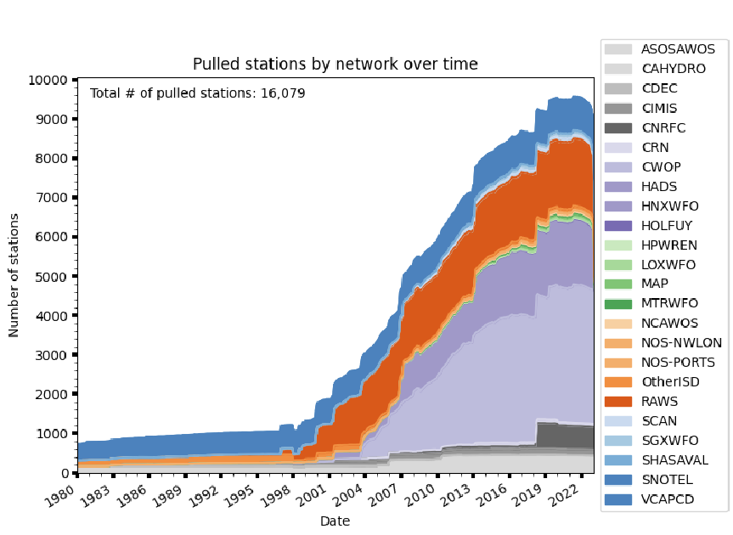
Development of climate data to support
energy research, policy, & planning
Find a slide portraying California climate data…
Susan Wilhelm, PhD

Slide 6
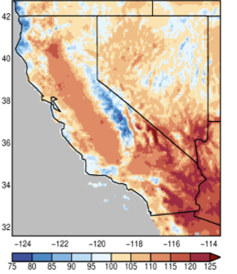
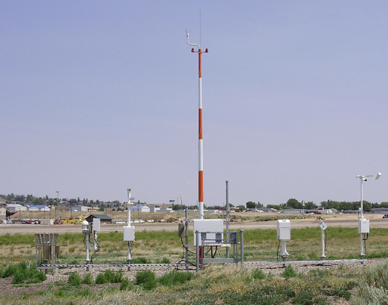
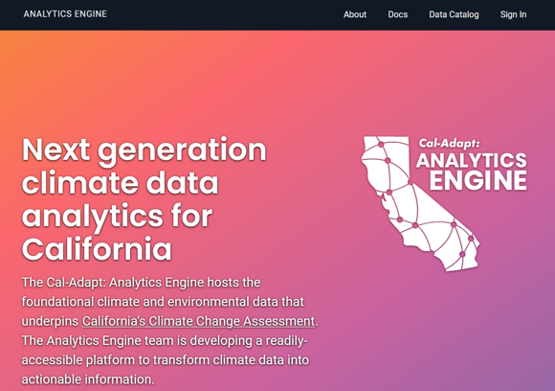
Coordinated portfolio to advance
climate-informed planning
Data Development & Analytic Platform
Energy System Research
Climate-Informed Zero-Carbon Generation Capacity Modeling
(Eagle Rock Analytics, Inc.)
Development of Climate Projections (Scripps w/ UCLA)
Historical Observations
(Eagle Rock Analytics)
Climate-Informed Load Forecasting & Electric Grid Modeling (E3)
Advancing California’s Electricity Resource Planning Tools to Assess and Improve Climate Resilience (Lumen Energy Strategy, LLC)
Cal-Adapt Analytics Engine (Eagle Rock Analytics)

Slide 7
Shift from characterization of risks to data-driven support
What’s exciting about this portfolio?
High-resolution climate & hydrological projections: a wealth of data tailored to energy sector
199 LOCA2 hybrid statistical projections: daily temperature, precip, solar radiation, vector wind on 3km × 3km grid
8 WRF (dynamical) projections: adds many variables critical to a high-renewable grid, with sub-daily resolution
To support use: Data Summaries on our Climate Data & Analysis Working Group site
“Historical Observation Platform”: an open, quality-controlled data archive for thousands of independently sourced weather stations across western USA
Powerful data platform & analytics for electricity sector vulnerability assessment, planning, research
Intensive, sustained collaborations + working groups → partnerships & capacity
Extensive guidance developed to support leveraging of data in decision-making
Development of Climate Projections (Scripps w/ UCLA, EPC-20-006)
Historical Observations
(Eagle Rock Analytics, PIR-19-006)
Cal-Adapt Analytics Engine (Eagle Rock Analytics EPC-20-007, EPC-23-024)
Notes:
Projections
199 LOCA2 hybrid projections, 1950-2100, for daily portray of T, precip, solar rad, vector wind (thanks to UCSD, Dan Cayan, Julie Kalansky, David Pierce)
“Hybrid” relaxes stationarity assumption
“LOCA2” involves bias correction that provides better capture of precipitation (particularly important for California)
8 WRF downscaled projections,
AGU “impactful dataset!”
E3
PATHWAYS modeling tool updated with WECC-wide perspective and portraying projected policy scenarios harmonizing with IEPR, CARB’s scoping plan, and IRP efforts.
RESOLVE model updated to ingest climate-informed load forecasts and renewable supply portfolios
Also: Climate-informed load profiles responding to increased temps and AC adoption.
Enables a comparison of modeled outputs, including capacity additions needed, generation mix, hourly dispatch in certain periods, and costs, under different policy scenarios and with or without climate change.

Slide 8
Shift from characterization of risks to data-driven support (cont.)
What’s exciting about this portfolio?
Analysis of renewable resource availability in changing climate
Responsiveness to Technical Advisory Committee to characterize a range of technologies
Update of key energy system models to enable exploration of climate-related stressor (PATHWAYS, RESOLVE) (E3)
… models already entrained in key energy sector activities in California (e.g., IRP, CARB Scoping Plan)
Development of a novel framework to model resilience of future elec. resource portfolios (Lumen Energy Strategy, LLC)
Conceptual model development & evaluation of future resource portfolios subject to climate trends and extremes
Integration of data and concepts into existing state processes (see next slide)
Climate-Informed Zero-Carbon Generation Capacity Modeling
(Eagle Rock Analytics, Inc.; EPC-21-037)
Climate-Informed Load Forecasting & Electric Grid Modeling (E3, EPC-21-041)
Advancing California’s Electricity Resource Planning Tools to Assess and Improve Climate Resilience (Lumen Energy Strategy, LLC; EPC-22-001)
Notes:
Projections
199 LOCA2 hybrid projections, 1950-2100, for daily portray of T, precip, solar rad, vector wind (thanks to UCSD, Dan Cayan, Julie Kalansky, David Pierce)
“Hybrid” relaxes stationarity assumption
“LOCA2” involves bias correction that provides better capture of precipitation (particularly important for California)
8 WRF downscaled projections,
AGU “impactful dataset!”
E3
PATHWAYS modeling tool updated with WECC-wide perspective and portraying projected policy scenarios harmonizing with IEPR, CARB’s scoping plan, and IRP efforts.
RESOLVE model updated to ingest climate-informed load forecasts and renewable supply portfolios
Also: Climate-informed load profiles responding to increased temps and AC adoption.
Enables a comparison of modeled outputs, including capacity additions needed, generation mix, hourly dispatch in certain periods, and costs, under different policy scenarios and with or without climate change.

Slide 9
Direct support for policy and practice
EPIC and Gas R&D programs focused on ratepayer benefits
Planning and Risk Assessment
Collaborative development of analytical tools to advance IOUs’ assessment of weather-related risks to infrastructure
Open data and methods toward integration of climate-informed data into California’s Energy Demand forecast
Regulatory Proceedings
Support for IOU filings of Climate Adaptation and Vulnerability Assessments (CAVA), which are required by CPUC’s Climate Adaptation Rulemaking (R.18-04-019).
CPUC Rulemaking 19-09-009 (Microgrids) workshops invited Lumen Energy Strategy to present on identification, analysis, and integration of resiliency needs into California's electric grid planning process
…beyond California’s energy sector
Governor’s Office for Land Use and Climate Innovation adopted the next generation of climate projections as part of California’s Fifth Climate Change Assessment, supporting adaptation at local, regional, tribal, & state levels
California’s Sea-Level Rise Guidance Update (Ocean Protection Council) incorporates Scripps’ hourly sea-level projections at 13 stations along the California coast, San Francisco Bay, and Delta
Notes:
From Annual Report:

Slide 10
Challenges and knowledge gaps
Please keep these in mind as we discuss how to move forward…
Empirical grounding: missing a strong observational basis for key variables
  Examples: hub-height wind, wind gusts, time-resolved photovoltaic relevant solar, …
Validation: regional, multi-decadal v. sub-daily, “point” location
  Example: rooftop solar generation during critical evening hours in coastal population center
Demonstration phase: translation prior to integration in rapid planning & regulatory workflows
  Example: annual/biannual cycles of demand forecast, integrated resource planning
Discontinuities with policy implications: “new” data can introduce perplexing results
  Example: demand forecast, building code
Continuous updates needed to ensure capture of most recent observations
  Example: planning processes with annual cycles need up-to-date historical grounding
Data availability amid federal cutbacks and private sector paywalls
  Examples: availability of supercomputers, IOU weather station data paywalls
Development & integration of new frameworks for modeling, analysis, planning, & policy
Notes:
From Annual Report:
The Cal-Adapt: Analytics Engine team, in close collaboration with IOUs and other electricity sector stakeholders, has continued to co-develop decision-support tools. In 2025, efforts focused on tools to assess weather-related risks to IOUs’ electricity infrastructure; support for IOU filings of Climate Adaptation and Vulnerability Assessments (CAVA), which are required by CPUC’s Climate Adaptation Rulemaking (R.18-14-019); and continued support for state agency planning processes, including providing open data that contribute to CEC’s energy demand forecast.
Throughout 2025, CEC staff worked with state agencies involved with California’s Fifth Climate Change Assessment, led by the Governor’s Office of Land Use and Climate Change (LCI), to support knowledge transfer of EPIC-funded climate projection, wildfire scenarios, and hydrological modeling efforts. Specifically, EPIC Recipients submitted plain-English memos describing key data products that have been adopted by the Fifth Assessment, have been made openly available through the Cal-Adapt: Analytics Engine, and are used to support energy sector resilience planning and research. After cross-agency review, these memos were publicly posted on CEC’s Climate Data and Analysis Working Group (C-DAWG) website.
Susan to update in collaboration with Emily.

Slide 11
Informing CEC’s investments in energy-related climate research
Discussion Questions
Data Products
1. How to balance analysis & integration of existing data v. generation of new data products?
2. On new data development: how should prioritize comprehensive gridded downscaling of CMIP7 global projections v. needs for data products better suited to shorter (ca. 3-15 years) time horizons, sub-daily perspective, and/or highly local representation?
  Possibilities for internally consistent, variable resolution datasets?
3. What variables, time horizons, and resolutions (temporal and spatial) are most needed?
4. How to design data products congruent with existing processes e.g., annual workflows?
Data Applications and Other Questions
5. What planning, modeling, or regulatory processes are priorities for public interest research?
6.How might we appropriately resource a demonstration phase to assess new models as they’re integrated into energy sector planning and policies?
7. How might California-focused research cope with “new” challenges related to, e.g., retreat of federal partners vis-à-vis climate, data, etc.?
8. Other research areas we haven’t broached?

Slide 12
5-minute break

Slide 13
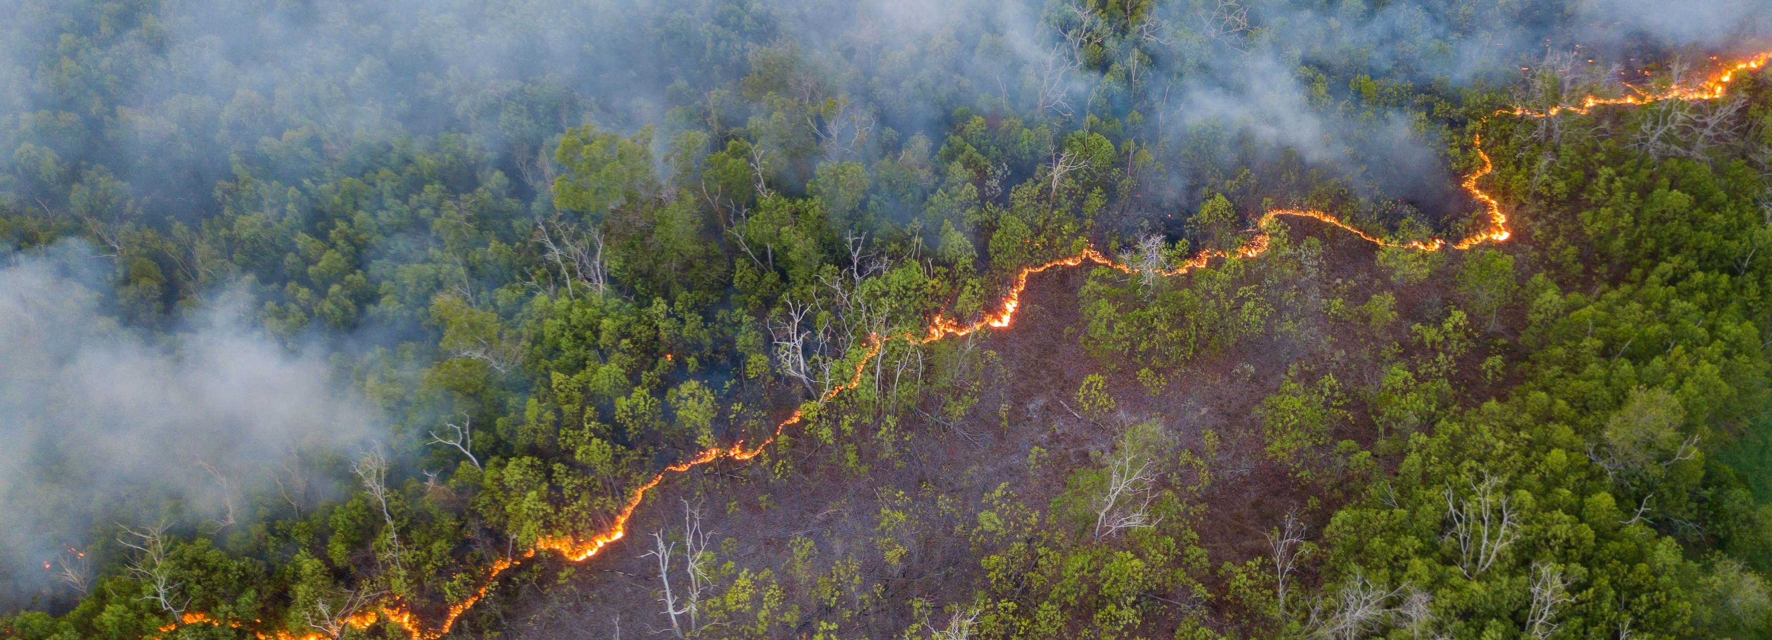
Research to inform utility wildfire risk mitigation
Jill Horing, PhD

Slide 14
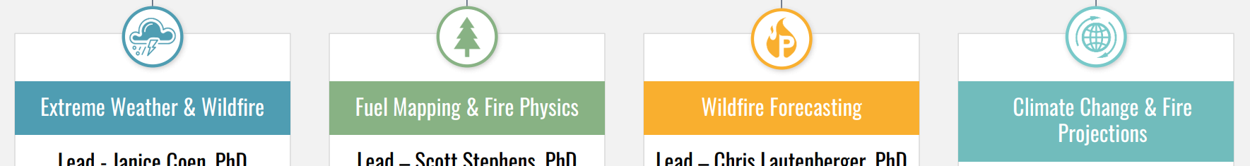
CEC wildfire research portfolio
Near-completed grants
Pyregence Consortium (EPC-18-026)
Key results indicated
Extreme weather is a dominant driver of California's most damaging wildfires
Need for modernized approaches to represent large-fuel combustion, long-duration heat release, and fine-scale fuel heterogeneity in fire behavior models
Operationally relevant fire forecasts at fine spatial and temporal scale can meaningfully inform utility management decisions
Scenario-based projections can support utility long-range planning to identify future high-risk areas and most effective solutions

Slide 15
Ongoing grants
CEC wildfire research portfolio
UCLA (EPC-25-032) will leverage long-term climate-informed wildfire scenarios to model evolving wildfire risks to and from utility infrastructure as well as the effectiveness of mitigation actions.
Spatial Informatics Group (EPC-25-025) will enhance PyreCast through integration of a dynamic coupled weather-fire model, upgrade existing fire spread models, and perform performance benchmarking.
Lawrence Livermore National Lab (EPC-25-024) improve the scientific foundation for near-term wildfire modeling by incorporating AI weather downscaling models and up-to-date live fuel moisture data.

Slide 16
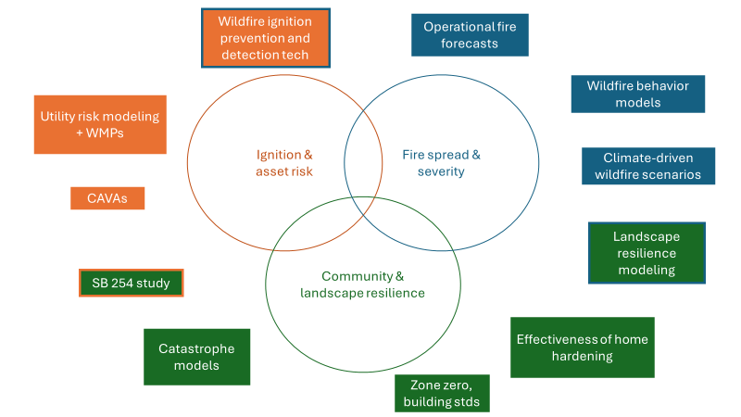
Broader CA wildfire risk landscape
(a non-comprehensive overview)

Slide 17
What's next for CEC wildfire research?
Opportunities for CEC's ratepayer-focused role
Current investment plan calls for research to:
Improve understanding, situational awareness, and forecasting of wildfire risks and impacts on grid operations (for example, generation and transmission disruption, PSPSs) - at seasonal, mid-term, and long-term scales
Improve modeling of wildfire spread in the extreme weather and fuel conditions resulting from climate change in California
Inform approaches to wildfire mitigation and insurance for California IOUs
Future opportunities respond to need for further research advancing climate adaptation in the electricity sector including:
Cost-effective operations and grid hardening for long-term climate impacts
Improved data and modeling tools and technologies to better predict climate risk to grid
RD&D on the use of clean DERs to reduce the impact of outage events

Slide 18
Challenges and knowledge gaps
What’s next for CEC wildfire research?
Need for a holistic wildfire risk mitigation framework
Quantitative and geospatially-resolved evaluation and comparison of wildfire risk mitigation
    Illuminating costs and risk reduction benefits
Integration of mitigation across utility and non-utility actions
    E.g., ignition risk reduction, landscape-level fuels treatment, community resilience
    Considering operational and infrastructure interventions
Potential for integration with existing or future tools (e.g., state catastrophe model)
Need for improved understanding of the governance and incentives needed to reach cost-effective risk reduction
Balancing affordability and equity in cost burden

Slide 19
Discussion questions
What's next for CEC wildfire research?
Research contributing to an integrated, quantitative wildfire risk framework:
How would this support the goals of your organization aligned with bringing benefits to CA ratepayers?
What opportunities or challenges do you anticipate with this research area? Does the necessary data (e.g., on cost and effectiveness of mitigation strategies) exist in the public domain?
What research studies are other agencies, universities, and others doing in this space that we should be aware of?
Future opportunities:
4. Where are you seeing continued knowledge gaps related to utility wildfire risk that electricity ratepayer- focused state funding could help fill?
5. Any other thoughts or comments?

Slide 20
Prioritization amid EPIC constraints
Limited funds remain under the EPIC 4 investment plan
CPUC has established “climate adaptation” as a strategic goal for EPIC 5 investment planning
Approval date for EPIC 5 tbd
Need to prioritize the most “urgent” work
  development of “new” climate & weather data
  continued exploration and collaboration based on existing data
  research to support effective management of wildfire risks by California IOUs

Slide 21
Thank you!
Reach out with any additional comments & suggestions
cdawg@energy.ca.gov
Next steps:
Be on the look out for follow up for written comment
Future grant funding opportunities will be posted to: https://www.energy.ca.gov/funding-opportunities/solicitations
Coming soon! Opportunity to weigh in on EPIC 5 initiative development
Notes:
Wrap up – request for additional comments, suggestions for future topics

