Slide 1
GFO-25-306 Pre-Application Workshop
Solar PV Located in Non-traditional Terrain (SPLINT)
Energy Research and Development Division
Presenter: Nathan Lubega, Renewable Generation Specialist
Date: April 9, 2026

Slide 2
Agenda
Time | Item
10:00 am | Welcome and Introduction
10:05 am | Solicitation Background EPIC Research Program Purpose of Solicitation Available Funding
10:25 am | Application Requirements Project Group Requirements Attachments Submission Process Evaluation Process
11:00 am | Q&As
12:00 pm | Adjourn

Slide 3

Housekeeping
This workshop will be recorded and posted to the CEC website.
Attendees will be muted during the presentation. Please chat your question using the Q&A window.
Updates to solicitation documents will be posted at the Grant Funding Opportunity’s webpage: https://www.energy.ca.gov/solicitations/2026-03/gfo-25-306-solar-pv-located-non-traditional-terrain-splint

Slide 4
Commitment to Diversity
The Energy Commission adopted a resolution strengthening its commitment to diversity in our funding programs. The CEC continues to encourage disadvantaged and underrepresented businesses and communities to engage in and benefit from our many programs.
To meet this commitment, Energy Commission staff conducts outreach efforts and activities to:
Engage with disadvantaged and underrepresented groups throughout the state.
Notify potential new applicants about the Energy Commission’s funding opportunities.
Assist applicants in understanding how to apply for funding from the Energy Commission’s programs.
Survey participants to measure progress in diversity outreach efforts.

Slide 5
We Want to Hear From You!
Participation Survey
Survey responses will be summarized anonymously to track attendance of underrepresented groups in our workshops for public reporting purposes.
Online participants, please use this link: https://forms.cloud.microsoft/g/Bgw58NuCZQ
Thanks!
Notes:
As part of our commitment to diversity, we’re surveying attendees to better understand the participation of underrepresented groups in our workshops. We’d appreciate if you would complete this quick 1-2 minute survey. The link will be placed in the chat and we ask that you please click the link to complete the survey. Thank you for your participation.

Slide 6

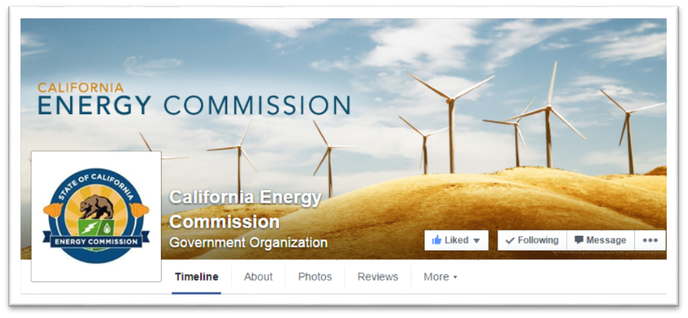


Connect With Us
Notes:
We encourage everyone to connect with us on a variety of social media platforms (Twitter, Instagram, LinkedIn, Flicker, Blogger) and the Energy Commission blog.

Slide 7
Find a Partner on EmpowerInnovation.net
Empower Innovation strives to accelerate your clean tech journey with easy access to funding opportunities from the Energy Commission and other funding providers, curated resources and events, and connections to people and organizations.
FIND A PARTNER
Announce your interest in this funding opportunity and message other interested parties to find potential partners.
RESOURCES & TOOLS
Browse the collection of resources for clean tech innovators including Resource Libraries, Funding Sources, Tools, and Databases.
https://www.empowerinnovation.net/en/custom/funding/view/52230
Notes:
Talking Points:
We encourage anyone interested in applying for a CEC grant to join Empower Innovation, the newest tool in the CEC’s Energy Innovation Ecosystem.
Empower Innovation is an online platform designed specifically for the cleantech community, and provides a great networking opportunity for individuals and organizations exploring our funding opportunities.
On Empower Innovation, you will find a community of cleantech entrepreneurs, developers, technology adopters, and community-based organizations. You will also be able to see the latest funding announcements from the CEC.
The "Find a Partner" feature allows you to announce your interest in a specific funding opportunity and view other interested parties to find potential partners in a trusted environment.
The site address for this solicitation with Empower Innovation is at the bottom of the slide.

Slide 8

EmpowerInnovation.net
Notes:
Talking Points:
We will now show a brief video describing the concept behind Empower Innovation and highlighting the various features of the platform.
In this video, you will see how Empower Innovation provides many opportunities to engage with the cleantech community and find resources and funding opportunities.
Again, we hope you will join us on EmpowerInnovation.net.

Slide 9
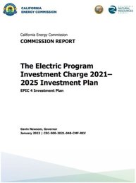
EPIC Program Background
This solicitation will award and fund projects from the Electric Program Investment Charge (EPIC) Program, an electricity ratepayer surcharge established by the California Public Utilities Commission (CPUC) in December 2011. ​​
EPIC Investment Plan 2021-25, Strategic objective: “Accelerate Advancements in Renewable Generation Technologies” (Chapter 2).​​
Initiative: Variable Renewable Energy​​
Topic: 3, Emerging Solar Energy Technologies (pp. 37-41) ​
The purpose of the EPIC program is to benefit the ratepayers of three investor-owned utilities (IOUs)​ by funding clean energy technology projects that promote greater electricity reliability, lower costs, and increased safety.
To access report: https://www.energy.ca.gov/publications/2021/electric-program-investment-charge-proposed-2021-2025-investment-plan-epic-4

Slide 10
Policy Drivers
Senate Bill (SB)-32:
Reduce GHG emissions to 40% below 1990 levels by 2030.
SBX 1-2:
Increase procurement of renewable energy resources.
SB 350:
Broadened the existing Energy Efficiency Action Plan to also cover agriculture, industry, new buildings, conservation voltage reduction, and fuel substitution.
SB 100:
100% of electricity procured from renewable energy resources and zero-carbon resources by 2045.

Slide 11


Purpose of Solicitation
Utility Scale Solar Installations
Lower cost
Increase energy output
Pair installations with battery storage
Siting in non-traditional locations
Identify community and ecosystem benefits

Slide 12
Available EPIC Funding
Project Group | Available Funding | Minimum Award | Maximum Award
Group 1: Optimization of Non-Traditional PV Solar | $3,000,000 | $1,000,000 | $2,500,000
Group 2: Data Collection and Processing for Site Assessment and Permitting | $1,500,000 | $500,000 | $1,000,000
Group 3: PV Plant Operations & Maintenance (O&M) Optimization | $1,500,000 | $500,000 | $1,000,000

Slide 13
Match Funding
20% match funding is required.
Match funding contributors must submit match funding commitment letters that meet the requirements. Failure to do so will disqualify the match funding commitment from consideration.
Refer to the Solicitation Manual for more details on match funding.
Notes:
The match requirement for this solicitation is 20% of requested CEC funds. In addition, applicants that provide match beyond the minimum requirement may receive additional points during scoring. Applicants must provide commitment letters from Match funding contributors in order to qualify, this includes any match the applicant will provide. Please see the solicitation manual for commitment letter requirements and scoring details.

Slide 14
Group 1: Optimization of Non-traditional PV Solar
Funding Amount: $3,000,000
Background:
Meeting SB 100 target will require 500,000 to 1 million acres of land for utility-scale solar PV installations.
Traditional solar in conflict with other users.
High cost for deploying solar installations in non-traditional locations.

Slide 15

Group 1: Optimizing Non-traditional PV Solar
Improve generation and storage in non-traditional locations.
Develop recommendations to optimize solar PV generation and energy storage systems.
Include innovations that mitigate impacts on or maximize benefits to ecosystems.
Source: Berkeley Food Institute

Slide 16
Group 2: Data Collection and Processing for Site Assessment and Permitting
Funding Amount: $1,500,000
Background:
Environmental effects of solar + solar not well understood
Siting and pre-installation design costly, time intensive
Opportunities:
Ease land use conflicts
Reduce impacts to ecosystems
Enhance site assessment activities

Slide 17
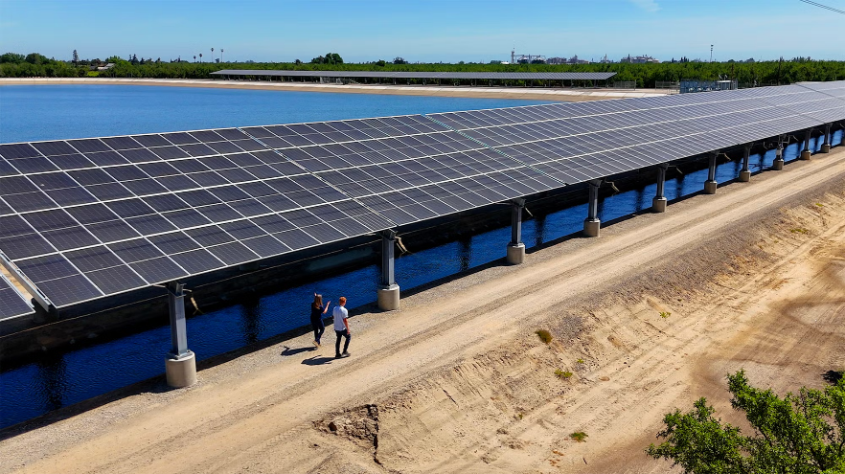
Group 2 Data Collection and Processing for Site Assessment and Permitting
Evaluate site viability
Inform permitting processes
Gather available field data
Explain the data sources and their availability
Develop guidelines and screening criteria
Source: University of California

Slide 18
Group 3: Solar PV Operations and Maintenance (O&M) Optimization
Funding Amount: $1,500,000
Background:
O&M costs ~16% total levelized cost of electricity (LCOE)
Innovative tools can reduce overall costs

Slide 19


Group 3: Solar PV O&M Optimization
Perform on-site testing to collect field data.
Develop guidelines and screening criteria for applying software tools.

Slide 20
Examples for maximizing benefits to strengthen proposal
Application of the latest research and technology developments to provide benefits across sectors
Data is applicable to real-world utility-scale solar PV and storage projects.
Clearly defined key metrics for measuring successful project outcomes. (Target Metrics, Section I.C.)

Slide 21
Additional Requirements
Include the following in the Technical Approach section of the Project Narrative (Attachment 4).
Description of:
Tool’s public accessibility
Data needed to complete project
Data sources and availability

Slide 22
Eligible Applicants
This is an open solicitation for public and private entities.
Applicants must accept applicable EPIC terms and conditions.
Standard, UC, DOE, and Tribal T&Cs available online: https://www.energy.ca.gov/funding-opportunities/funding-resources
Applicants are encouraged to register with the California Secretary of State, as all recipients must be registered and in good standing to enter into an agreement with the Energy Commission: http://www.sos.ca.gov
Notes:
The solicitation is open to all [public and private entities].
All applicants are required to accept the applicable Terms and Conditions, for this GFO when applying to this solicitation. The link to the all Terms & Conditions is also provided here. If you haven’t worked with the Energy Commission before we strongly encourage you to review these before applying.
The link to the Secretary of State website is provided here, and new applicants are encouraged to register if they haven’t already done so.

Slide 23
Application Requirements
Each Applicant must complete and include the following:
1. Executive Summary (.docx) | 8. Past Projects Information Form (.docx, .pdf)
2. Project Narrative (.docx) | 9. Commitment and Support Letters (.pdf)
3. Project Team (.docx, .pdf) | 10. Project Performance Metrics
4. Scope of Work (.docx) | 11. Applicant Declaration (.docx)
5. Project Schedule (.xlsx)
6. Budget (.xlsx)
7. CEQA Compliance Form (.docx)
Notes:
Provided is a summary of all the application attachments for this solicitation. Please note that attachments have been updated recently. All items listed are required for a complete application. The ECAMS system will prohibit incomplete applications from being submitted. Please refer to Application Manual for additional information including formatting and page limit recommendations.
Remember you can contact the Commission Agreement Officer, if you have any questions.

Slide 24
Project Narrative (Attachment 2)
This is your opportunity to explain the entirety of the project. The narrative should explain:
Why is your project necessary and important to California?
What is your project approach and how will each major task be implemented?
How will the project be completed in the term proposed?
Does the project have the appropriate resources (team and budget) to complete successfully?
How will the project outcomes benefit electric ratepayers?
Address the requirements for your group as described in Section I.C.
Respond to the scoring criteria described in Section IV.F.

Slide 25
Scope of Work (Attachment 4)
Tell us exactly what you are proposing to do in your project.
Identify what will be delivered to the Energy Commission.
Be sure to include in the technical tasks:
At least one product deliverable per task.
Address requirements in Section I.C. under Project Focus.
Be sure to include in the Project Schedule (Attachment 5):
Product deliverables that correspond with the Scope of Work.
Realistic dates on when product deliverables can be completed.

Slide 26
Budget (Attachment 6)
Identify how the Energy Commission funds and match funds will be spent to complete the project.
Subrecipients receiving $100,000 or more Energy Commission funds must complete a separate budget form.
Ensure that all rates provided are maximum estimated rates for the entire project term and any potential increases are included.
Travel Restrictions:
CEC funds should be limited to project task specific in-state travel.
Travel to conferences are generally not considered applicable travel for projects and should not use CEC funds.

Slide 27
Commitment and Support Letter Forms (Attachment 9)
Follow guidelines provided for commitment and support letters.
Commitment letters are required for entities or individuals that are committing match funding, testing/demonstration sites, including the Applicant (prime).
Support letters describe a project stakeholder’s interest or involvement in the project.
All applicants must submit at least one support letter.
Match funding must be supported by a match fund commitment letter(s).
Any project partners that will make contributions to the project (other than match and sites) must submit a commitment letter.
Limit to two pages per letter, excluding the cover page.

Slide 28
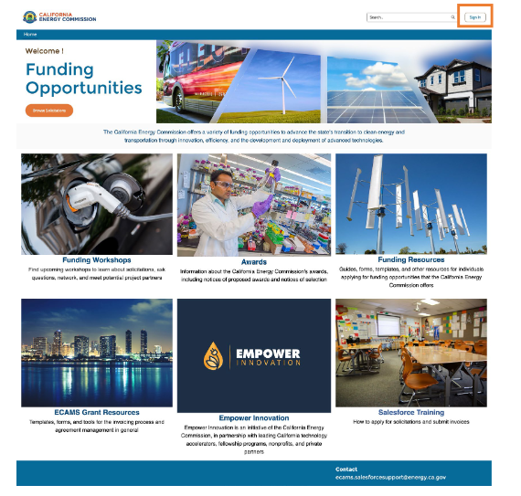
GFO Submission Requirements
Applicants must have or must create a user account to submit a solicitation application. To create an account, please see the guidance User Registration Instructions at: https://www.energy.ca.gov/media/7893
Note: One account manager per organization, but users can be added by account manager
Applications must be submitted through the Energy Commission Agreement Management System (ECAMS) at: https://ecams.energy.ca.gov/
Notes:
This solicitation will be using the new ECAMS system to receive applications. All participating applicants will need to create an account if their organization doesn’t already have one. A user guide on how to create an ECAMS account is posted on our website an can be found at the first link on the screen. Although there is only one account manager per organization, there can be multiple users added once an account is created. Applicants are strongly encouraged to register early if they are first time users. Users can submit their application at ECAMS and the link is provide at the bottom of the slide.

Slide 29
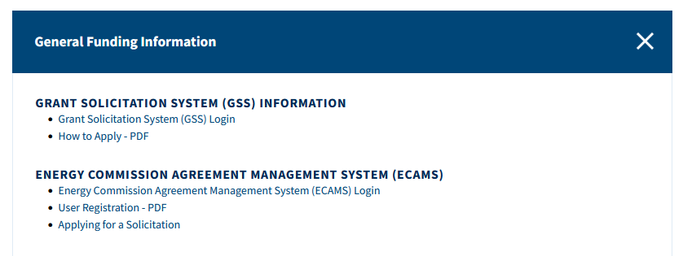
GFO Submission Requirements (cont.)
For detailed instructions on application submittal, please see the Applying for a Solicitation at: https://www.energy.ca.gov/media/7956
Both referenced guidance documents are available at: https://www.energy.ca.gov/funding-opportunities/funding-resources under General Funding Information.
Questions with the ECAMS system should be directed to: ECAMS.SalesforceSupport@Energy.ca.gov
Notes:
In addition to the User Registration we talked about, we have posted a guide to assist users in application submittal. You can find that at the address provide at the top of the slide. Applicants may find all these references on the CEC’s Funding opportunities page. If users are experiencing issues with the ECAMS system and the application process, they may reach out to our ECAMS Support staff at the email address at the bottom of the slide. Please be aware that support staff is only available during normal business hours Monday-Friday.

Slide 30
GFO Submission Requirements (cont..)
Electronic files, other than those requiring signatures, must be consistent with the specific file format provided in the solicitation.
Application documents should meet formatting requirements, and page recommendations as specified in the solicitation manual.
Attachments requiring signatures (Application Form and Support/Commitment Letters) may be signed, scanned, and submitted in PDF format.
Notes:
When submitting an application please member to submittal all attachments in the native version provided unless a signature is needed. All responses should follow the formatting and page recommendations described in the solicitation manual. Lastly, attachments needing signatures may be signed and submitted at a PDF document.

Slide 31
Submission Warning
START THE PROCESS EARLY!
Applications must be fully submitted BEFORE the deadline listed in the solicitation manual.
The ECAMS system will reject applications submitted after the deadline.
Applications in the process of being submitted prior to the deadline will NOT be accepted after the deadline.
ECAMS support is ONLY available from 8am – 5pm Monday-Friday.
Notes:
The ECAMS system will not allow applications to be submitted after the application due date and time. Please submit applications well before the deadline, and ensure all attachments are included. Please be aware that if needed, ECAMS submittal support is only available during business hours of 8am to 5 pm Monday thru Friday. Please plan accordingly.

Slide 32
Application Submission
Register as a New User (if applicable)
Log In
4-Step Application Submittal Process:
Select Solicitation
Enter Application Information
Upload Files
Select documents for upload
Tag files with document type
Designate confidential documents (if applicable)
Review and Submit
Confirmation from ECAMS system that submission was successful
All steps must be complete BEFORE the submission deadline
Notes:
The ECAMS system has multiple steps applicants must complete before applications are fully submitted. Applicants will need a user account in order to apply. Once user has logged in they will need to select the solicitation they are applying for. Applicants will enter require information into the system before uploading their application to the system. Applicants will receive a confirmation after all required documents have been successfully uploaded and submitted.

Slide 33
Application Reminders
We recommend you carefully review your application before submission.
Verify that all necessary documents have been uploaded.
Verify that all documents uploaded are the accurate version you intend to submit as your final.
Verify that your documents are not marked "confidential" unless the solicitation allows specific material to be confidential. Most solicitations do not allow submission of confidential information.
Verify that your match commitment letters accurately reflect the match amounts included in your budgets, including the match provided by the prime applicant.
Verify that support and commitment letters are included, if required.
Verify that amounts entered within the system's budget (if any) concur with information included on uploaded budget worksheets.

Slide 34

How will my Application be Evaluated?
Application Screening
Admin Screening Process
Energy Commission staff screens applications per criteria in Section IV.E.
Criteria are evaluated on a pass/fail basis.
Applicants must pass all screening criteria, or the application will be disqualified.
Some Reasons for Disqualification
Application is not submitted by the specified due date and time.
Application does not include one or more support letters.
Application contains confidential material.
Notes:
Applications will be evaluated in a two stage process. In Stage 1, the applications will be screened according to the criteria found in Section 4 of the GFO Manual. This stage is pass/fail and proposals must pass EACH requirement in order to move on to the Evaluation Committee for further review and scoring.
Some of the reasons for rejecting proposals during Stage 1 include (but are not limited to):
Application:
- is not submitted on time
--includes confidential information

Slide 35
Application Scoring
How will my Application be Evaluated?
Evaluation Committee applies the scoring scale to the scoring criteria.
Applications must obtain a minimum passing score of 52.5 points for Criteria 1-4 in order to continue evaluation.
Applications must obtain a minimum passing score of 70 points for Criteria 1-7 in order to be considered for funding.
Review Section IV of the manual and ensure the application provides a clear and complete response to each scoring criteria.
Scoring Criteria | Maximum Points
1. Technical Merit | 15
2. Technical Approach | 25
3. Impacts and Benefits for CA IOU Ratepayers | 20
4. Team Qualifications, Capabilities, and Resources | 15
5. Budget and Cost-Effectiveness | 10
6. CEC Funds Spent in California | 10
7. Ratio of Direct Labor Costs to Indirect Costs | 5
Total | 100
Minimum Points to Pass | 70
Notes:
In Stage 2, the Evaluation Committee will use the Scoring Scale, which can be found in the GFO Manual, as a guide to score each criterion listed.
I want to point out to experienced applicants that the scoring criteria has been updated, so we encourage you all to read carefully the new scoring criteria.
Applicants must then score at least a 70% for the first section of the scoring criteria (this is criterion 1-4), in order be evaluated for the second section (which includes criterion 5-7). Additionally, applicants must pass with a minimum of 70% of the total combined points possible in order to be considered for an award.
An area to highlight is Funds Spent in California which is often confusing for applicants that have not worked with the Energy Commission before. “Spent in California” means that: (1) Funds under the “Direct Labor” category and all categories calculated based on direct labor (Prime and Subcontractor Labor Rates) are paid to individuals who pay California state income taxes on wages received for work performed under the agreement; and/or (2) Business transactions that are entered into with a business located in California. Out of state workers and travel out of state do not count.

Slide 36
Application Scoring Preference Points
How will my Application be Evaluated?
Passing applications (score of 70 or more from Criteria 1-7) will be considered for bonus points. Criteria for bonus points include:
Disadvantaged Communities
Scoring Criteria | Maximum Points
8. Disadvantaged & Low-income Communities | 10
Total Bonus Points | 10
Notes:
Preference points may will be awarded to applications that include benefits to disadvantaged & low-income communities as described in Scoring Criteria. Preference points will only be applied to those obtaining the minimum of 70% passing score.

Slide 37
Disadvantaged Communities
Projects with all test or demonstration sites located in disadvantaged and/or low-income communities and justifies how the project will benefit these communities may receive additional points.
A disadvantaged community is identified by census tract and represents the 25% highest scoring tracts in CalEnviroScreen 4.0 or later versions: https://oehha.ca.gov/calenviroscreen/report/calenviroscreen-40
Low-income communities are defined as communities within census tracts with median household incomes at or below 80 percent of the statewide median income, or at or below the threshold designated as low-income by the California Department of Housing and Community Development. http://www.hcd.ca.gov/grants-funding/income-limits/index.shtml

Slide 38
Next Steps After Grant Award
Notice of Proposed Award: Shows total proposed funding amounts, rank order of applicants by project group, and the amount of each proposed award.
Applicant Debriefings: Applicants may request a debrief of their application evaluation within 30 days of the NOPA posting.
Agreement Development: Proposal documents will be processed into a legal agreement.
Failure to Execute: The Energy Commission reserves the right to cancel the pending award if an agreement cannot be successfully executed with an applicant.
Project Start: Recipients may begin work on the project only after the agreement is fully executed (approved at an Energy Commission business meeting and signed by the Recipient and the Energy Commission).
Notes:
A Notice of Proposed Award is posted after all applications have been evaluated and scored by the evaluation team.
Applicants may choose to request a debriefing of their application by the evaluation team. All requests must be made within 30 calendar days of the NOPA posting date. The purpose of these debriefings are to provide feedback to applicants so that they may improve upon their future applications. Debriefings are not intended to be a comprehensive examination of all deficiencies within an application.
After the NOPA posting, the Commission Agreement Manager will work with awardees to develop the agreement. Because of the tight timeline, awardees need to be available and ready to provide needed edits and answers to questions.
The Energy Commission reserves the right to cancel the pending award if an agreement cannot be made.
The project can only begin after both the recipient and the Energy Commission have signed the agreement.
Neither match funding nor Energy Commission funds can be spent before the grant agreement has been fully executed.
Applicants who did not receive an award may request a debrief with the Commission Agreement Officer.

Slide 39
Key Dates
Activity | Date
Solicitation Release | March 18, 2026
Pre-Application Workshop | April 9, 2026 at 10:00 am
Deadline for Written Questions | April 23, 2026 at 5:00 pm
Anticipated Distribution of Questions and Answers | Week of May 4, 2026
Deadline for ECAMS Submission Support | Ongoing until June 9, 2026 at 5:00 pm
Deadline to Submit Applications | June 9, 2026 at 11:59 pm
Anticipated Notice of Proposed Award Posting | Week of August 10, 2026
Anticipated Energy Commission Business Meeting | November 13, 2026
Anticipated Agreement Start Date | December 1, 2026
Anticipated Agreement End Date | March 31, 2030
Notes:
Listed are the key dates for this solicitation. We will be accepting written questions until 5 PM April 23rd and anticipate having written questions and answers posted the week of May 4th.
The deadline to submit applications is June 9th at 11:59 pm (There are NO EXCEPTIONS)
We anticipate posting the NOPA on or about August 10th and taking the resulting agreements to a November Business Meeting.
This means that once the NOPA is issued, the awardees need to be available for agreement development. We may move on to the next ranked applicant if we feel the funding is in jeopardy due to the delay of the awardee.
We anticipate an agreement start date of December 1st.

Slide 40
Questions and Answers
Please chat your question into the Q & A window or raise your hand and you will be called on to unmute yourself. Please remember to introduce.
Keep questions under 2 minutes to allow time for others.
Note that our official response will be given in writing and posted on the GFO webpage.
Notes:
We will now start our questions and answers period. We will start with questions in the Q&A and will then move to attendees who would like to ask their questions live. You can also ask your question using the Q&A window. Or you may raise your hand and we will call on you to unmute yourself. (Feature found under the Participants panel) Please remember to introduce yourself by stating your name and affiliation and to keep questions under 3 minutes to allow time for other attendees. Please note that our official response will be given in writing and posted on the GFO webpage.

Slide 41
Additional Questions
Please send all questions related to GFO-25-306 to:
Natalia Calderon
Commission Agreement Officer
715 P St., MS-1
Sacramento, CA 95814
natalia.calderon@energy.ca.gov
Deadline to submit questions:
Thursday, April 23rd 5:00 PM
Notes:
Additional technical questions can be sent to the Commission Agreement Officer. Their information is listed on this slide.
Just as a reminder, this deadline does not apply to non-technical questions or to questions that address an ambiguity, conflict, discrepancy, omission, or other possible errors in the solicitation. Such questions may be submitted to the Commission Agreement Officer at any time prior to the application deadline.

Slide 42
Thank You!
Notes:
Thank you all for interest and attending this Pre-Application workshop.

