Slide 1
GFO-25-605 Pre-Application Workshop
Reliable Electric Charging for Eligible School-Bus Sites (RECESS)
Fuels and Transportation Division
April 16, 2026 | 09:00 a.m.

Slide 2
Workshop Agenda
Welcome and Introductions
Solicitation Overview
Application Components
Application Evaluation
Application Submittal
Questions & Answers
Next Steps
Adjourn

Slide 3
Housekeeping
Workshop is recorded on Zoom
Grant Funding Opportunity (GFO) Webpage: https://www.energy.ca.gov/solicitations/2026-04/gfo-25-605-reliable-electric-charging-eligible-school-bus-sites-recess
Virtual Participation via Zoom or telephone during the Q&A period
Written Questions to Commission Agreement Officer:
Carissa Peri, email: Carissa.peri@energy.ca.gov
Subject: GFO-25-605
Q&A Deadline: Monday, April 27, 2026, by 5:00 PM

Slide 4
Commitment to Diversity
The CEC adopted a resolution strengthening its commitment to diversity in our funding programs. The CEC continues to encourage disadvantaged and underrepresented businesses and communities to engage in and benefit from our many programs.
To meet this comment, CEC staff conducts activities to:
Engage with disadvantaged and underrepresented groups throughout the state;
Notify potential new applicants about the CEC’s funding opportunities;
Assist applicants in understanding how to apply for funding from the CEC’s programs;
Survey participants to measure progress in diversity outreach efforts.

Slide 5
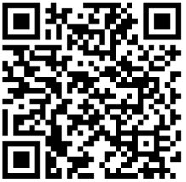
Diversity Survey
One Minute Survey
The information supplied will be used for public reporting purposes to display anonymous overall attendance of diverse groups
Zoom Participants, please use the link in the chat to access the survey or scan the QR code on the left of the screen with a phone or tablet to access the survey
Survey will be closed at the end of the day
Scan the code on a phone or tablet with a QR reader to access the survey.

Slide 6
Find Partners on EmpowerInnovation.net
Empower Innovation aims to accelerate your clean tech journey with easy access to funding opportunities from the Energy Commission and others, resources and events, and connections to people and organizations.
www.empowerinnovation.net
FIND A PARTNER
Announce your interest in funding opportunities and message potential project partners directly.
RESOURCES & TOOLS
Browse the collection of resources including Resource Libraries, Funding Sources, Tools, and Databases.

Slide 7

EmpowerInnovation.net

Slide 8
Clean Transportation Program
Established in 2007 by Assembly Bill 118 (2007)
Extended to July 1, 2035, by Assembly Bill 126 (2023)
Provides approximately $100 million of funding per year
Investment Plan determines funding allocations across various categories

Slide 9
Solicitation Overview

Slide 10
Purpose of Solicitation
Multi-funding lane grant solicitation that makes $22 million in grant funds available for projects that will install charging infrastructure for existing and future electric school bus deployments
Overview of funding lanes:
Funding Lane 1 ($4 million available): First come, first served
Funding Lane 2 ($9 million available): Competitive
Funding Lane 3 ($9 million available): Competitive
Solicitation Manual p. 1-5, "Introduction"

Slide 11
Maximum Number of Applications
Applicants are only eligible to submit one application under this solicitation
Applicants must choose only one funding lane when applying
Applications can include multiple eligible project site locations
Solicitation Manual p. 7, "Maximum Number of Applications"

Slide 12
Funding Lane 1
First Come, First Served
$4 million in grant funds available
Eligible applicants: Local educational agencies that received Clean Truck and Bus Incentive Project (HVIP) Public School Bus Set Aside (PSBSA) Year 1 or Year 2 funded electric school buses, but did not receive the CEC’s Energy Infrastructure Incentives for Zero-Emission Commercial Vehicles Project (EnergIIZE) PSBSA Year 1 or Year 2 infrastructure funding
Single applicant cap: The maximum number of charging ports an applicant can request is based off the number of HVIP PSBSA electric school buses the applicant received
See Table 4 in the solicitation manual for a list of eligible applicants and the maximum number of charging ports each Applicant can request
Solicitation Manual p. 4-6, "Funding Lanes" and p. 11-13, "Applicant Requirements"

Slide 13
Funding Lane 2
Competitive
$9 million in grant funds available
Eligible applicants: California local educational agencies that serve K-12th grade students, which include public school districts, public charter schools, Joint Power Authorities, and County Offices of Education
Private schools are not eligible applicants
Applicants eligible under Funding Lane 1 may apply for up to the maximum number of charging ports shown in Table 4 of the solicitation manual, or they can apply under Funding Lane 2 for more than the maximum number of charging ports shown in Table 4
Single applicant cap: $2,250,000
Solicitation Manual p. 4-6, "Funding Lanes" and p. 11-13, "Applicant Requirements"

Slide 14
Funding Lane 3
Competitive
$9 million in grant funds available
Eligible applicants: Third-party transportation providers, defined as transportation service providers that own and maintain school buses and provide transportation services to K-12th grade students from local educational agencies
A local educational agency applying in Funding Lane 1 or Funding Lane 2 cannot also be a local educational agency served in Funding Lane 3
Single applicant cap:
$2,250,000 for an Applicant that serves one local educational agency
$4,500,000 for an Applicant that serves more than one local educational agency
Solicitation Manual p. 4-6, "Funding Lanes" and p. 11-13, "Applicant Requirements"

Slide 15
Maximum Award Amount
Determined by the number of grid-connected charging ports an Applicant can demonstrate need for and the type of grid-connected charger proposed to be installed
Applicants can apply to purchase and install at maximum one grid-connected charging port per electric school bus that they can demonstrate is in need of charging infrastructure
Example: An Applicant can apply for two dual port grid-connected chargers (four ports total) if they can demonstrate they have four electric school buses that need supporting charging infrastructure
Solicitation Manual p. 5-7, “Maximum Award Amounts"

Slide 16
Maximum Award Amount By Charger Type
Charger Type | Maximum Award Amount
Level 2 (L2) Charging Port | $20,000
Dual Port Direct Current Fast Charger (DCFC) or Dual Port Bidirectional DCFC* | $75,000
*All DCFCs or bidirectional DCFCs proposed to be installed under this grant solicitation must be dual port
Solicitation Manual p. 7, "Table 3: Maximum Award Amounts by Charger Type"

Slide 17
Maximum Award Amount Equation
Applicants can use the following equation to calculate their maximum award amount:
(Number of L2 charging ports to be installed x $20,000)
+ (Number of Dual Port DCFCs to be installed x $75,000)
= Maximum award amount, up to the single applicant cap
by funding lane
Solicitation Manual p. 5-7, "Maximum Award Amounts"

Slide 18
Maximum Award Amount Example
An Applicant can demonstrate they have four electric school buses that need supporting charging infrastructure. Thus, they can apply for grant funds for up to four charging ports.
Proposal 1: The Applicant could propose to install one dual port grid-connected L2 charger and one dual port grid-connected DCFC, and be eligible for a maximum award of $115,000 for its infrastructure project.
Proposal 2: The Applicant could propose to install two dual port grid-connected L2 chargers, and be eligible for a maximum award of $80,000 for its infrastructure project.
Solicitation Manual p. 5-7, "Maximum Award Amounts"

Slide 19
Match Funding
There is no match share requirement
Applicants may use funding sources other than funding from other active CEC projects to supplement eligible project costs
Solicitation Manual p. 24, “Match Funding Requirements”

Slide 20
Eligible Project Costs
An Applicant's award amount is intended to cover all eligible costs associated with the purchase and installation of the proposed grid-connected charger(s), and can cover other eligible infrastructure project costs after the aforementioned costs are fully covered.
Example: If an Applicant requests the maximum award of $80,000 for two dual port grid-connected L2 chargers and the cost of the chargers and their installation is estimated to be $60,000, then the Applicant can budget for $20,000 in other eligible project costs such as but not limited to commercially available zero-emission distributed energy resources, mobile chargers, or off-grid chargers.
Solicitation Manual p. 5, "Maximum Award Amounts" and p. 23 – 24, "Eligible Project Costs"
"Eligible Project C

Slide 21

Eligible Project Costs Examples
CEC reimbursable project costs are limited to actual eligible costs incurred during the agreement term. Eligible project costs include but are not limited to:
Charging infrastructure warranties
Commercially available zero-emission distributed energy resources, such as battery energy storage systems or solar photovoltaics
Commercially available zero-emission mobile chargers
Demand management equipment/software
Electric meters and panels
Electricity transmission materials
Grid-connected chargers
Installation and commissioning costs
Mandatory utility service upgrades that are not paid by the utility
Networking agreement
Operation and maintenance service agreement
Planning and engineering design
Solicitation Manual p.23 – 24, “Eligible Project Costs”

Slide 22
Ineligible Project Costs
Examples
Ineligible project costs include but are not limited to:
Applicant’s direct labor, fringe benefits, and indirect costs or overhead​
Charging-as-a-service​
Cost of electricity or power​
Design and/or manufacturing of chargers​
Distributed energy resources used to meet Energy Code requirements
Electric school bus procurement​
Electric school bus related expenses
Equipment that is received from warranty insurance claims​
Equipment that is resold, rebuilt, or rented/leased​
Outreach and engagement ​
Profit for Applicant​
Research and development ​
Software development​
Travel costs​
Solicitation Manual p. 25, “Ineligible Project Costs”​

Slide 23
Project Requirements
Infrastructure Deployment Requirements
Must install a newly purchased grid-connected charging port
Proposed charging ports may replace existing charging ports that are not operational and are not under warranty, with adequate justification and evidence provided in Letter Indicating Need for New Infrastructure (Attachment 8)​
Repairing charging ports or installing new parts in existing units is not eligible under this solicitation ​
All charging ports must meet the Minimum Technical Requirements listed in Section II.C of the solicitation manual
Solicitation Manual p. 14 – 22, “Project Requirements”

Slide 24
Project Requirements Ownership and Usage Requirements
The Applicant must be the owner of the electric school buses and all proposed charging infrastructure ​
All charging ports must be operational for a minimum of six years after commissioning and have a product warranty that covers both parts and labor and lasts for at least six years post commissioning​
All charging ports must collect data from the project and perform recordkeeping and reporting on operations and reliability as specified in the Scope of Work (Attachment 4)​
Solicitation Manual p. 14 – 22, “Project Requirements”

Slide 25
Project Requirements Location Requirements
The proposed grid-connected and off-grid (if any) charging infrastructure must be located in an Applicant's bus yard(s) or depot(s) in California​
The proposed grid-connected and off-grid (if any) charging infrastructure must be located at existing structures or facilities and involve negligible or no expansion of existing or former use ​
The Applicant must demonstrate ownership or contractual right to access all project sites
Solicitation Manual p. 14 – 22, “Project Requirements”

Slide 26
Project Requirements Electric School Bus Deployment Requirements
Electric school buses supported by the proposed charging infrastructure must either be new electric school buses to be purchased or existing electric school buses that are not in operation due to a lack of charging infrastructure ​
Demonstrated in Letter of Intent to Place a Purchase Order and/or a Letter Indicating Need for New Infrastructure (Attachment 8)​
All electric school buses to be procured must be on the HVIP Vehicle Catalog, which can be found at https://californiahvip.org/vehicle-category/school-bus/?type=655
Solicitation Manual p. 14 – 22, “Project Requirements”

Slide 27
Project Requirements Timeline Requirements
The CEC reserves the right to cancel proposed awards that do not meet these deadlines:
Within three months of the release date of the Notice of Proposed Awards,
Applicants proposed for award must submit correspondence from the project site’s(s’) utility provider(s) that confirms the utility will provide necessary power at the project site(s)
All projects proposed for award must provide evidence the California Environmental Quality Act (CEQA) process was completed by the lead agency​
Within six months of the project's approval at a CEC Business Meeting, ​
Agreements must be executed by the funding Recipient​
Within six months of agreement execution,​
Funding Recipients that submitted a Letter of Intent to Place a Purchase Order (Attachment 8) must place and provide evidence of the purchase order(s)
Solicitation Manual p. 7, “Agreement Execution Date,” p. 14 – 22, "Project Requirements"​

Slide 28
Application Components

Slide 29
Application Content
Item​ | Attachment Number​ | Funding Lane​
Application Form ​ | Attachment 1 ​ | All ​
Funding Lane 2 Project Narrative ​ | Attachment 2 ​ | 2 ​
Funding Lane 3 Project Narrative ​ | Attachment 3 ​ | 3 ​
Budget Forms ​ | Attachment 6 ​ | 2 and 3 ​
Letters of Commitment ​ | Attachment 7 ​ | 3 ​
Letter of Intent to Place a Purchase Order AND/OR ​ Letter Indicating Need for New Infrastructure ​ | Attachment 8 ​ | 2 and 3 ​
Evaluation Criteria for Priority Populations ​ | Attachment 9 ​ | 2 and 3 ​
CEQA Worksheet ​ | Attachment 10 ​ | 2 and 3 ​
Past Performance Form​ | Attachment 11​ | 3​
Application Declaration​ | Attachment 12​ | All​

Slide 30
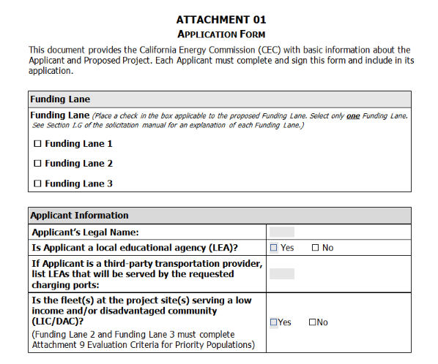
Application Form
Attachment 1
Required for all Funding Lanes​
Requests the following: ​
Funding lane​
Applicant and project manager information​
Amount of CEC funding requested​
Charging equipment information​
Term of project​
Site address(es)​
Electric school bus information​
CEQA compliance information​
Site ownership or access rights information​
Key project partners
Solicitation Manual p. 27-39, “Application Content”​

Slide 31
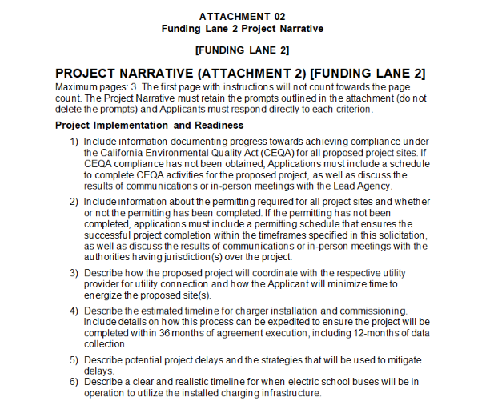
Funding Lane 2 Project Narrative
Attachment 2
Required only for Funding Lane 2​
Limited to 3 pages​
First page with instructions will not count towards the page count​
Must retain the prompts outlined in the attachment (do not delete the prompts)
Include page numbers​
Project Narrative must address each scoring criterion described in the Funding Lane 2 Evaluation Criteria (p. 45-46)​
Solicitation Manual p. 27-39, “Application Content”​

Slide 32
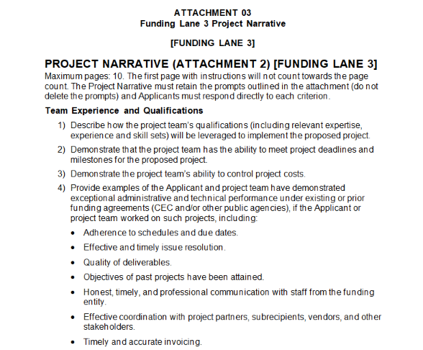
Funding Lane 3 Project Narrative
Attachment 3
Required only for Funding Lane 3
Limited to 10 pages​
First page with instructions will not count towards the page count​
Must retain the prompts outlined in the attachment (do not delete the prompts)
Include page numbers​
Project Narrative must address each scoring criterion described in the Funding Lane 3 Evaluation Criteria (p. 46-47)​
Solicitation Manual p. 27-39, “Application Content”​

Slide 33
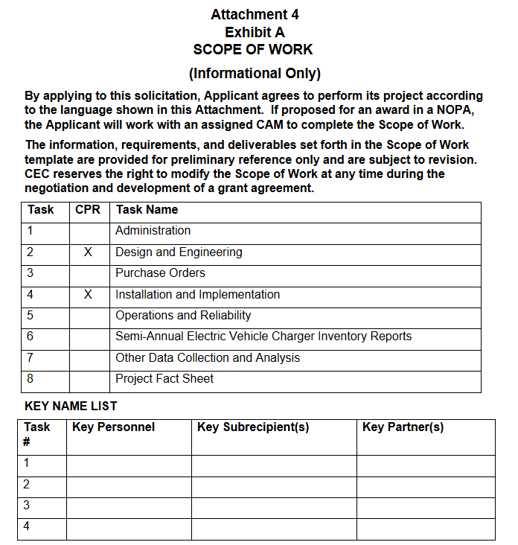
Scope of Work
Attachment 4
Informational only – do not submit​
By applying to this solicitation, the Applicant agrees to perform its project according to the language shown in Attachment 4 ​
If proposed for award in a NOPA, the Applicant will work with an assigned Commission Agreement Manager to complete the Scope of Work
Solicitation Manual p. 27-39, “Application Content”​

Slide 34
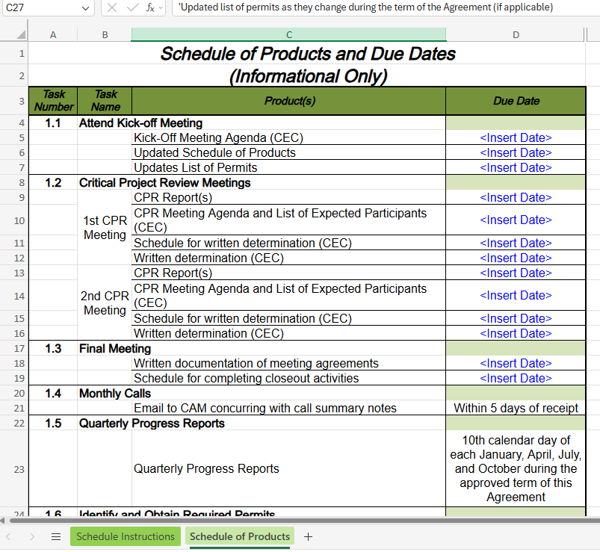
Schedule of Products and Due Dates
Attachment 5
Informational only – do not submit​
Projects should be completed within 36 months of agreement execution, including 12-months of data collection, under normal circumstances​
All work must be scheduled for completion no later than March 31, 2030, to allow timely processing of final invoices before the liquidation date of CEC funds
Solicitation Manual p. 27-39, “Application Content”​

Slide 35
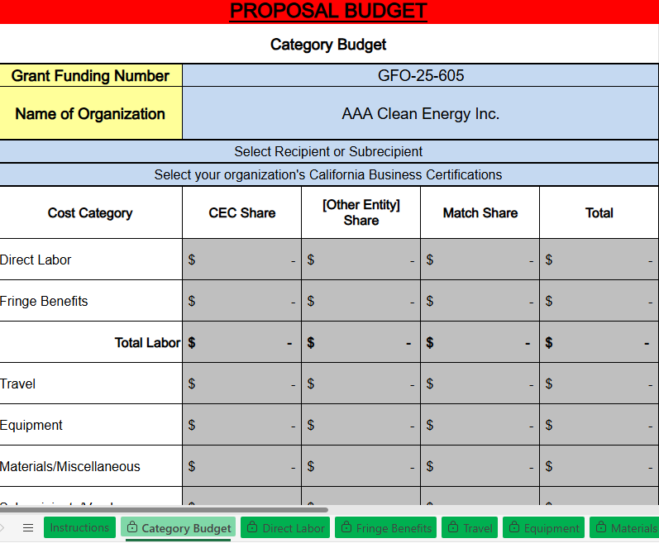
Budget Forms
Attachment 6
Required for Funding Lane 2 and Funding Lane 3​
Informational for Funding Lane 1 – Do not Submit
Solicitation Manual p. 27-39, “Application Content”​

Slide 36
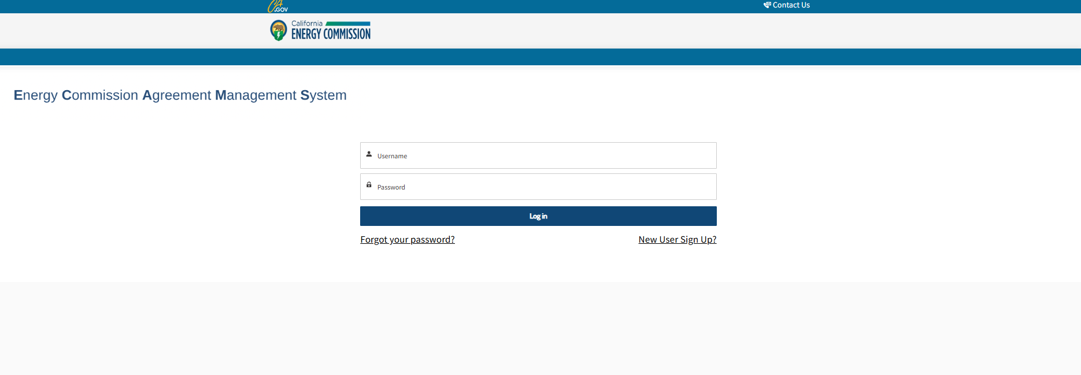
Budget Forms Attachment 6 Entry: Option 1
Applicants enter budget information directly into ECAMS for Prime Applicant ONLY and upload Excel Attachment 6 for both Prime and Major Subrecipient(s)​
Identify how CEC funds will be spent to complete the project​
CEC ECAMS Resources webpage: https://www.energy.ca.gov/funding-opportunities/funding-resources/ecams-resources ​
Solicitation Manual p. 27-39, “Application Content”​

Slide 37
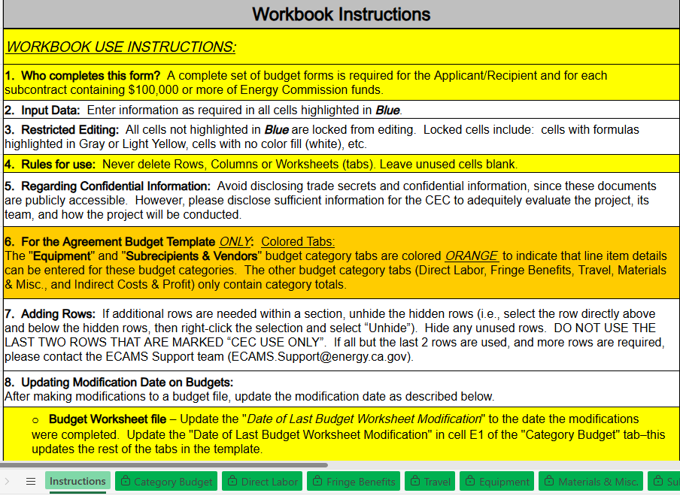
Budget Forms Attachment 6 Entry: Option 2
Upload all budgets (Prime and Major Subrecipients) as MS Excel attachments​
Follow Budget Instructions​
Identify how CEC funds will be spent to complete the project​
CEC ECAMS Resources webpage at: https://www.energy.ca.gov/funding-opportunities/funding-resources/ecams-resources
Solicitation Manual p. 27-39, “Application Content”​

Slide 38
Letters of Commitment
Attachment 7
Required only for Funding Lane 3​
Applicants must submit the following commitment letters: ​
Key Project Partners: Letters from key project partner(s) verifying their ability to fulfill their identified roles​
Service Agreement Documentation: Letters from each local educational agency that the project will support that verifies an existing transportation service agreement with the local educational agency prior to application submission​
Station Site Owner Letter of Commitment: Letter of commitment from the current owner of the site for each proposed charging station location that indicates the site owner will operate, or allow the Applicant to operate, the proposed charging ports for a minimum of six years after commissioning ​
Letters are limited to two-pages each ​
Solicitation Manual p. 27-39, “Application Content”​

Slide 39
Letter of Intent to Place a Purchase Order AND/OR Letter Indicating Need for New Infrastructure
Attachment 8
Required by Funding Lane 2 and Funding Lane 3​
Letter of Intent to Place a Purchase Order: Must reflect plans to place a purchase order within six months of grant agreement execution, and specify the type(s) and number(s) of electric school buses to be procured and justify the need for the proposed infrastructure ​
Letter Indicating Need for New Infrastructure: Must state the type(s) and number(s) of electric school buses that are in need of charging infrastructure and explain the need for the new infrastructure. Reasons may include, but are not limited to: ​
Existing charging infrastructure is insufficient for the current fleet of electric school buses ​
Existing charging ports are not operational, are not under warranty, and need to be replaced​
Letters are limited to two-pages​
Solicitation Manual p. 27-39, “Application Content”​

Slide 40
Evaluation Criteria for Priority Populations
Attachment 9
Required by Funding Lane 2 and Funding Lane 3​
Must submit a map of their service boundaries with the addresses of at least two stops in their service boundaries to verify whether the project will serve priority populations ​
Priority populations include low-income communities and/or disadvantaged communities that are determined using the California Climate Investments Priority Populations map, located online at https://gis.carb.arb.ca.gov/portal/apps/experiencebuilder/experience/?id=5dc1218631fa46bc8d340b8e82548a6a&page=Priority-Populations-4_0
A project will be considered to serve priority populations if any portion of their service boundaries overlaps with a designated low-income or disadvantaged community area on the map ​
Solicitation Manual p. 27-39, “Application Content”​

Slide 41
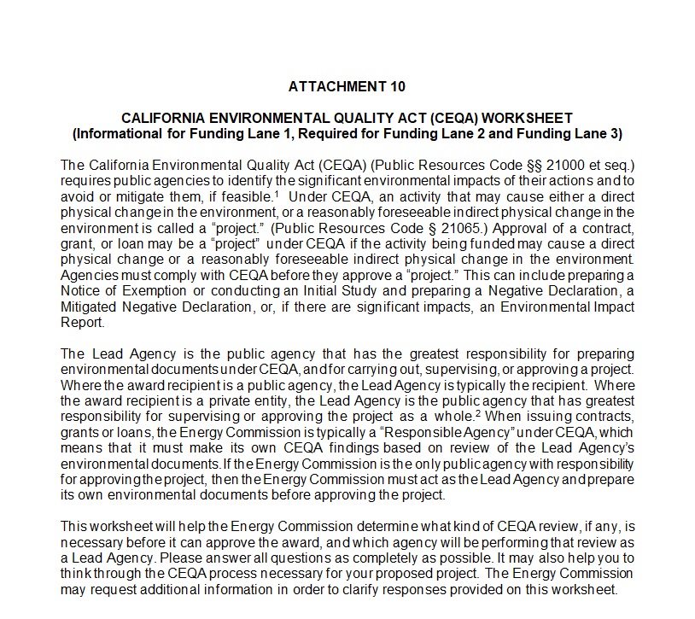
CEQA Worksheet
Attachment 10
Required for Funding Lane 2 and Funding Lane 3​
Informational for Funding Lane 1​
Applicants must submit a complete Attachment 10​
The CEC requires this information to assist with our CEQA determinations
Solicitation Manual p. 27-39, “Application Content”​

Slide 42
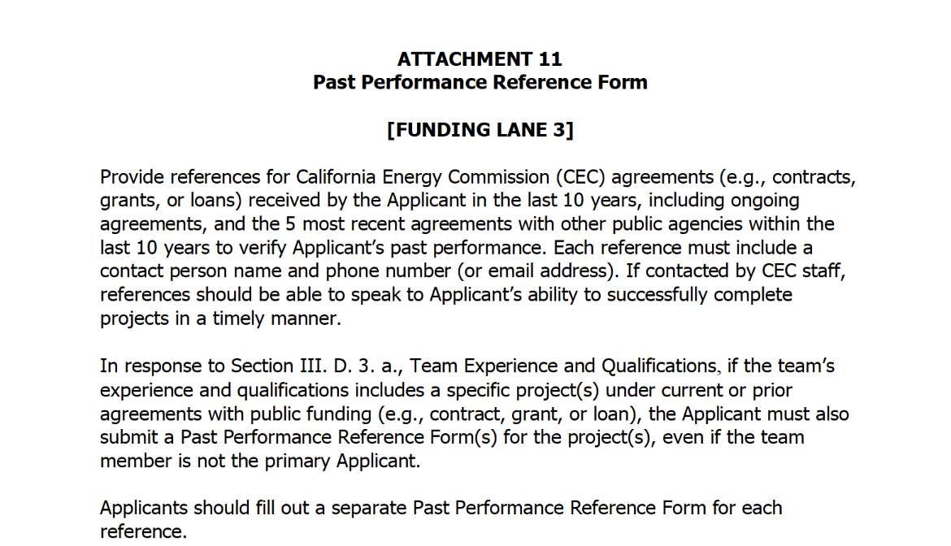
Past Performance Reference Form
Attachment 11
Required only for Funding Lane 3
Must provide reference forms for:​
CEC agreements received by the Applicant in the last ten years​
The five most recent agreements with other public agencies within the past ten years​
References must include a contact person name and phone number or email address
Applicants should fill out a separate Past Performance Reference Form for each agreement reference
Solicitation Manual p. 27-39, “Application Content”​

Slide 43
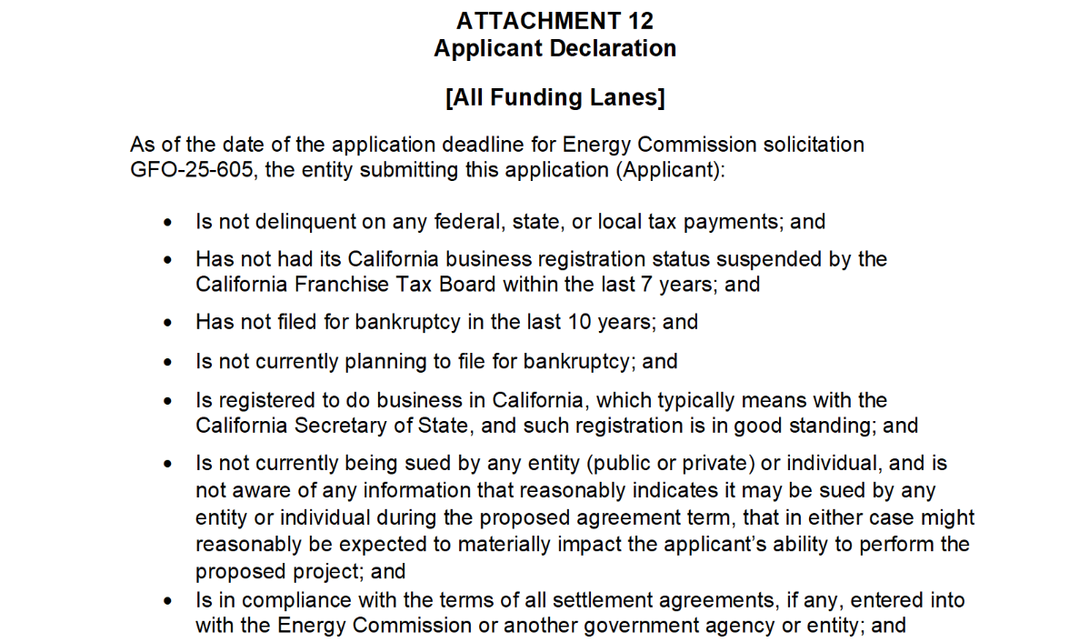
Applicant Declaration
Attachment 12
Required by all funding lanes​
Applicants must complete Attachment 12 in order for the application to be considered complete
Solicitation Manual p. 27-39, “Application Content”​

Slide 44
Application Evaluation

Slide 45
Application Evaluation Overview
Stage One for all Funding Lanes: Application Screening​
(Pass/Fail)​ Administrative Screening Criteria
(Pass/Fail) Technical Screening Criteria
Stage Two for Funding Lane 2 and Funding Lane 3: Application Evaluation​
Competitive scoring
Applicants must pass ALL screening criteria, or the application shall be rejected and eliminated from further evaluation
Funding Lane 1 (first come, first serve) applicants may resubmit an application before the application's deadline if their application is rejected
Solicitation Manual p. 40 – 42, "Application Evaluation"​

Slide 46
Application Evaluation Administrative Screening Criteria
Criteria ​ | Pass/Fail​
The application is received by the due date and time specified in the “Key Activities Schedule” in Section I of this solicitation. ​ | Pass or Fail​
2. The Applicant has not included a statement that is contrary to the required authorizations and certifications when submitting in ECAMS. ​ | Pass or Fail​
Solicitation Manual p. 40 – 44, "Application Evaluation"​

Slide 47
Application Evaluation Technical Screening Criteria
Criteria ​ | Pass/Fail​
The Applicant is an eligible Applicant. ​ | Pass or Fail​
2. The project is an eligible project. | Pass or Fail​
Solicitation Manual p. 40 – 44, "Application Evaluation"​

Slide 48

Past Performance Screening
An applicant may be disqualified due to severe performance issues characterized by significant negative outcomes under one or more prior or active CEC agreement(s) within the last ten years
Any applicant that does not have an active or prior agreement equates to no severe performance issues and therefore would pass this screening criteria
Solicitation Manual p. 40 – 44, "Application Evaluation"​

Slide 49
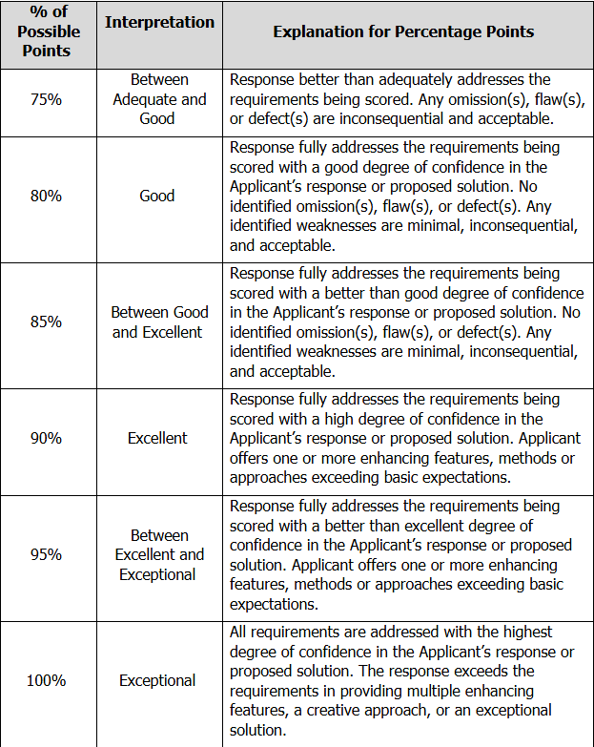
Application Evaluation Funding Lane 2 and Funding Lane 3 Scoring
The Evaluation Committee applies the scoring scale to the evaluation criteria​
Applications must obtain a minimum passing score of 70% or 70 points in order to be considered for funding​
Review Section IV of the solicitation manual and ensure the application provides a clear and complete response to all scoring criteria​
Solicitation Manual p. 43-47, "Scoring Scale", and "Evaluation Criteria"

Slide 50
Funding Lane 2 Application Evaluation
Scoring Criteria
Scoring Criteria​ | Possible Points​
Project Implementation and Readiness*​ | 80​
Budget​ | 10​
Innovation and Benefits​ | 10​
Total Possible Points​ | 100​
Minimum Points to Pass (70%)​ | 70​
*Project Implementation and Readiness must obtain a minimum passing score of 56 points (70 percent) within this evaluation criterion to be eligible for funding.
Solicitation Manual p. 43-47, "Scoring Scale", and "Evaluation Criteria"

Slide 51
Funding Lane 2 Scoring Criterion
Project Implementation and Readiness
Applications will be evaluated on the degree to which:​
The proposed project has achieved compliance under CEQA
Required permitting for the proposed project has been completed
The estimated timeline to energize the site(s) is realistic and minimized
The estimated timeline for charger installation and commissioning is realistic and expedited
Potential project delays and strategies to mitigate delays are identified
The timeline for when electric school buses will be in operation to utilize the installed charging infrastructure is clear and realistic
Solicitation Manual p. 43-47, "Scoring Scale", and "Evaluation Criteria"

Slide 52
Funding Lane 2 Scoring Criterion Budget
Applications will be evaluated on the degree to which:​
The proposed budget is complete and provides confidence that the applicant has anticipated all eligible costs associated with the proposed infrastructure project
The proposed budget is justifiable and reasonable, and the cost per charging port is minimized
Solicitation Manual p. 43-47, "Scoring Scale", and "Evaluation Criteria"

Slide 53
Funding Lane 2 Scoring Criterion Innovation and Benefits
Applications will be evaluated on the degree to which:​
The proposed project will provide direct, meaningful and assured benefits or serve residents of disadvantaged and low-income communities (“priority populations”) in accordance with the California Climate Investments Priority Populations map, located online at https://gis.carb.arb.ca.gov/portal/apps/experiencebuilder/experience/?id=5dc1218631fa46bc8d340b8e82548a6a&page=Priority-Populations-4_0
Solicitation Manual p. 43-47, "Scoring Scale", and "Evaluation Criteria"

Slide 54
Funding Lane 3 Application Evaluation
Scoring Criteria
Scoring Criteria​ | Possible Points​
Team Experience and Qualifications​ | 20​
Project Implementation and Readiness*​ | 30​
Budget​ | 30​
Innovation and Benefits​ | 20​
Total Possible Points​ | 100​
Minimum Points to Pass (70%)​ | 70​
*Project Implementation and Readiness must obtain a minimum passing score of 21 points (70 percent) within this evaluation criterion to be eligible for funding.
Solicitation Manual p. 43-47, "Scoring Scale", and "Evaluation Criteria"

Slide 55
Funding Lane 3 Scoring Criterion Team Experience and Qualifications
Applications will be evaluated on the degree to which:​
The project team’s qualifications are appropriate for successful implementation of the proposed project ​
The project team demonstrates the ability to meet deadlines and milestones for the proposed project
The project team demonstrates the ability to control project costs
The Applicant and project team have demonstrated exceptional administrative and technical performance under existing or prior funding agreements (CEC and/or other public agencies), if the Applicant or project team worked on such projects​
Solicitation Manual p. 43-47, "Scoring Scale", and "Evaluation Criteria"

Slide 56
Funding Lane 3 Scoring Criterion Project Implementation and Readiness
Applications will be evaluated on the degree to which:
The proposed project has achieved compliance under CEQA
Required permitting for the proposed project has been completed
The estimated timeline to energize the site(s) is minimized
The estimated timeline for charger installation and commissioning is realistic and expedited
Potential project delays and strategies to mitigate delays are identified
The timeline for when electric school buses will be in operation to utilize the installed charging infrastructure is clear and realistic
Solicitation Manual p. 43-47, "Scoring Scale", and "Evaluation Criteria"

Slide 57
Funding Lane 3 Scoring Criterion
Budget
Applications will be evaluated on the degree to which:
The proposed budget reflects a cost-effective use of CEC funds, including a clear rationale for the requested CEC funds and the cost per charging port
The Applicant demonstrates the need for state funding for the proposed project
The proposed budget is justifiable and reasonable, and the cost per charging port is minimized
Solicitation Manual p. 43-47, "Scoring Scale", and "Evaluation Criteria"

Slide 58
Funding Lane 3 Scoring Criterion Innovation and Benefits
Applications will be evaluated on the degree to which:
The proposed project mitigates potential negative grid impacts related to EV charging
The proposed charging infrastructure will support the operation of existing electric school buses and/or electric school buses to be procured
The proposed project will provide direct, meaningful and assured benefits or serve residents of disadvantaged and low-income communities (“priority populations”) in accordance with the California Climate Investments Priority Populations map, located online at https://gis.carb.arb.ca.gov/portal/apps/experiencebuilder/experience/?id=5dc1218631fa46bc8d340b8e82548a6a&page=Priority-Populations-4_0
Solicitation Manual p. 43-47, "Scoring Scale", and "Evaluation Criteria"

Slide 59
Tie Breakers
Funding Lane 2 and Funding Lane 3
If the score for two or more applications is tied, the application with the higher score in the Project Implementation and Readiness criterion will be ranked higher
If still tied, the application with the higher score in the Budget criterion will be ranked higher
If still tied, an objective tiebreaker (such as a random drawing) will be utilized
Solicitation Manual p. 47, "Tie Breakers"

Slide 60
Terms and Conditions

Slide 61
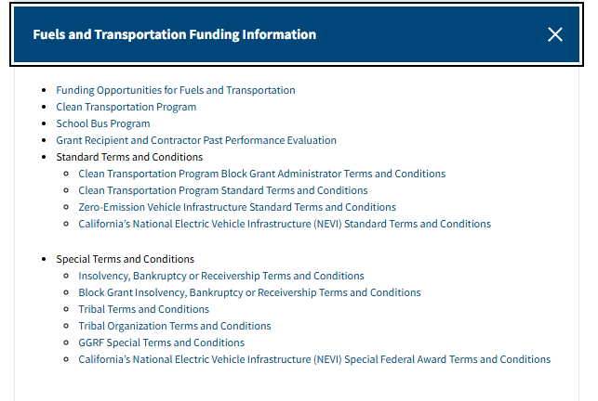
Terms and Conditions Required by All Applicants
Applicants must accept the Terms and Conditions, without negotiation
Applicants and private entities are required to register with the California Secretary of State and be in good standing
Terms and Conditions can be found on the ECAMS Resources webpage at https://www.energy.ca.gov/funding-opportunities/funding-resources
Solicitation Manual p. 13-14, "Terms and Conditions" and "California Secretary of State Registration"

Slide 62
Application Submittal

Slide 63
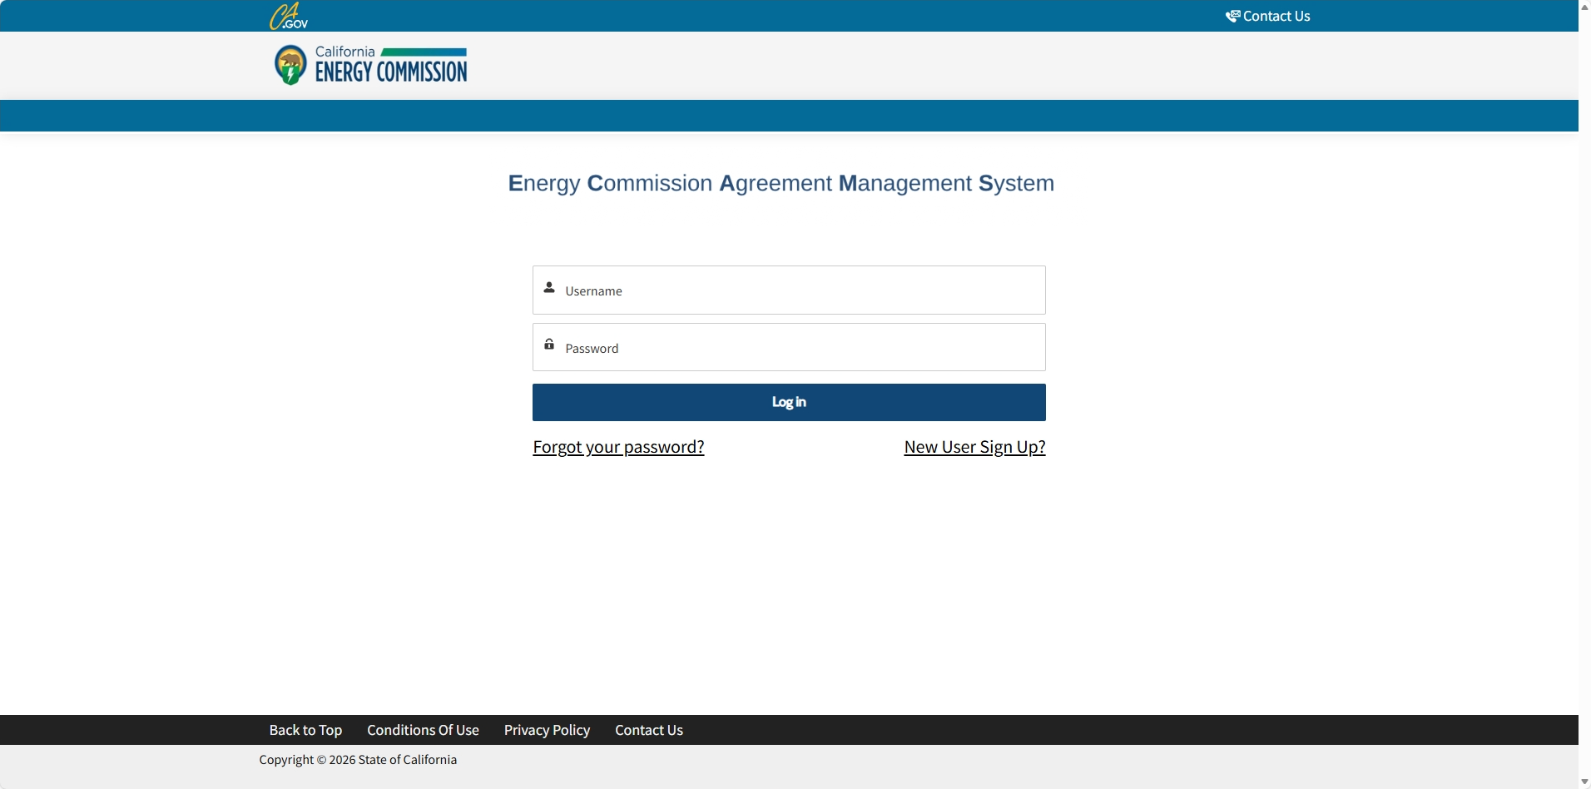
Submission Requirements
Energy Commission Agreement Management System (ECAMS)
Applications will be submitted through ECAMS, available at https://ecams.energy.ca.gov/
Applicants must have or create a user account to apply for this solicitation
There can only be one account manager per organization, but users can be added by account manager
Solicitation Manual p. 26-27, "Method for Delivery"

Slide 64
Submission Requirements ECAMS Uploads
Application documents should meet formatting requirements and page limits provided in the solicitation manual
Applicants will be required to upload all attachments marked “required” in the system in order for the application to be submitted
Solicitation Manual p. 26 - 39, "Method for Delivery" and "Application Content"

Slide 65
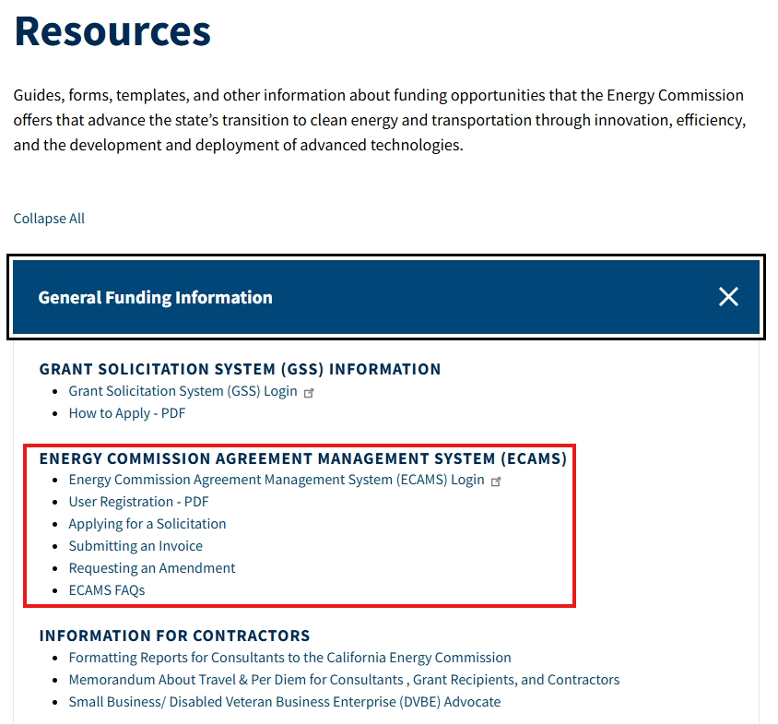
Submission Resources
ECAMS
Guidance documents are available at https://www.energy.ca.gov/funding-opportunities/funding-resources under General Funding Information
For detailed instructions on how to submit an application, please see the ”Applying for a Solicitation” document
Questions about the ECAMS system can be sent to: ECAMS.SalesforceSupport@Energy.ca.gov

Slide 66
Submit applications early!
ECAMS will stop accepting application documents promptly at the deadline of 11:59 p.m. on June 5, 2026
Applications in the process of being submitted prior to the deadline will NOT be accepted after the deadline

Slide 67
Key Activities and Dates
Activity | Action Date
Solicitation Release | April 06, 2026
Pre-Application Workshop | April 16, 2026
Deadline for Written Questions by 5:00 p.m. | April 27, 2026
Anticipated Distribution of Question/Answers | Week of May 11, 2026
Support for Application Submission in the Energy Commission Agreement Management System (ECAMS) until 5:00 p.m. | Ongoing until June 5, 2026
Deadline to Submit Applications by 11:59 p.m. | June 05, 2026
Solicitation Manual p. 2, "Key Activities and Dates"

Slide 68
Key Activities and Dates (cont’d)
Activity | Action Date
Anticipated Notice of Proposed Awards Posting | Funding Lane 1: Ongoing as needed through week of August 3, 2026 Funding Lanes 2 and 3: Week of August 3, 2026
Anticipated CEC Business Meeting | October / November 2026
Solicitation Manual p. 2, "Key Activities and Dates"

Slide 69
Questions and Answers
Three ways to ask questions:
Please state your name and affiliation. Keep questions under 3 minutes to allow time for others.
Use the raise hand function in Zoom
Zoom Phone Controls:
*6 – Toggle mute/unmute
*9 – Raise hand
Type questions in the Zoom Q&A Box
Submit written questions Send written questions to Carissa.Peri@energy.ca.gov Deadline: April 27 2026, 5:00 p.m. PST
An official CEC response will be provided in writing and posted on the GFO webpage during the week of May 11, 2026.

Slide 70
Written Questions
Please send all questions related to GFO-25-605 to:
Carissa Peri
Commission Agreement Officer
Carissa.Peri@energy.ca.gov
(Please add subject line: GFO-25-605)
Deadline to submit questions: April 27, 2026 5:00 p.m. PST

Slide 71
Next Steps
Activity | Action Date
Deadline for Written Questions by 5:00 p.m. | April 27, 2026
Anticipated Distribution of Question/Answers | Week of May 11, 2026
Support for Application Submission in ECAMS until 5:00 p.m. | Ongoing until June 5, 2026
Deadline to Submit Applications by 11:59 p.m. | June 5,2026
Updates to solicitation documents will be posted on the GFO Webpage:
https://www.energy.ca.gov/solicitations/2026-04/gfo-25-605-reliable-electric-charging-eligible-school-bus-sites-recess

Slide 72
Thank You!
Applications due June 5, 2026 by 11:59 p.m.

