Slide 1
Geothermal Grant and Loan Program
Pre-Application Workshop (GFO-25-902)
Reliability, Renewable Energy, & Decarbonization Incentives (RREDI) Division
June 16, 2026

Slide 2
Agenda
Commissioner Gallardo's Opening Remarks
Housekeeping
Section I - Introduction
Section II - Eligibility Requirements
Section III - Application Submission Instructions
Section IV - Evaluation and Award Process
Conclusions
  Key Dates
  Question and Answer Period

Slide 3
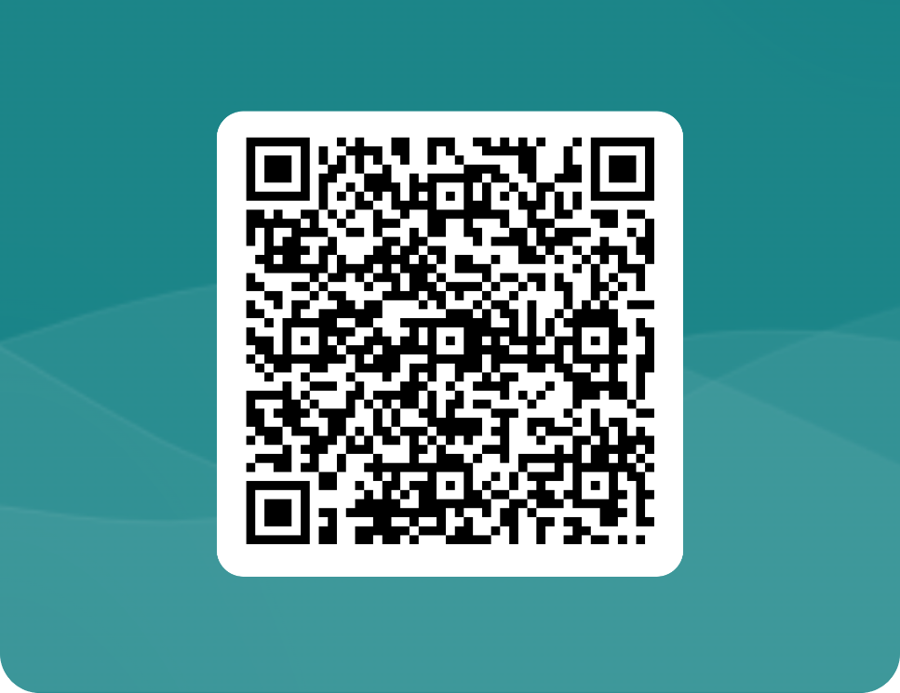
Diversity Survey
The Energy Commission is committed to ensure participation in its funding programs.
We are collecting voluntary information about the attendance of this workshop.
The information supplied will be used to display anonymous overall attendance of diverse groups.

Slide 4
Instructions
Meeting is being recorded
Presentation materials
Updates to the solicitation

Slide 5
Section I
Introduction and Background

Slide 6
I.B. Geothermal Grant and Loan Program Background
Section I – Introduction
When?
The Geothermal Program was established in 1980
How?
50% allocated to the Geothermal Resources Development Account as a funding source
Revenues paid to the state from geothermal royalties and leases on federal lands in CA
30% to the California Energy Commission’s (CEC) Geothermal Grant and Loan Program
What?
Statute
Public Resources Code (PRC). Division 3. Chapter 6. Sections 3800 – 3827
Defines who can apply and the topics that can be funded
Regulations
Title 20. Division 2. Chapter 4. Article 7. Sections 1660 – 1665 and Appendix A
Defines application process, award procedures, and scoring criteria

Slide 7
I.B. Geothermal Program Mission
Support development of CA's vast geothermal energy resources and advance lithium recovery from geothermal brine
Mitigate adverse impacts caused by geothermal development and lithium recovery from geothermal brine
Assist local jurisdictions, CA Native American tribes, and private entities offset costs
Support state energy and climate goals
Section I – Introduction

Slide 8
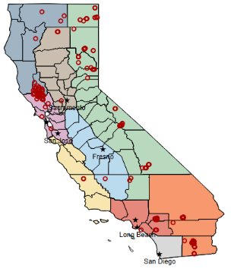
I.B. Geothermal Program in Numbers
Section I – Introduction
Since Inception of Program:
  $65 million awarded across 173 projects.
  $47 million in disadvantaged, low-income, and the overlapping areas of disadvantaged + low-income communities.
  $1 million in projects benefiting tribes.
Geothermal Program Project Locations in California
  Central Coast
  Inland South
  Los Angeles
  North Coast
  Sacramento Valley
  San Diego
  San Francisco Bay Area
  San Joaquin Valley
  Sierra Nevada Mountains
  Project Locations
N
Source: CEC Geothermal Program staff and 2022 CEC IEPR Report

Slide 9
I.A. Purpose of Solicitation 1 of 3
Section I – Introduction
Provide cost-share funding for applicants who apply for and receive an award under an eligible federal Funding Opportunity Announcement (FOA) and meet the requirements of this solicitation
This solicitation involves two phases (pre- and post- federal award)
Applicants looking for partnering opportunities visit CEC’s Empower Innovation webpage
If the applicant has already received a federal award and is seeking retroactive cost-share, that application will not be eligible for CEC cost-share funds under this solicitation

Slide 10
I.A. Purpose of Solicitation 2 of 3
Empower Innovation
See Video Here: https://www.empowerinnovation.net/

Slide 11
I.A. Purpose of Solicitation 3 of 3
Overview of Phase I (Pre-Federal Award) and Phase II (Post-Federal Award)
A federal FOA is released
CEC elects to provide a cost-share for the federal FOA and amends the solicitation
Phase I
Applications for CEC cost-share that are awarded will be provided with a letter of intent
Phase II
Phase I applicants receive federal award, and proof of award is given to CEC.
CEC re-reviews proposals and releases NOPA

Slide 12
I.D. Funding
Section I – Introduction
Amount Available
  Min and max amounts depend on the FOA
  The award depends on receiving a federal award listed in the eligibility requirements Section II.B.
  The CEC award cannot exceed the amount of the federal award.
Cost Share Requirements
  CEC may fund up to 100% of the required cost share
  At least 70% of the combined CEC and federal award amount must be spent in California
  Phase II begins only after the Phase I applicant submits:
    Evidence of required match share (if applicable)
    Evidence of the federal award
Changes in Scope, Project Site, or Funding Amount
  Identify any changes to project scope, site, or budget in Att. 15.
Change in Funding Amount
  CEC may adjust funding amounts, allocate extra funds to ranked applicants, or reduce funding and revise the Scope of Work as needed

Slide 13
I.E. Match Funding Considerations 1 of 2
Section I – Introduction
Phase I (Pre-Federal Funding Award)
Eligible Applicants | Statutory Match Funding Requirements | Documents Required
Local Jurisdiction | 0% | For additional match beyond federal award: Commitment letter (see Section IV.F.)
Private Entity | Minimum 100% (Anticipated federal award considered as funding) | For additional match beyond federal award: Commitment letter (see Section IV.F.)
Phase II (Post Federal Funding Award)
Eligible Applicants | Statutory Funding Match Requirements | Documents Required
Local Jurisdiction | 0% | Proof of Federal Award Updated Commitment letter (see Section IV.F.)
Private Entity | Minimum 100% (Anticipated federal award considered as funding) | Proof of Federal Award Updated Commitment letter (see Section IV.F.)

Slide 14
I.E. Match Funding Considerations 2 of 2
Match funds must be spent only during the agreement term
Types of match
Cash
In-kind
If providing match, the commitment letter must:
Confirms the source of the funds
Justifies the dollar value claimed
Letter that guarantees the availability of the funds of the project
Describes a strategy for replacing the funds if they are significantly reduced or lost

Slide 15
I.F. Key Activities
Section I – Introduction
ACTIVITIES | DATE | TIME
*Distribution of Q&A Document | On-going
Deadline to Submit Pre-Federal Funding Award Applications (Phase I) | Refer to Section II.B. of the manual
*Notice of Letter of Intent | At least a week prior to the federal funding submission deadline
Deadline to Submit Post Federal Funding Award Applications (Phase II) | No later than 30 days after federal funding award
*Notice of Proposed Award (NOPA) Posting Date | No later than 60 days after submitting the evidence of federal funding award
*CEC Business Meeting Date | 90 days after the CEC received the federal award documentation
*Agreement Start Date | 30 days after the CEC business meeting
*Agreement End Date | No later than three years from the execution of the agreement
* Anticipated dates, subject to change

Slide 16
I.H. Questions
Section I – Introduction
Submit Questions to:
Commission Administrative Officer
Marissa Sutton
California Energy Commission
715 P Street, MS-18
Sacramento, California, 95814
E-mail: marissa.sutton@energy.ca.gov
All communication should be directed in writing to the assigned solicitation administrative officer.

Slide 17
I.I. Applicants' Admonishment
Important Disclaimers
Applicants are responsible for the cost of developing a full application
Documents will become public upon request after the posting of NOPA
If an agreement is not being successfully executed, the CEC may cancel a proposed award
No portion of your application will be considered confidential

Slide 18
I.J – I.K. Environmental Review Requirements and CEC’s Rights and Remedies
CEC must complete CEQA review before approving a project; applicants must provide complete CEQA information promptly
Applicants should structure proposals to minimize CEQA review time and coordinate early with lead or responsible agencies
CEC may cancel a proposed award if CEQA review is unlikely to finish on time, even if the applicant is diligent
Delays may occur when:
Another agency is the CEQA lead agency
The project is part of a larger effort requiring additional environmental analysis
The project is not exempt and requires environmental studies
Projects already covered by valid CEQA exemptions or completed environmental reviews have a higher likelihood of timely approval
Any process explained in this solicitation is in addition to, and does not restrict, any other rights and remedies available to the CEC
Section I – Introduction

Slide 19
Section II
Eligibility Requirements

Slide 20
II.A. Applicant Eligibility
Section II – Eligibility Requirements
Local Jurisdictions
Any unit of California Native American Tribes (Tribe)
Any city, county, or district, including, but not limited to, regional planning agencies and public utility districts
Must submit a resolution form (Att. 11)
“Public utility district” does not include any public utility district which generates for sale more than 50 megawatts of gross electricity
Private Entities
Any individual or organization engaged in exploration and development of geothermal energy for profit
Must provide tangible benefits to a local jurisdiction (Att. 2)
Must be approved by the City, County or CA Native American tribe where project is to be located (Att. 2)
State and Federal Agencies
Not eligible to apply for funding as applicant
May be eligible as a project partner or
subrecipient

Slide 21
II.B. Eligible Federal FOAs
Section II – Eligibility Requirements
FOA Number and Title | CEC Application Due Date (Phase I – Pre Federal Award) | Recommended Minimum CEC Cost Share Award* | Recommended Maximum CEC Cost Share Award* | Maximum Total Funding for CEC Cost Share Across Awards | Eligible Topic Area/Areas of Interest
DE-FOA-0003589 Critical Minerals and Materials Accelerator Notice of Funding Opportunity | June 29, 2026 | Topic Area 3A: No minimum Topic Area 3C: $200,000 | Topic Area 3A: $2,000,000 Topic Area 3C: $1,000,000 | Topic Area 3A: $2,000,000 Topic Area 3C: $1,000,000 | Topic Area 3A: Cost-competitive direct lithium extraction. Topic Area 3C: Exploration and characterization of critical materials and rare earth elements from volcanically hosted geothermal systems.

Slide 22
II.C. Eligible Project Focus
Section I – Introduction
Research and development.
Planning and policy development.
Preparation of ordinance, regulation, and guidelines for identified mitigation measures of adverse impacts.
Collecting baseline data and conducting environmental monitoring.
Preparation or revision of geothermal resource elements.
Administration costs incurred by the local jurisdiction that are attributed to the development and production of geothermal resources.
Monitoring and inspection for compliance.
Identification, research, and implementation of mitigation measures of adverse social and economic impacts.
Planning, construction, operation and maintenance of public services and facilities.
Undertaking projects demonstrating the technical and economic feasibility of geothermal direct heat and electrical generation applications.
Enhancement, restoration, or preservation of natural resources.
Recovery of lithium, minerals, metals from geothermal brine.

Slide 23
II.D – II.E. Terms, Conditions, and Registration Requirements
Section II – Eligibility Requirements
Applicants must accept CEC grant terms and conditions (T&C) without negotiation
Special T&C for California Native American Tribes and Tribal Organizations with Sovereign Immunity in addition to the standard T&C
Entities doing business in California (corporations, LLCs, LPs, LLPs) must be registered and in good standing with the Secretary of State prior to its project being recommended at a Business Meeting

Slide 24
II.F. – II.G Disadvantage Communities and Sanctions Requirements
Section II – Eligibility Requirements
Projects are not required to be within a disadvantaged, low-income community, or tribal land. However, those that benefit these communities may be considered during the scoring process.
CEC funds cannot be budgeted for out-of-country spending.

Slide 25
II.H. Project Requirements
Section II – Eligibility Requirements
Project location
Field demonstration and deployment activities must be located in California
Project Focus
Technical Approach (Att. 2) must outline key milestones, their importance, and address required questions (see section IV.F.)
Knowledge Transfer Expenditures
Must include knowledge transfer activities as outlined in the scope of work (att.12)

Slide 26
Section III
Application Organization and Submission

Slide 27
III.A. Method for Delivery
Section III – Application Submission Instructions
How to apply using ECAMS
NO EXCEPTIONS will be entertained
Submit applications using the Energy Commission Agreement Management System (ECAMS)

Slide 28
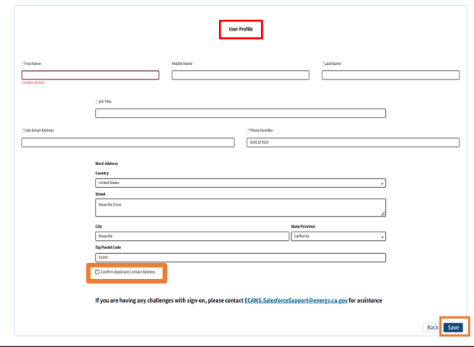
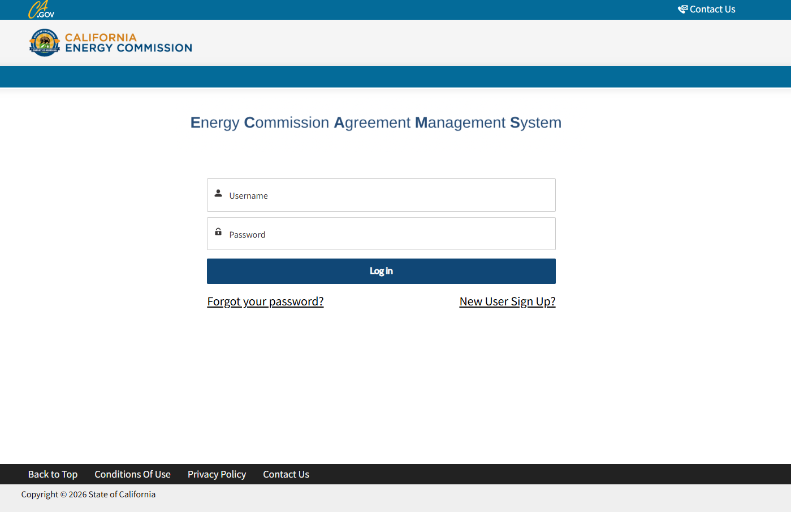
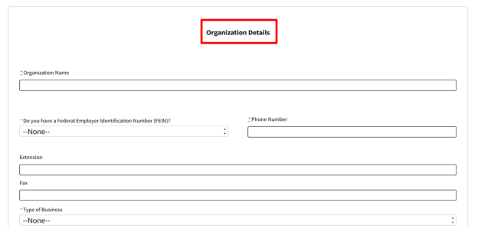
III.A. Method for Delivery – ECAMS (1 of 2)
ECAMS Registration
#1
#2

Slide 29
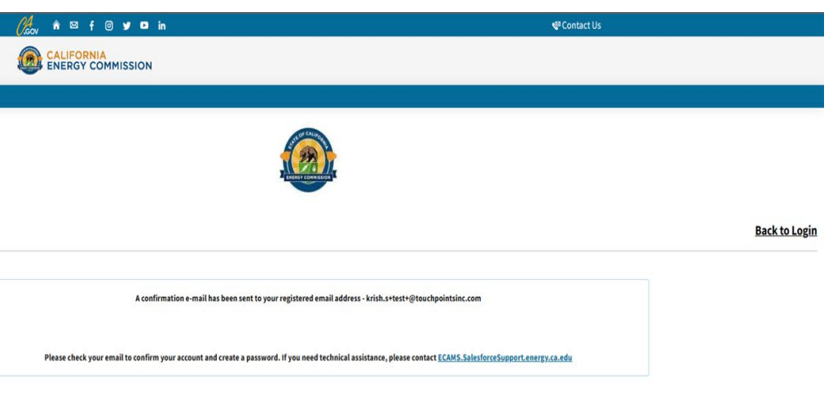
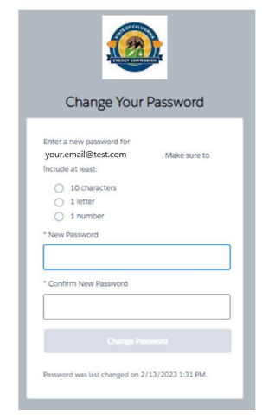
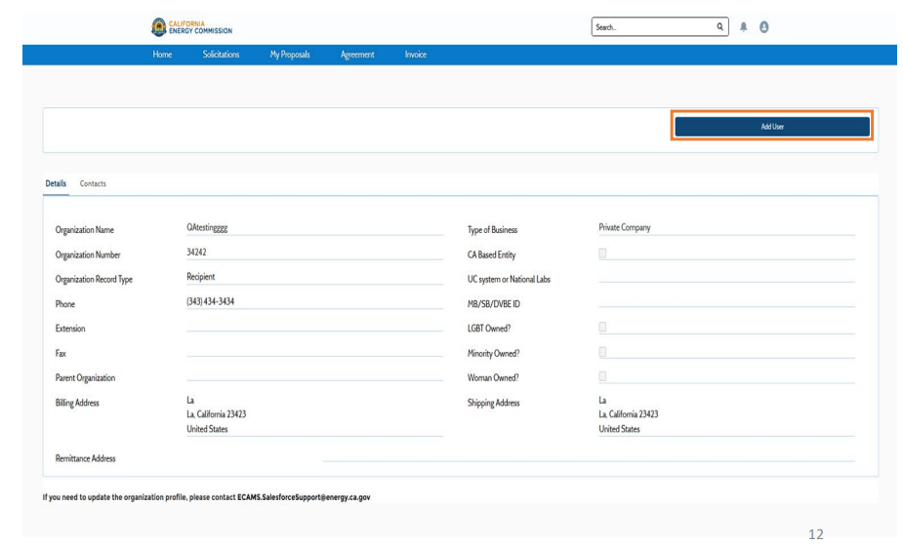
III.A. Method for Delivery – ECAMS (2 of 2)
ECAMS Confirmation
#3
Email Confirmation
#4
Add new users
ECAMS related questions: ecams.salesforcesupport@energy.ca.gov

Slide 30
III.B. – III.C. Phase I Application Attachments
Format, Page Limits, and Content
Application Attachment | Description | Page Limit | File Format
(1) Application Form | Basic information of applicant and project | No page limit | .docx., .pdf
(2) Project Narrative | Detailed description of project | 10 pages excluding CEQA | .docx., .pdf
(3) Team Form | Resumes | 2 pages each | .docx., .pdf
(4) Budget Form – Phase I | Labor costs, indirect costs, etc. of project | No page limit | .xlsx
(5) CEQA/Environmental Compliance Form | Evaluation of proposed activities under CEQA | No page limit | .docx., .pdf
(6) Past Project Information | Past agreements with CEC and other entities | 2 pages for each project description | .docx, .pdf
(7) Commitment and Support Letter Form | Support letter: support from project location Commitment letter: match funds commitment | 2 pages excluding the cover page | .docx., .pdf
(8) Contacts | Authorized representatives for the State and the applicant | No page limit | .docx., .pdf
(9) Application Declaration | Proof of not a delinquent or being sued | 1 page | .docx., .pdf

Slide 31
III.B. & III.D. Phase II Application Attachments
Format, Page Limits, and Content
Application Attachments | Description | Page Limit | File Format
(1-9) Phase I Application | Resubmit with necessary changes, if applicable | Refer to Phase I Requirements | .docx., .pdf, .xlsx
(10) Feasibility Study | Project focused on resource development, directly resulting in revenue or energy savings | 20 pages | .docx., .pdf
(11) Local Jurisdiction Resolution | Require a resolution from the local jurisdiction’s governing body | 1 page | .docx., .pdf
(12) Scope of Work | Identifies tasks to complete the project | 30 pages limit | .docx, .pdf
(13) Project Schedule | Key dates for tasks of the project | 4 pages | .xlsx
(14) Budget Phase II | Labor costs and indirect cots of the project | No Page limit | .xlsx
(15) Post-Federal Award Proposal Change Summary | Identifies changes made to proposed project after CEC letter of intent was awarded | No page limit | .docx, .pdf
(16) Federal Award Confirmation | Provide letter from the awarding agency | No page limit | .docx, .pdf
(17) Approved Federal Scope of Work | Provide copy of the scope of work approved by federal agency | No page limit | .docx, .pdf
(18) Approved Federal Budget | Provide a copy of the budget approved by federal agency | No page limit | .docx, .pdf

Slide 32
Section IV
Evaluation and Award Process

Slide 33
IV.A. Phase I – Pre-Federal Award: Letter of Intent
Section IV – Evaluation and Award Process
Screening and Scoring by Evaluation Committee
Applications that fail any of the screening criteria will be rejected
Minimum score of 70 points is required to be eligible for funding and receive letter of intent

Slide 34
IV.B. Phase II – Post Federal Award: Notice of Proposed Award (NOPA)
Section IV – Evaluation and Award Process
NOPA
CEC will publish NOPA on the website
NOPA includes:
(1) the total proposed funding amount
(2) the rank order of applicants
(3) the amount of each proposed award
Application Requests and Debriefings
No later than 30 days
Available upon request

Slide 35
IV.B. Phase II – Post Federal Award: Agreement Development
NOPA released
30-day review
Dept. of Finance
Legislative Analyst
Joint Legislative Committee
Begins agreement development between the awardee and CEC
Final signatures by awardee and CEC
Awardee carries out the project only after full execution of the agreement
Approval at a CEC Business Meeting.
Section IV – Evaluation and Award Process

Slide 36
IV.C. Grounds to Reject an Application or Cancel an Award
Section IV – Evaluation and Award Process
Applications that do not pass the screening stage will be rejected
The CEC reserves the right to reject an application and/or to cancel an award

Slide 37
IV.D. Miscellaneous
Section IV – Evaluation and Award Process
Solicitation Cancellation and Amendment
Modification or Withdrawal of Application
Confidentiality
Solicitation Errors
Immaterial Defect
Disposition of Applicant’s Documents
Tiebreakers
Clarification Interviews
Opportunity to Cure Administrative Errors

Slide 38
IV.E. Phase I and Phase II– Stage One: Application Screening
The application is submitted by the deadline
Eligible applicant
Eligible project
Accepted the terms and conditions (Att. 1)
Good past performance
At least 70% of the combined CEC and Federal award amount will be spent within California

Slide 39
IV.F. Phase I and Phase II – Stage Two: Application Scoring
10 pts.
1. Technical Merit
10 pts.
2. Technical Approach
15 pts.
3. Proven Extent of the Resource
15 pts.
4. Contribution to California’s Resource Development
10 pts.
5. Benefits
10 pts.
6. Public Involvement
15 pts.
7. Project Team and Planning
10 pts.
8. Budget and Cost Effectiveness
5 pts.
9. Additional Match Funds
Total 100 pts.
Must have a minimum score 70 points

Slide 40
IV.G. Phase II – Post Federal Award Confirmation
Section IV – Evaluation and Award Process
Applicants who receive a federal award must submit all documents in Section III.D. Application Content
Changes must be detailed in the Post-Federal Award Proposal Change Summary (Att. 15)
CEC will rescore all applications based on the information provided

Slide 41
Conclusion

Slide 42
Important Reminder
Section II – Eligibility Requirements
FOA Number and Title | CEC Application Due Date (Phase I – Pre Federal Award) | Recommended Minimum CEC Cost Share Award* | Recommended Maximum CEC Cost Share Award* | Maximum Total Funding for CEC Cost Share Across Awards | Eligible Topic Area/Areas of Interest
DE-FOA-0003589 Critical Minerals and Materials Accelerator Notice of Funding Opportunity | June 29, 2026 | Topic Area 3A: No minimum Topic Area 3C: $200,000 | Topic Area 3A: $2,000,000 Topic Area 3C: $1,000,000 | Topic Area 3A: $2,000,000 Topic Area 3C: $1,000,000 | Topic Area 3A: Cost-competitive direct lithium extraction. Topic Area 3C: Exploration and characterization of critical materials and rare earth elements from volcanically hosted geothermal systems.

Slide 43
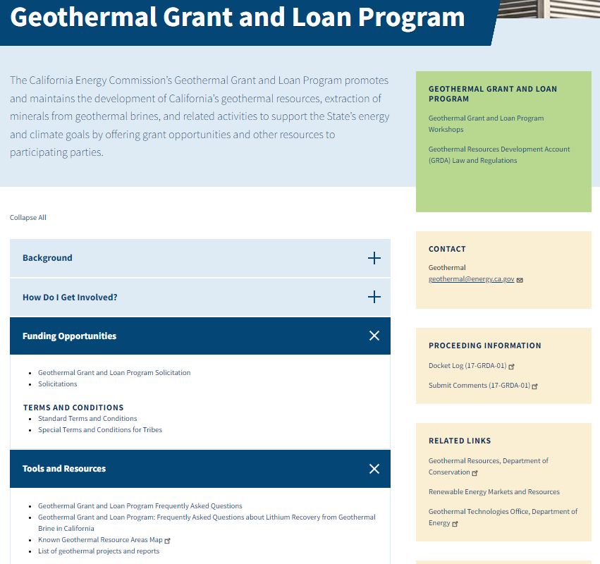
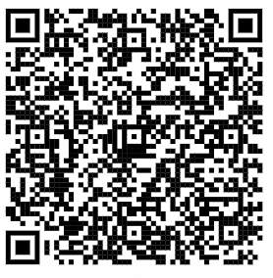
Geothermal Grant and Loan Program Webpage
Geothermal Grant and Loan Program

Slide 44
Questions and Answer Period
For Phone Participation: (888) 475-4499 Enter Webinar ID: 892 9267 5156
3 minutes per person
1 representative per organization
State your name and affiliation
Option to remain anonymous
Will be on mute until hosts call on you and open your line
By computer: use “raise hand” feature
Write Questions and Comments in “Q&A” feature
By telephone: dial *9 to “raise hand” and *6 to mute or unmute ​

Slide 45
Additional Questions?
Submit Questions to:
Solicitation Administrative Officer
Marissa Sutton
California Energy Commission
715 P Street, MS-18
Sacramento, California, 95814
E-mail: marissa.sutton@energy.ca.gov
All communication should be directed in writing to the assigned solicitation administrative officer.
Deadline: June 16, 2026

Slide 46
Thank You!
Solicitation Administrative Officer: marissa.sutton@energy.ca.gov
Subscription Topic: Geothermal

